Slide 1
The Weather Channel Integrated Daily Details, Mobile App
—
Specifications and Style Guide 2024.Q1.V1
Please use Presentation Mode to view animated examples.

Slide 2
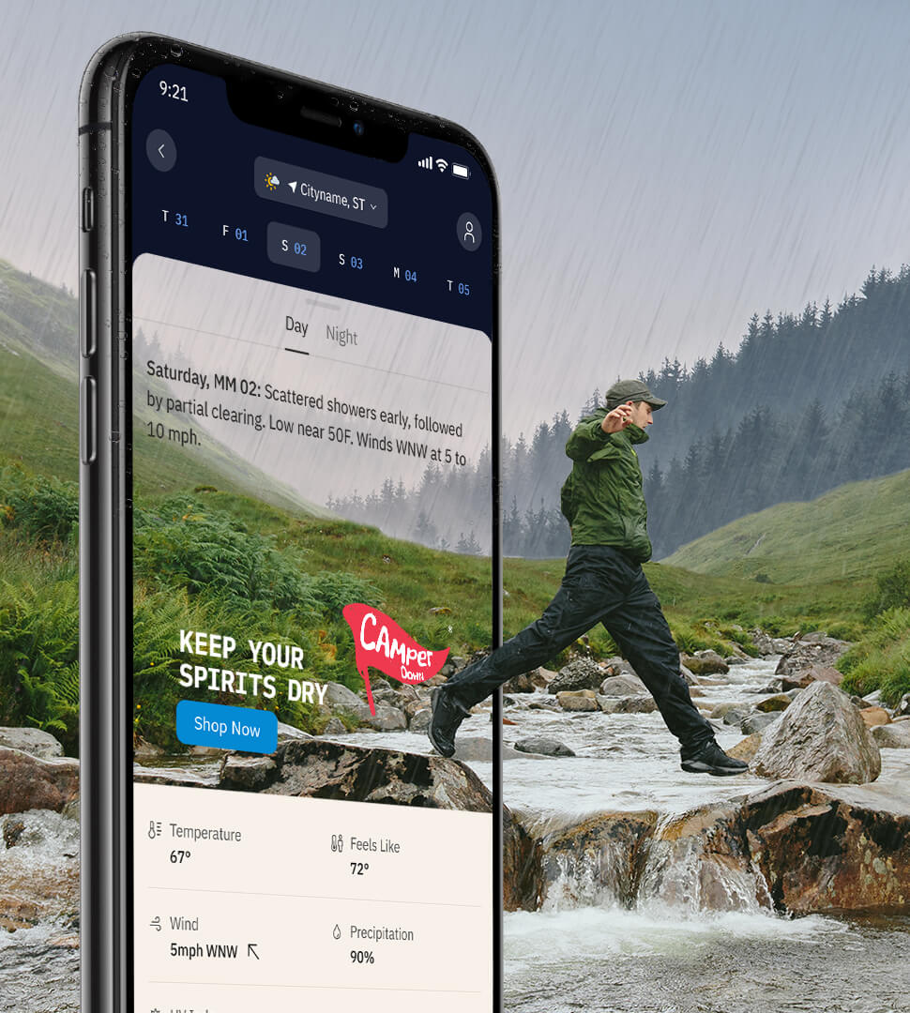
Overview
The Weather Channel is an essential platform for consumers’ daily and weekly planning routines. How to dress, what to cook, when to take care of projects around the house — these are all things that are impacted by the weather forecast.
The Integrated Daily Details unit presents a unique opportunity to reach our millions of daily users* in these key planning moments: as they look to the week ahead, choose activities for the weekend, and decide how to celebrate a holiday or special occasion.
Featured on the single most visited page of The Weather Channel’s app, the unit combines brand imagery and messaging with real-time weather information to create an impactful, highly relevant ad experience.
Design and development is handled by The Weather Company in partnership with the Advertiser and/or Creative Agency. Please note this unit supports static imagery only.
* 15 million+ / day. Amplitude, Daily Details page, avg. daily visits, 90-day avg., Sep–Dec 2022

Slide 3
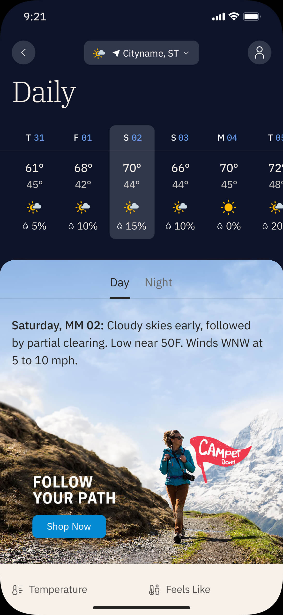
Weather
The Integrated Daily Details unit must feature accurate weather imagery in an unobstructed sky.
This creates contextual alignment between the data displayed in the app and the creative featured in the ad unit. It’s also what allows the unit to have such a large footprint in the app.
Who does what?
All weather imagery is sourced or created by The Weather Company’s Creative Lab. This is to ensure that UI accessibility requirements are being met and that the weather imagery itself aligns with our product standards.
Clients can simply deliver their key campaign art along with any other required elements (see “Production Assets” slide for more information) and the Creative Lab will build out the surrounding scenes, including the weather.
3

Slide 4
Weather Conditions Adaptor
Using a matrix of four general weather conditions and two dayparts (daytime and night), we build up to eight variations of a given creative.
When our users navigate to a sponsored tab in their daily forecast (see “Sponsorship Options” slide 10), the creative variations that match the forecasted conditions for both day and night will be served.
Spend Level: Tier 1
Please note that Integrated Daily Details units do not run during severe weather conditions.
> Presentation Mode

Slide 5
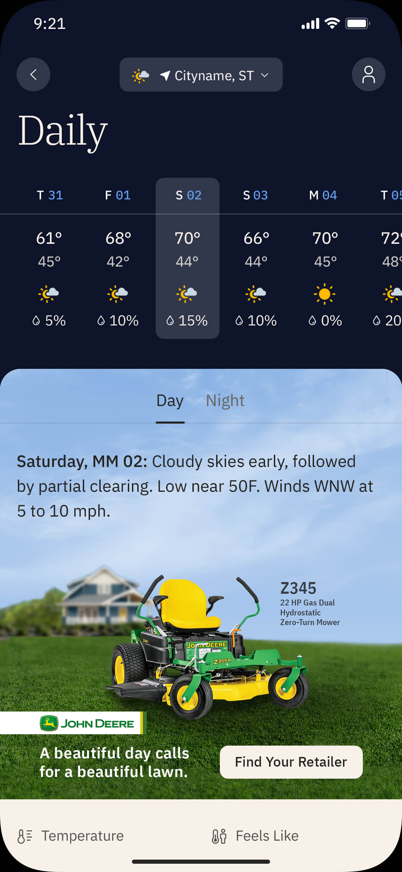
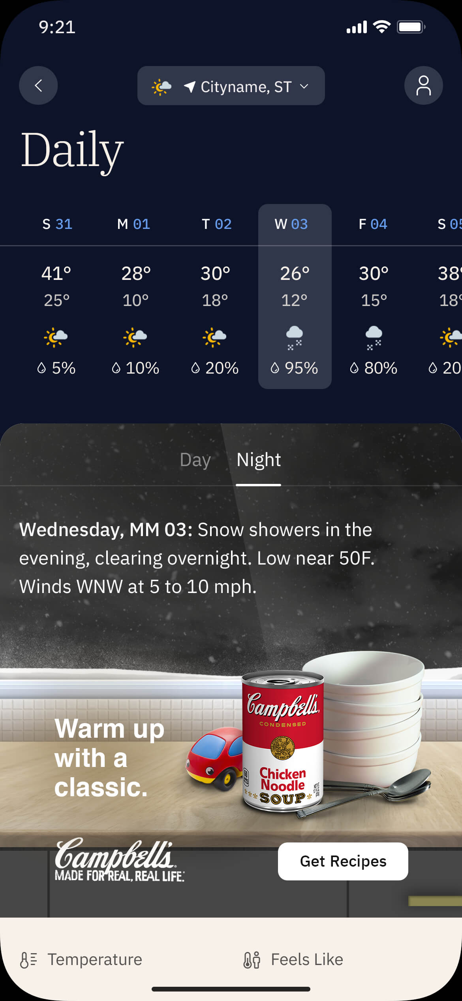
Weather Conditions Adaptor
Brand Integration: In-Scene
Our primary method for combining brands and products with weather is to integrate them directly into an adaptive weather scene.
Outdoor settings are most common but indoor scenes can also be created so long as unobstructed weather imagery is still present.
Please note:
Products must be integrated into a scene that includes a clear, unobstructed view of the sky. Indoor scenes must include a large, single-pane window to meet this requirement.
Background image must meet WCAG-defined AA “small type” contrast levels for the App UI and not interfere with UI legibility.
Brand imagery is limited to the lower portion of the overall image. Logo, copy (20–24 characters recommended), and CTA (12–16 characters max) should use no more than 1/3 of that area.
Brand copy and product visuals may vary per condition so long as they’re consistent in integration.
To support the native integration of brand elements within the app we recommend adopting the CTA styling used throughout the app for this unit.
The creative may not include severe weather elements such as tornados, hurricanes, lightning bolts, etc.
Weather imagery is sourced or created by The Weather Company in partnership with the Advertiser and/or Creative Agency.
Outdoor Scene
Indoor Scene

Slide 6
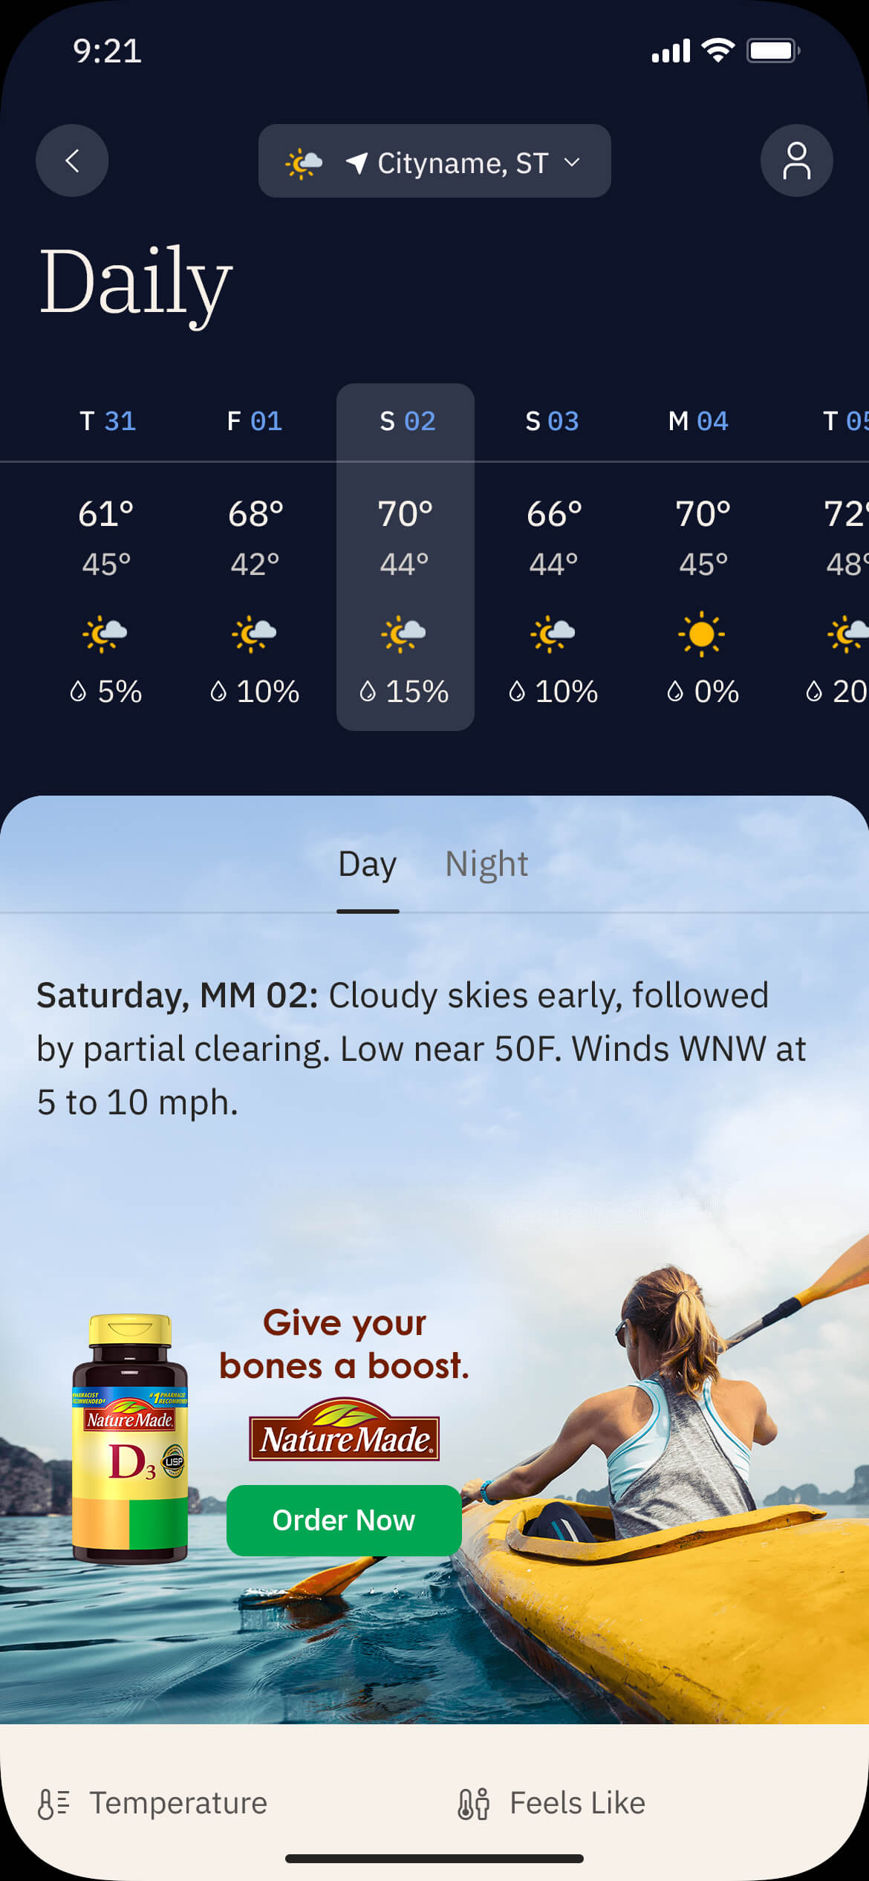
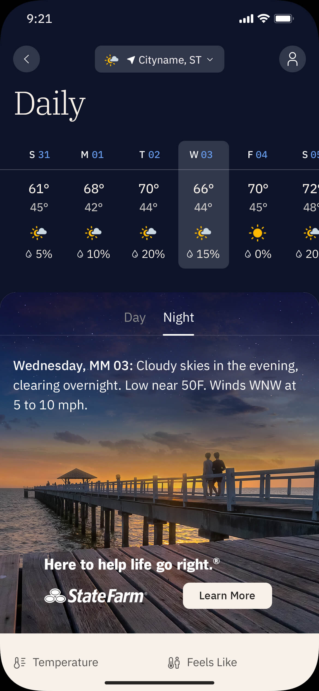
Weather Conditions Adaptor
Brand Integration: Floating
If a featured product will not optimally integrate into an adaptive weather scene, it can be “floated” above it as part of the brand lockup.
Similarly, if the featured content is a service versus a physical product the brand lockup floats above a custom weather scene.
Please note:
Product cannot be cropped or placed at the viewport edge due to variability in user device widths.
The background scene must include a clear, unobstructed view of the sky.
Background image must meet WCAG-defined AA “small type” contrast levels for the App UI and not interfere with UI legibility.
Brand imagery is limited to the lower portion of the overall image. Logo, copy (20–24 characters max), and CTA (12–16 characters recommended) should use no more than 1/3 of that area.
Brand copy and product visuals may vary per condition so long as they’re consistent in integration.
To support the native integration of brand elements within the app we recommend adopting the CTA styling used throughout the app for this unit.
The creative may not include severe weather elements such as tornados, hurricanes, lightning bolts, etc.
Weather imagery is sourced or created by The Weather Company in partnership with the Advertiser and/or Creative Agency.
Floating Product
6
Service (No Product)

Slide 7
Additional Features

Slide 8
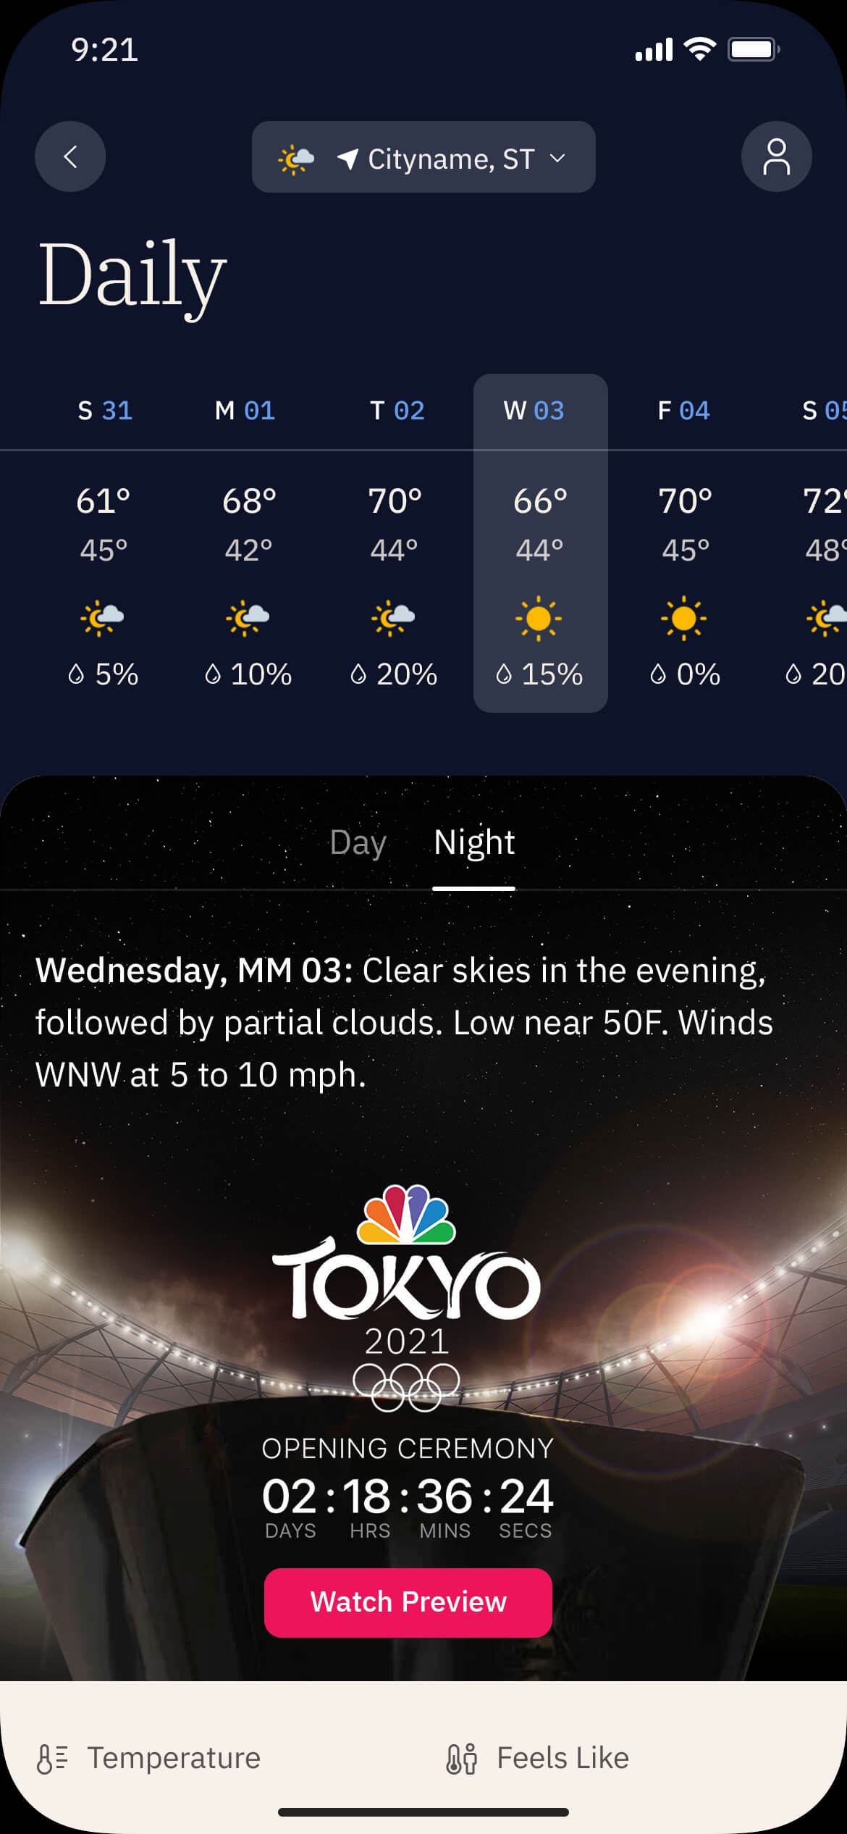
Additional Features
Countdown Functionality
Countdowns are an optional feature for Integrated Daily Details units. They allow advertisers to build anticipation ahead of an event, drive awareness, and offer users greater incentive to click on the creative.
Some common use-cases for the Countdown include series or movie premieres, special events, holidays, the weekend, limited time offers, etc.
Spend Level: Tier 1
8

Slide 9
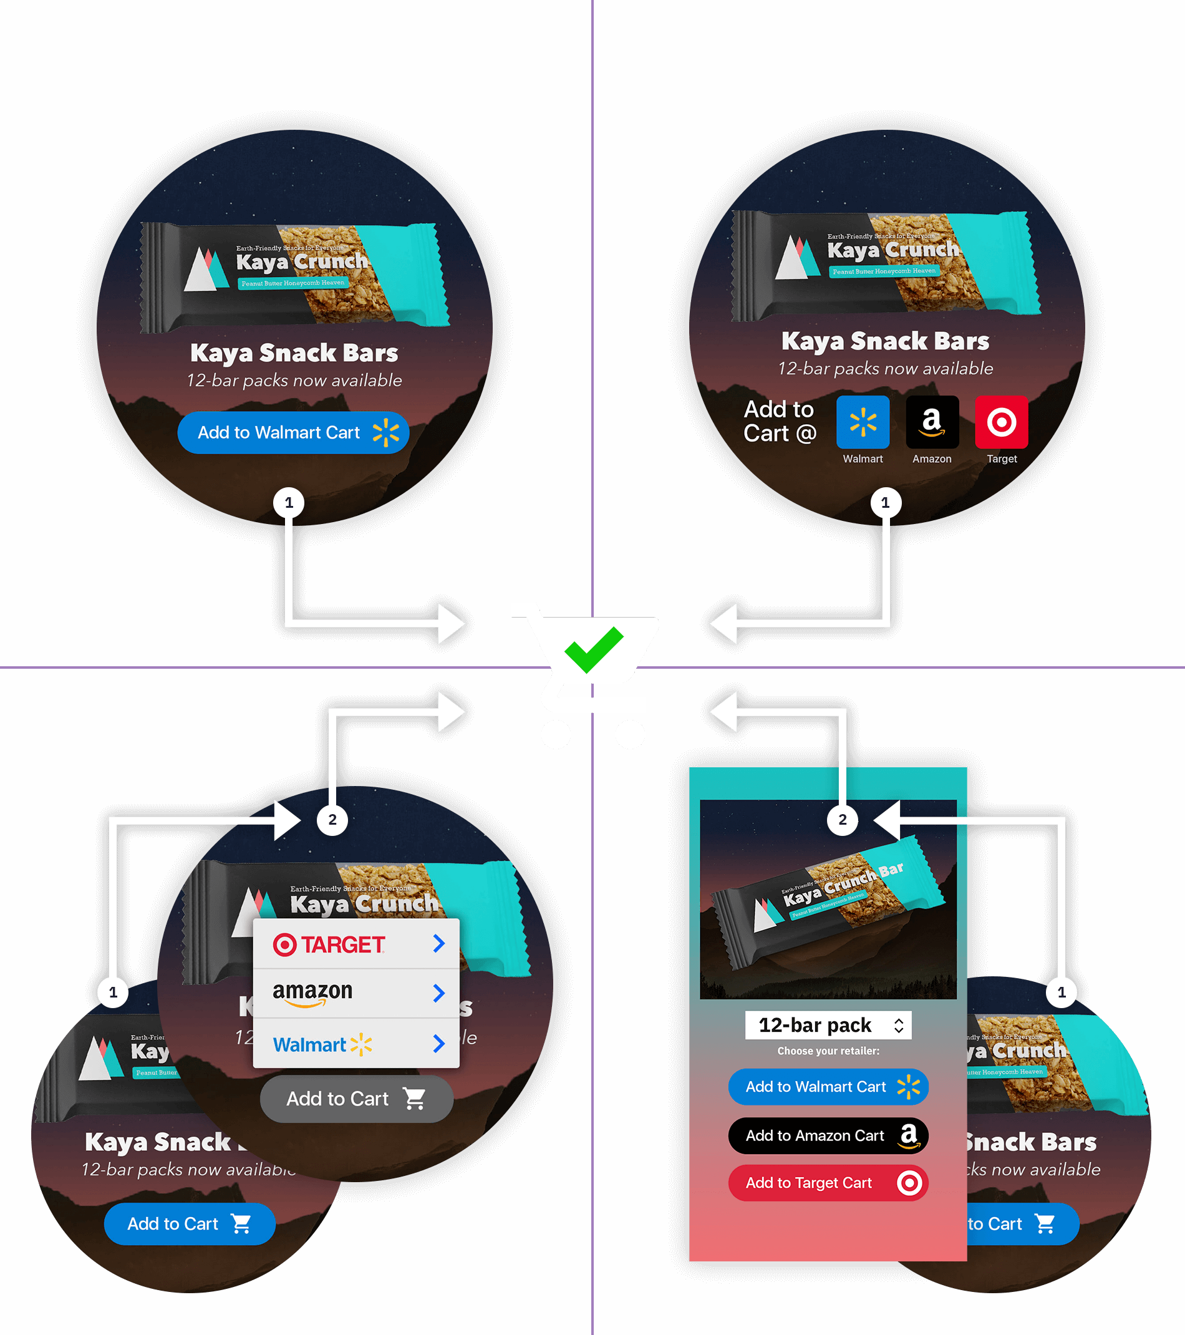
Click2Cart®
Additional Features
A) Single-Retailer Direct
1-click, ~90% CSR
B) Multi-Retailer Direct
1-click, ~90% CSR
Click2Cart is an e-commerce add-on for our premium ad product offerings that places products directly into retailer shopping carts.
There are several Click2Cart options, each with their own use-case:
A) Single-Retailer Direct 1-click, ~90% carting success rate One CTA drives directly to a retailer cart. The simplicity of this option tends to yield the highest overall performance.
B) Multi-Retailer Direct 1-click, ~90% carting success rate Multiple CTAs (3–5) are presented, each driving directly to a retailer cart. Requires dedicating a significant portion of the ad composition to the Click2Cart user interface.
C) Multi-Retailer Menu 2-click, 2–20% carting success rate Multiple retailer options (3–5) are revealed via a menu CTA. This interaction model requires less space in the initial ad composition but typically results in a lower carting rate than a 1-click direct model.
D) Multi-Retailer Window 2-click, 2–20% carting success rate Upon user interaction, multiple retailer and/or product options are presented in an overlay screen (app) or new browser tab (web). This interaction model requires less space in the initial ad composition but typically results in a lower carting rate than a 1-click direct model.
Retailer and product information will be required prior to the production phase of the unit.
Spend Level: Tier 2
C) Multi-Retailer Menu
2-click, 2–20% CSR
D) Multi-Retailer Window
2-click, 2–20% CSR

Slide 10
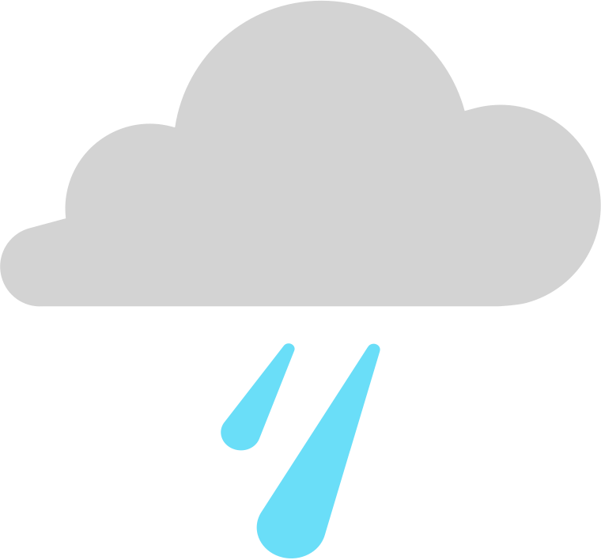
Sponsorship Options
Flight Duration
Sun – Mon
Week Ahead
SUN
MON
TUE
WED
THU
FRI
Our sponsorship options are tailored to reach our users in the moments that matter.
Week Ahead Flight runs all day Sunday and Monday, when our users are getting organized for the coming week. During that time, the integrated ad lives on the Sunday through Wednesday tabs of the Daily Details page.
Weekend Planning Flight runs Thursday through Saturday, when weekend activities are being considered. During that time, the integrated ad lives on the Saturday and Sunday tabs of the Daily Details page.
Holiday / Event Flight runs 4 days prior to a holiday or event, as well as on the day itself, to take advantage of The Weather Channel’s traditional spike in traffic as our users plan how to celebrate. During that time, the integrated ad lives on the tab of the Daily Details page that corresponds with the holiday or event.
For a list of holidays and events available for sponsorship please contact your TWC sales representative. Run-of-network placements are also available. Please note, RON placements will not be accompanied by a branded Insight element (see “Sponsored Insights” slide 11).
Integrated Ad Tabs
Flight Duration
Thu – Sat
Weekend Planning
THU
FRI
SAT
SUN
MON
TUE
Integrated Ad Tabs
Flight Duration
5 Days
Holiday / Event
DAY 1
DAY 2
DAY 3
DAY 4
HOL
—
Integrated Ad Tab
10

Slide 11
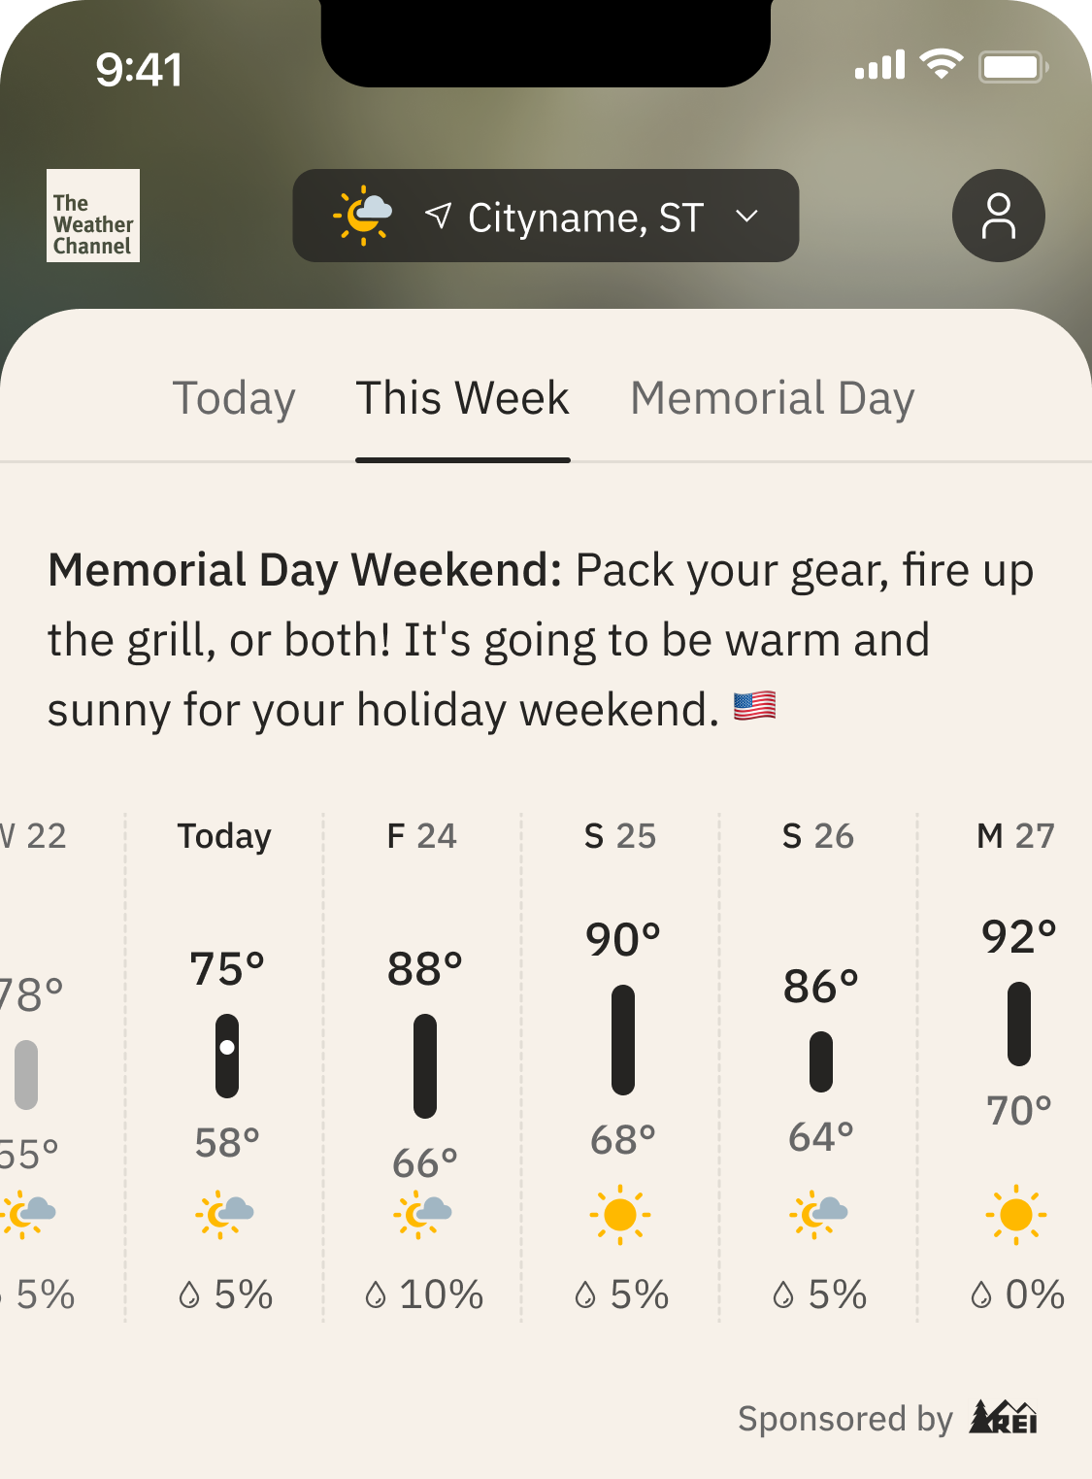
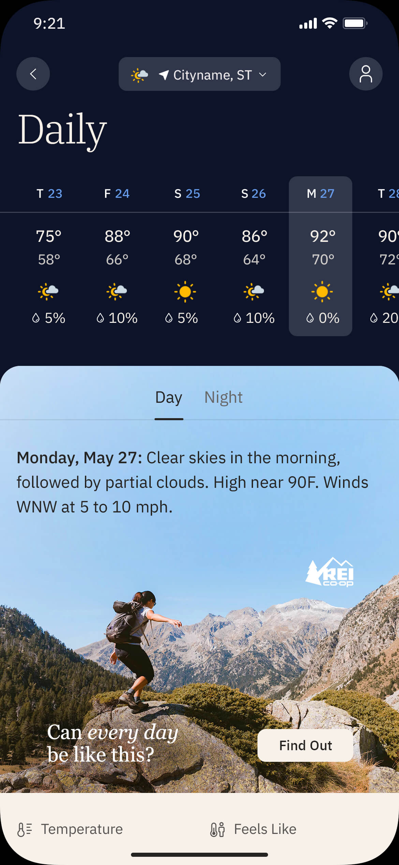
Sponsored Insights
Several touch points in the app drive to the Daily Details page, including weather “Insights”. Insights are part of the app’s home page experience and provide our users with observations and suggestions based on their forecast.
When an advertiser runs an Integrated Daily Details sponsorship, one or more of the Insights will feature a “sponsored by” brand element and drive directly to the integrated ad placement within the Daily Details page.
Week Ahead and Weekend Planning sponsorships will feature a sponsored insight on the “This Week” tab of the app home page.
Holiday/Event sponsorships will feature a sponsored insight on both the “This Week” and the “Event” tabs of the app home page.
11

Slide 12
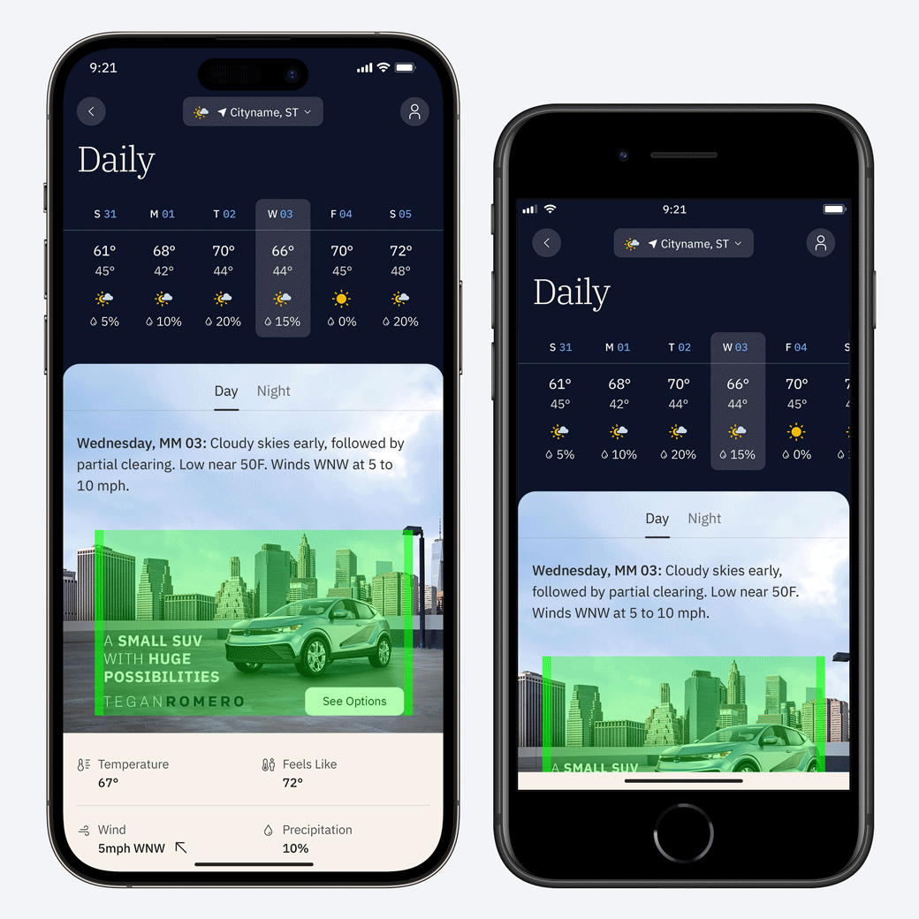
Specifications
The Integrated Daily Details ad unit consists of two separate layers that fit together seamlessly:
An interactive HTML5 layer that houses all brand elements. This is the brand area.
A static background layer that extends behind the forecast information and is non-interactive.
The unit is optimized to sit “above the fold” on regular-to-large devices, but, depending on the amount of forecast information present on-screen and/or the size of the device, users may have to scroll to bring the entire unit into view.
12

Slide 13
Production Assets
Clients or agencies can simply provide their key campaign art and messaging — The Weather Company’s Creative Lab will then build out the full range of weather-based creatives per our product specifications. The weather imagery itself is sourced or created by The Weather Company.
The overall creative vision for how a brand or product is presented in this space is the most critical piece of information for our team to understand. We will make sure these goals are being met while also aligning with the requirements of the ad unit.
Mock templates are available to partners’ creative teams for use in comping up layouts. Final designs are handled by the Creative Lab.
Standard Assets
Hi-resolution brand imagery: flat files or PSD(s)
Brand messaging (20–24 characters reco for headlines, 12–16 for CTAs)
Any required copy such as legal disclaimers, trademarks, or copyrights
Fonts (zip file / licensing info)
Logos (PNG, EPS, SVG)
Single-color versions, both light and dark, are required for the Moments Card “presented by” placements
Please ensure that all assets provided by Advertiser or Agency to Media Company are legally owned and/or legally licensed for digital usage in the U.S.
Upon completion of a campaign, The Weather Company does not share the final creative design or final coded source files to be used for any other advertising purposes beyond our platform.
13

Slide 14
Production Timeline
Timeline begins after receipt of approved assets & creative direction.
3
1
3
3
TO 5
DAYS
OR MORE
DAYS
TO 5
DAYS
DAYS
STEP 1
Design
The Weather Company’s Creative Lab builds out all condition-based creative. Details >
STEP 2
Client Review & Approval
Timeline will be adjusted based on estimated days for client approval and/or feedback.
The Weather Company’s Creative Lab will provide a maximum of three (3) client reviews and design revisions and one (1) redesign per Creative Build prior to launch. Full policy >
STEP 3
Development & QA
Creative and tracking is handed off to dev team for coded build. Details >
Please note tracking is required for development to begin.
STEP 4
Launch
CID prep, final QA, trafficking, and launch.
Once an approved creative build has been trafficked, further edits and changes are no longer available.
Additional tracking preparation time is required for: Campaign Intelligence (+3 days), Click2Cart (+5 days). This work must be complete prior to development (Step 3).
Project timelines may be extended due to multiple products/builds, complex custom animations or interactivity, client feedback/approval times, multiple/complex trafficking placements.

