Slide 1
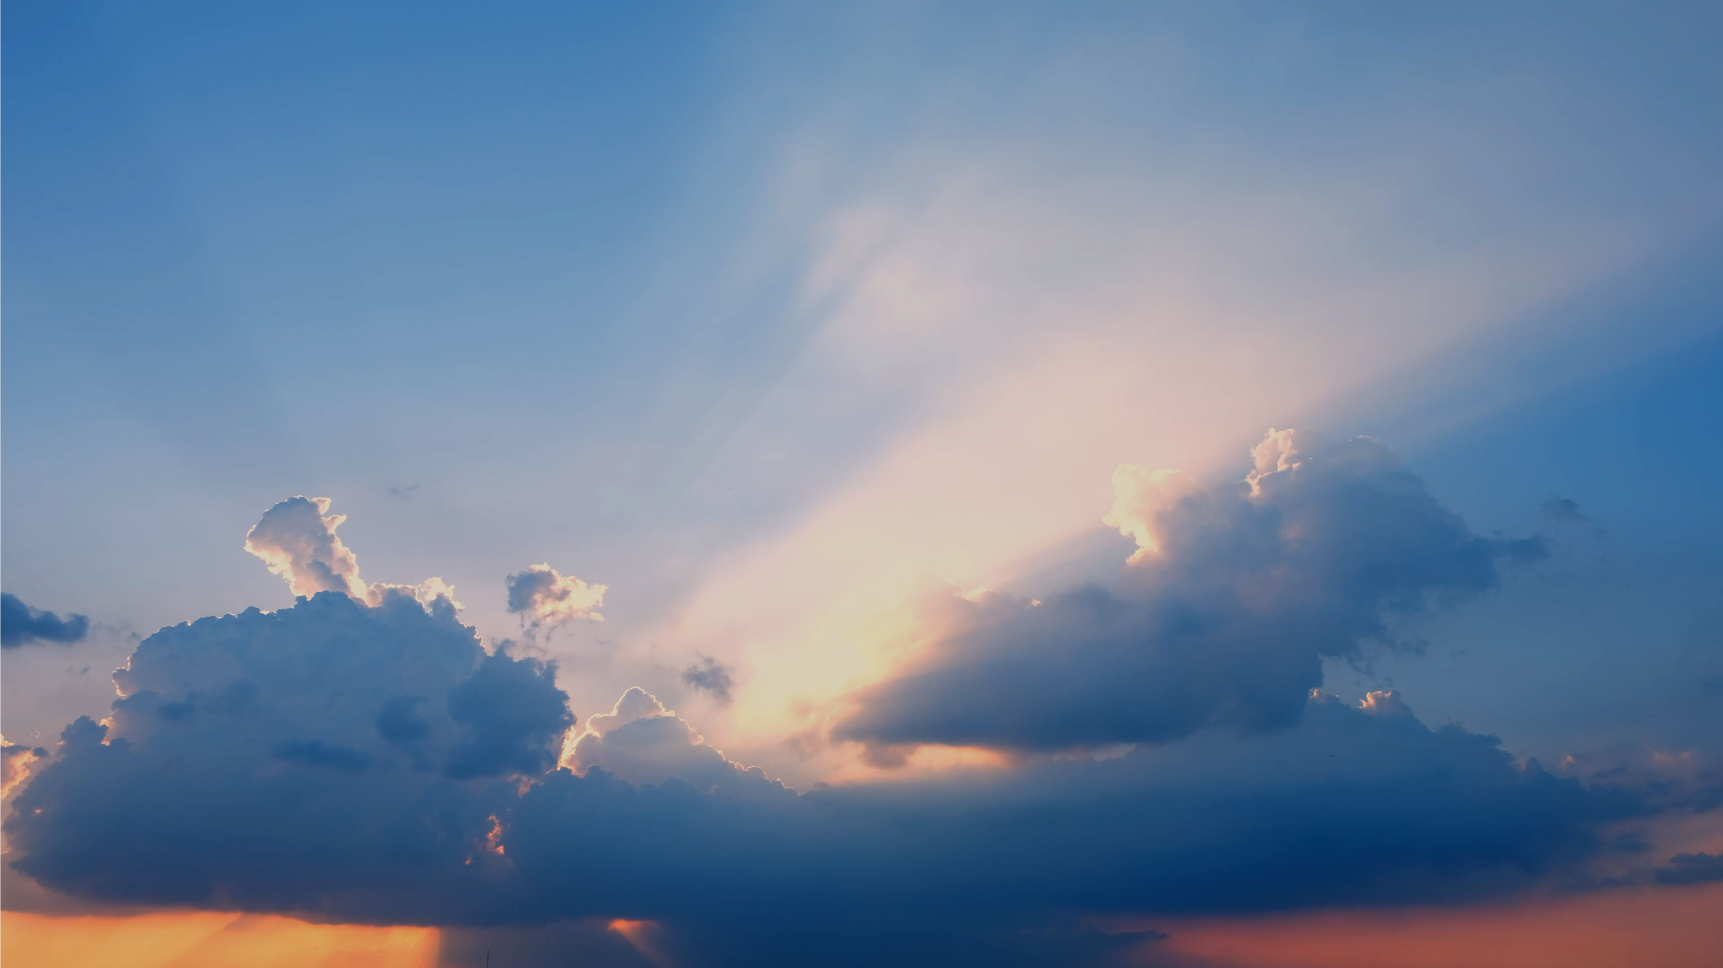
The Weather Channel Integrated Marquee, Mobile App
—
Specifications and Style Guide 2024.Q1.V1
Please use Presentation Mode to view animated examples.

Slide 2
Overview
The Integrated Marquee is The Weather Company’s premium native ad product. It combines brand imagery and messaging with real-time weather conditions to create stunning, contextually-relevant ads.
This unit runs on The Weather Channel iOS and Android app home screens. As a platform that reaches 15 million+ daily users,* it is a highly effective space for brands to engage a massive audience.
By default, the Integrated Marquee reflects the weather conditions and time of day in a user’s location — it can be further customized using our proprietary Adaptor logic and Weather Targeting platform.
HTML5-based features such as video playback, animation, and expandable full-screen overlays are also available.
Advertisers can choose the feature or combination of features that best suits their marketing goals.
* Source: Qlik, US only, Q3 Avg. 2022

Slide 3
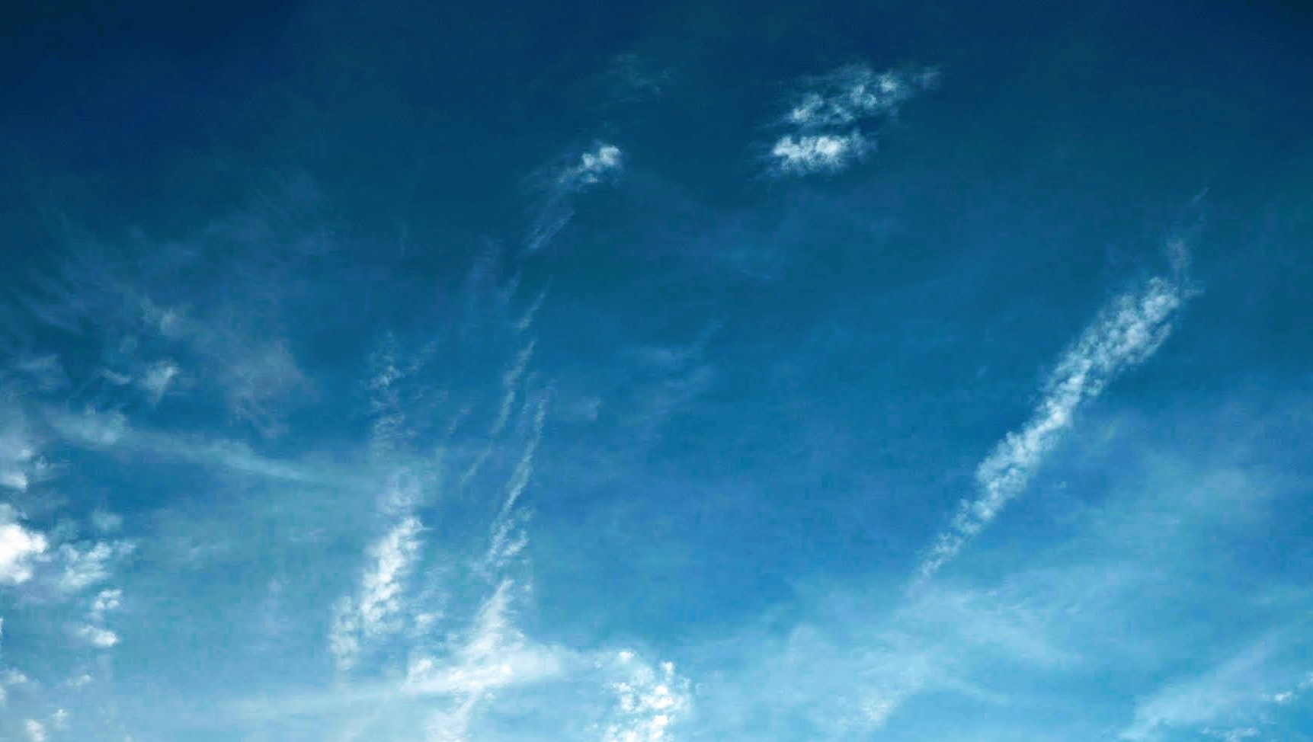
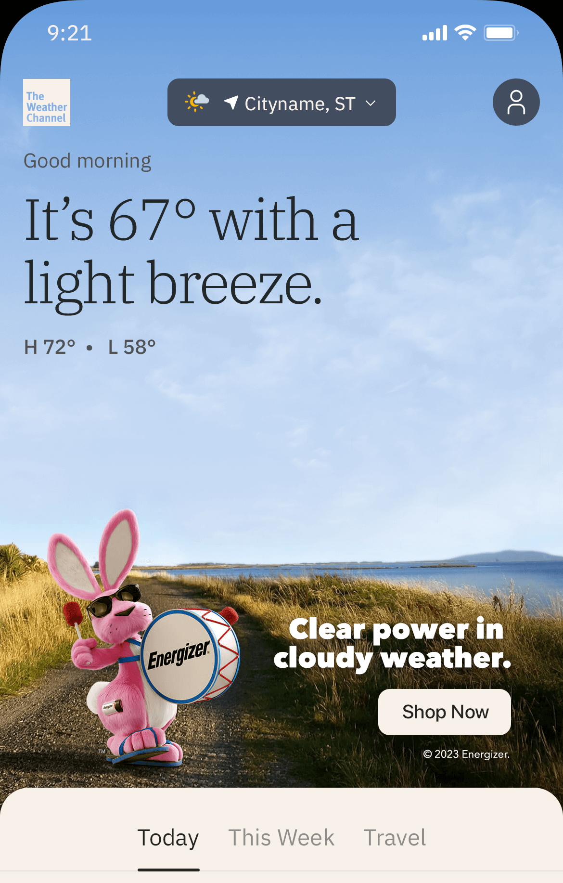
Weather
The Integrated Marquee must feature accurate weather imagery in an unobstructed sky.
This creates contextual alignment between the data displayed in the app and the creative featured in the ad unit. It’s also what allows the unit to have such a large footprint on the app’s home screen.
Who does what?
All weather imagery is sourced or created by The Weather Company’s Creative Lab. This is to ensure that UI accessibility requirements are being met and that the weather imagery itself aligns with our product standards.
Clients can simply deliver their key campaign art along with any other required elements (see “Production Assets” slide for more information) and the Creative Lab will build out the surrounding scenes, including the weather.
3

Slide 4
Weather Conditions Adaptor
Using a matrix of four general weather conditions and two dayparts (daytime and night), we build up to eight variations of a given creative.
Each time the unit loads, the version that matches the time of day and current weather conditions for our user’s location or the location they are viewing will serve.
Spend Level: Tier 1
Please note that Integrated Marquees do not run during severe weather conditions.
4
> Presentation Mode

Slide 5
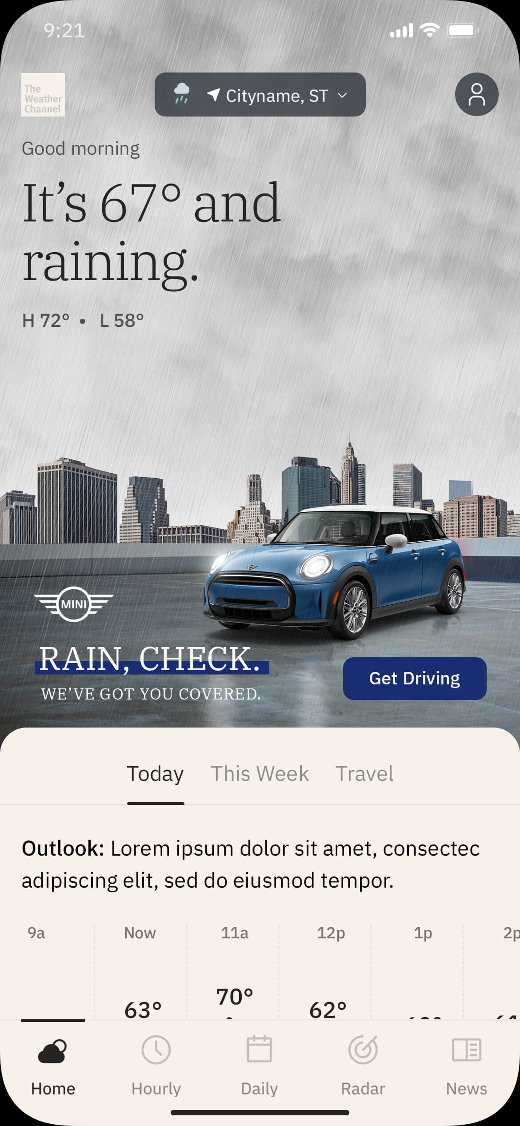
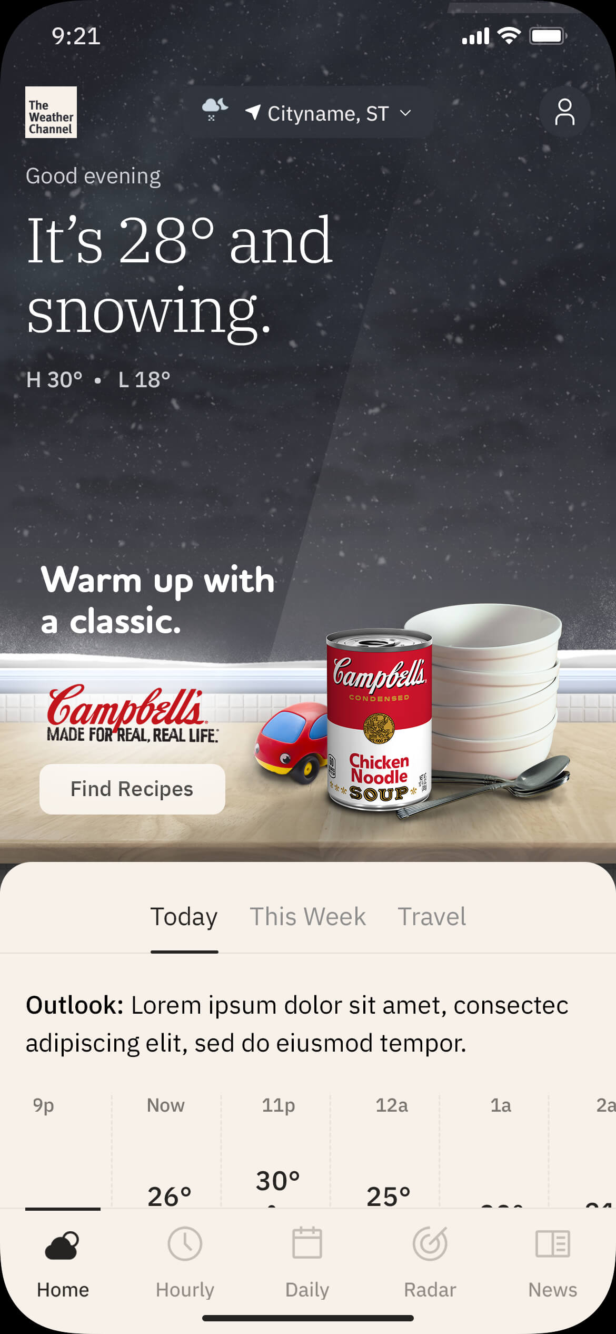
Weather Conditions Adaptor
Brand Integration: In-Scene
Our primary method for combining brands and products with weather is to integrate them directly into an adaptive weather scene.
Outdoor settings are most common but indoor scenes can also be created so long as unobstructed weather imagery is still present.
Please note:
Products must be integrated into a scene that includes a clear, unobstructed view of the sky. Indoor scenes must include a large, single-pane window to meet this requirement.
Background image must meet WCAG-defined AA “small type” contrast levels for the App UI and not interfere with UI legibility.
Brand imagery is limited to the lower portion of the overall image. Logo, copy (20–24 characters recommended), and CTA (12–16 characters max) should use no more than 1/3 of that area.
Brand copy and product visuals may vary per condition.
To support the native integration of brand elements within the app we recommend adopting the CTA styling used throughout the app for this unit.
The creative may not include severe weather elements such as tornados, hurricanes, lightning bolts, etc.
Weather imagery is sourced or created by The Weather Company in partnership with the Advertiser and/or Creative Agency.
Outdoor Scene
Indoor Scene

Slide 6
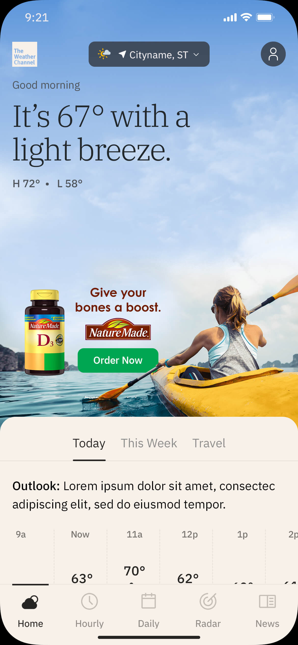
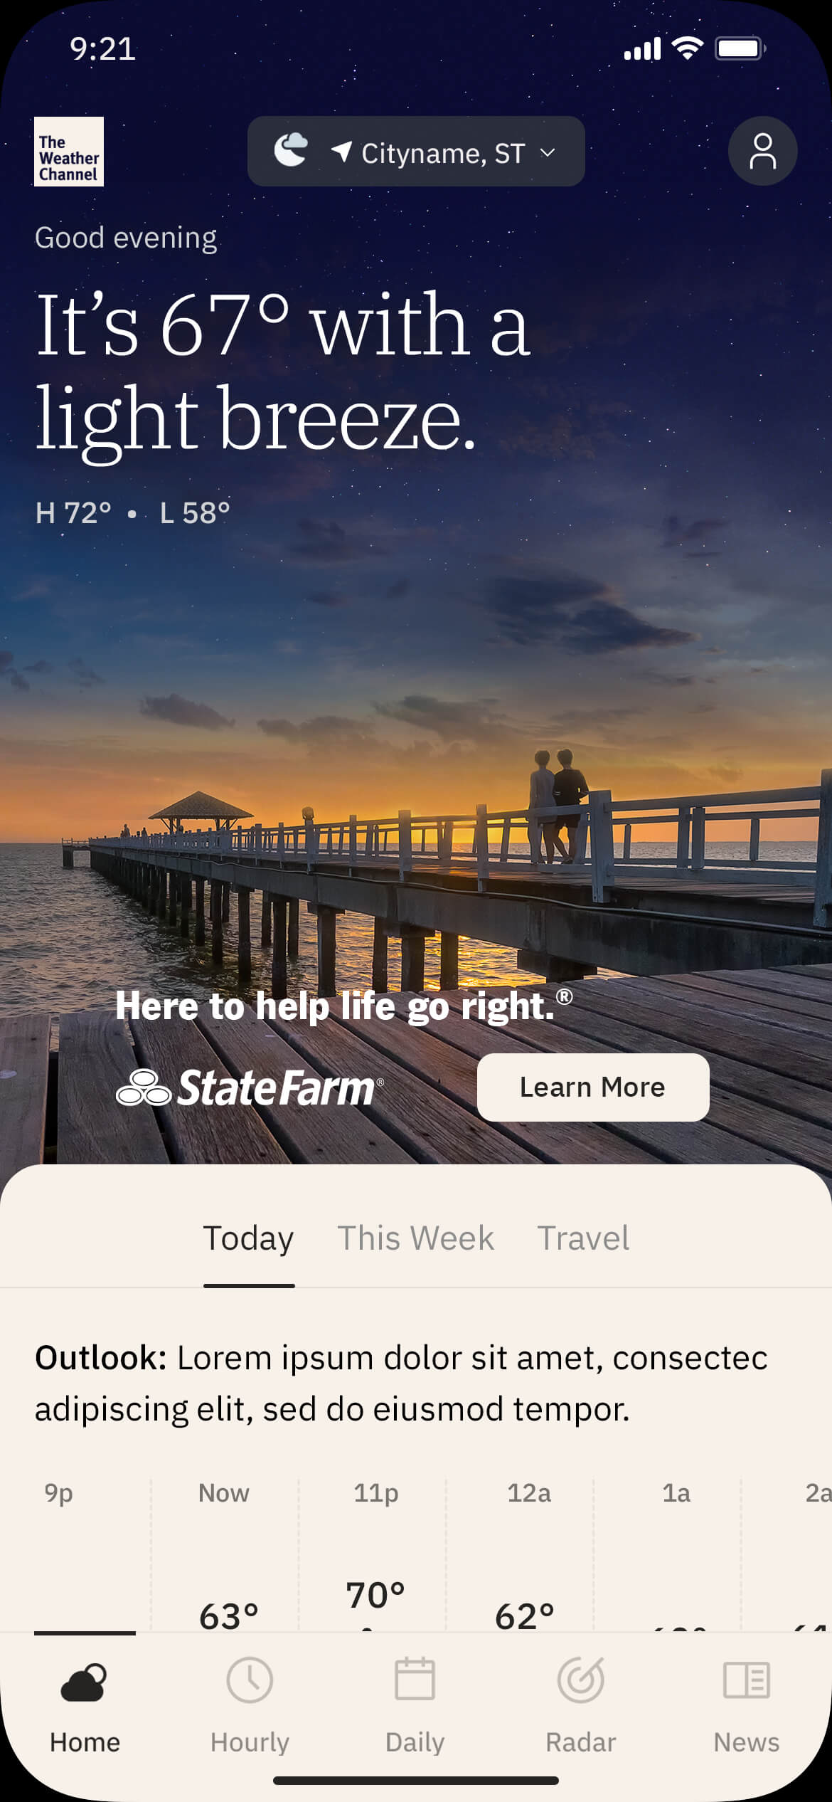
Weather Conditions Adaptor
Brand Integration: Floating
If a featured product will not optimally integrate into an adaptive weather scene, it can be “floated” above it as part of the brand lockup.
Similarly, if the featured content is a service versus a physical product the brand lockup floats above a custom weather scene.
Please note:
Product cannot be cropped or placed at the viewport edge due to variability in user device widths.
The background scene must include a clear, unobstructed view of the sky.
Background image must meet WCAG-defined AA “small type” contrast levels for the App UI and not interfere with UI legibility.
Brand imagery is limited to the lower portion of the overall image. Logo, copy (20–24 characters recommended), and CTA (12–16 characters max) should use no more than 1/3 of that area.
Brand copy and imagery may vary per condition.
To support the native integration of brand elements within the app we recommend adopting the CTA styling used throughout the app for this unit.
The creative may not include severe weather elements such as tornados, hurricanes, lightning bolts, etc.
Weather imagery is sourced or created by The Weather Company in partnership with the Advertiser and/or Creative Agency.
Floating Product
Service (No Product)

Slide 7
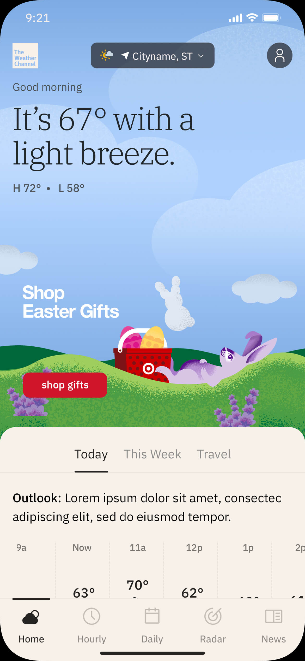
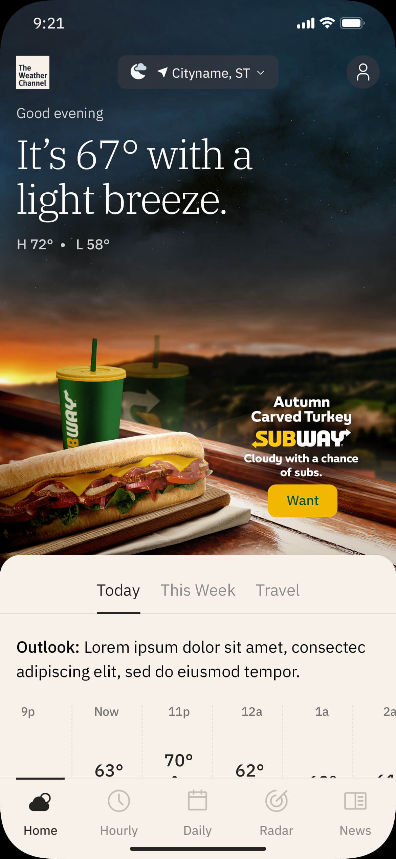
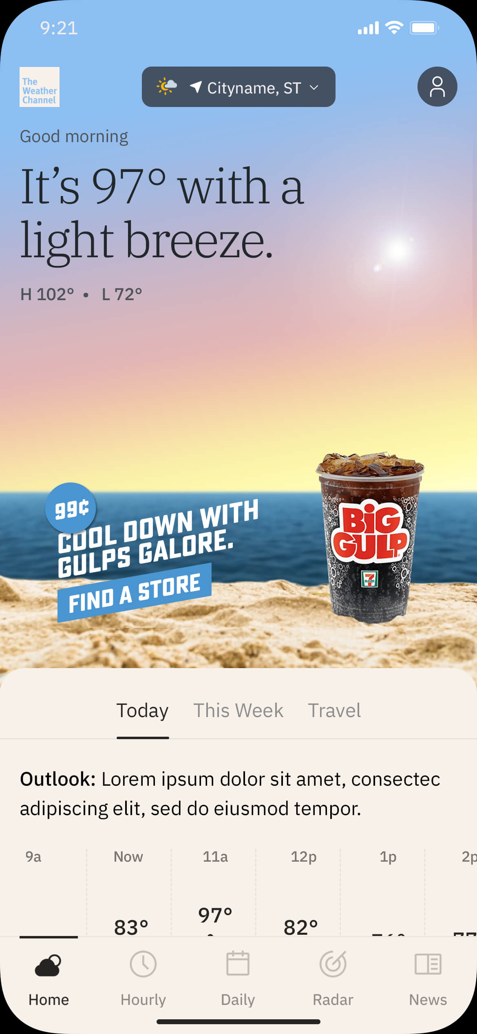
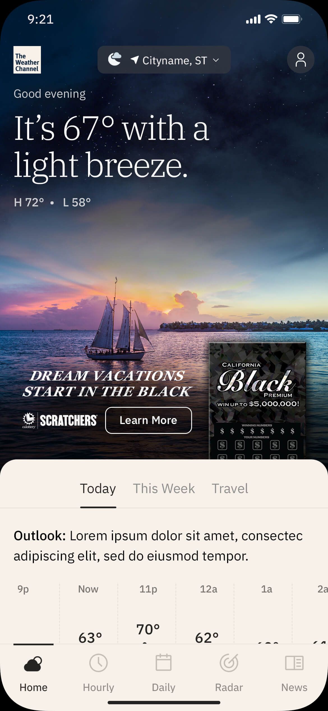
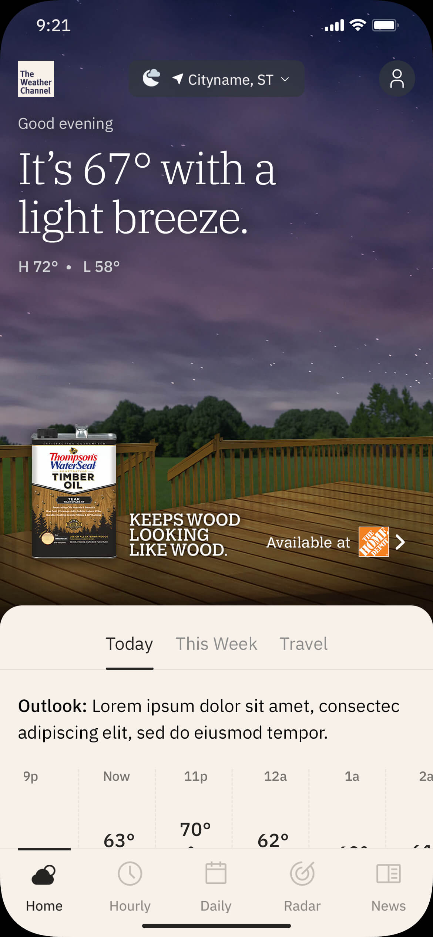
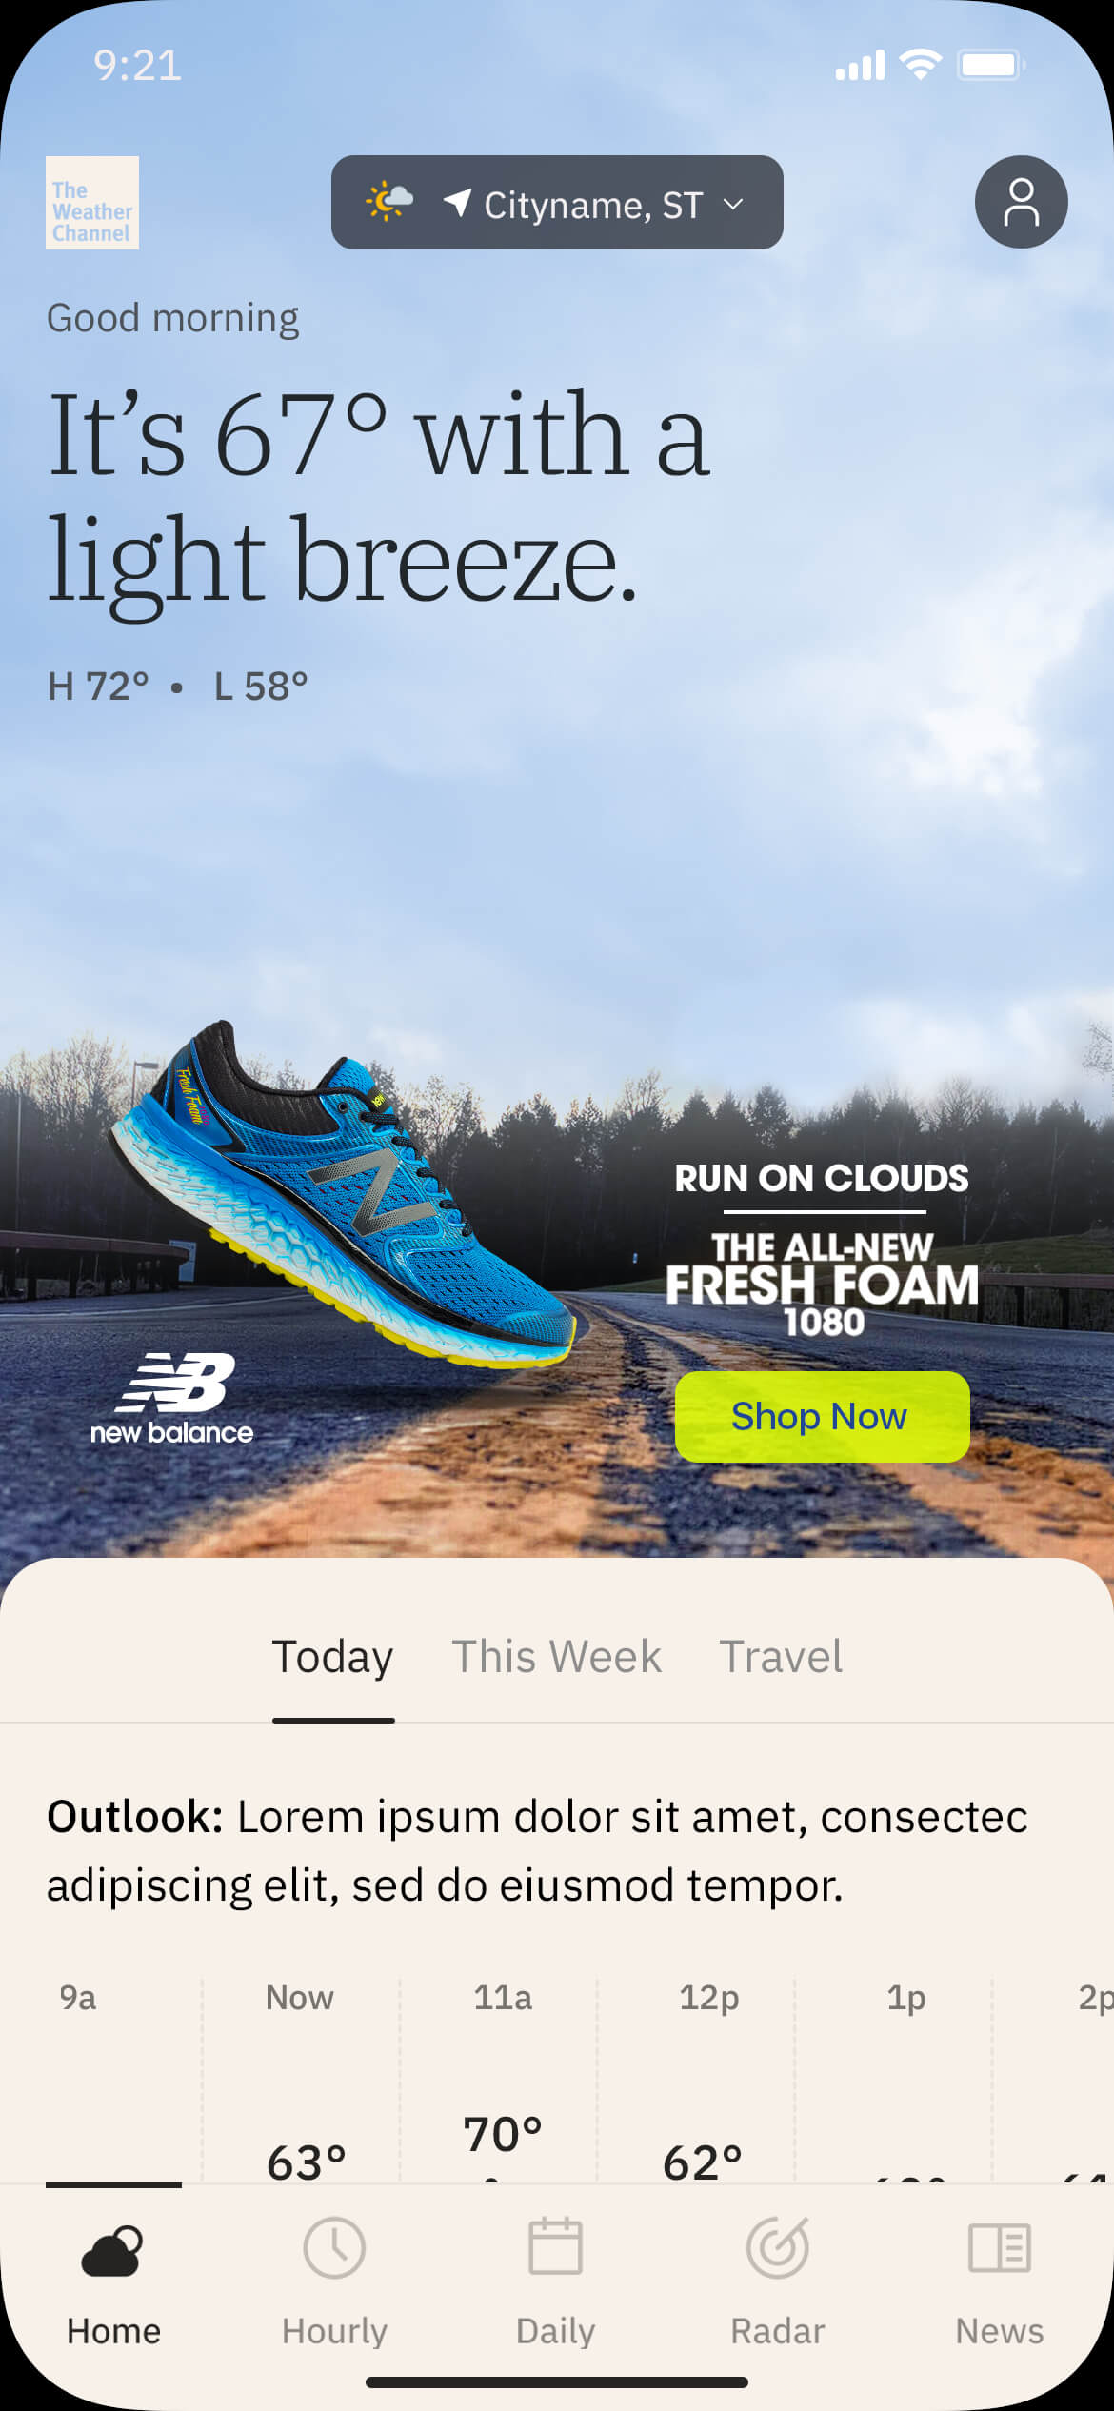
Brand Integration Examples
7

Slide 8
Additional Adaptor Functionalities
These optional functionalities further extend the unit’s weather-based adaptability, creating an even more contextually-relevant brand experience for our users.
Spend Level: Tier 1

Slide 9
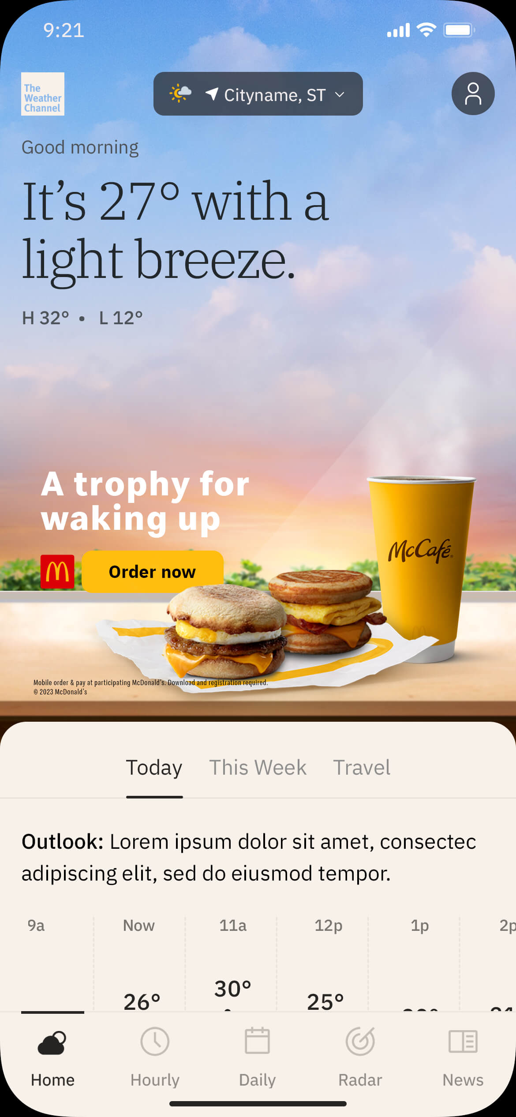
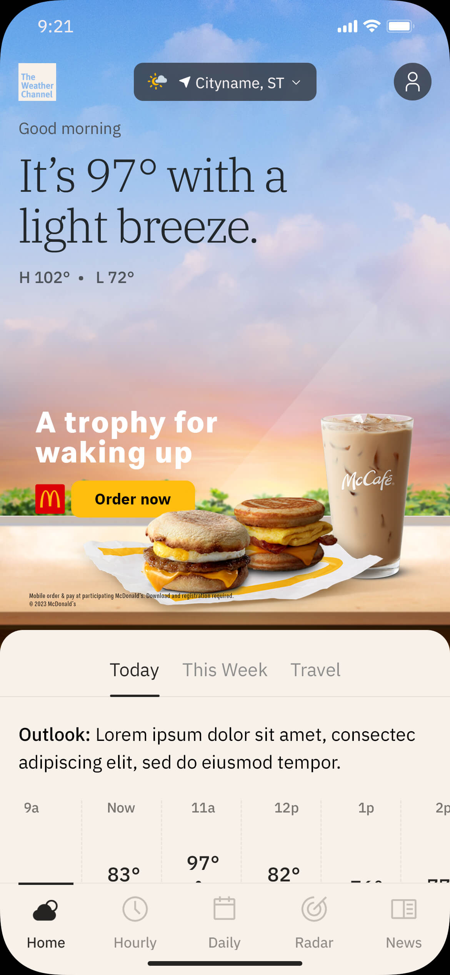
Additional Adaptor Functionalities
Temperature Range
This logic allows advertisers to assign different visuals and messaging to different temperature ranges.
For example, an outdoor retailer could choose to market lightweight gear and accessories on a hot day and cold weather gear on a cold day. Similarly, a QSR advertiser could feature hot beverages on a cold day and cold beverages on a hot day.
Example Temperature Range Matrix:
91° or higher
Featured product and messaging address extremely hot temperatures.
51°– 90°
General message for moderate temperatures.
31°– 50°
Featured product and messaging address cool temperatures.
30° or lower
Featured product and messaging address extremely cold temperatures.
Default Displays if targeted conditions are unavailable

Slide 10
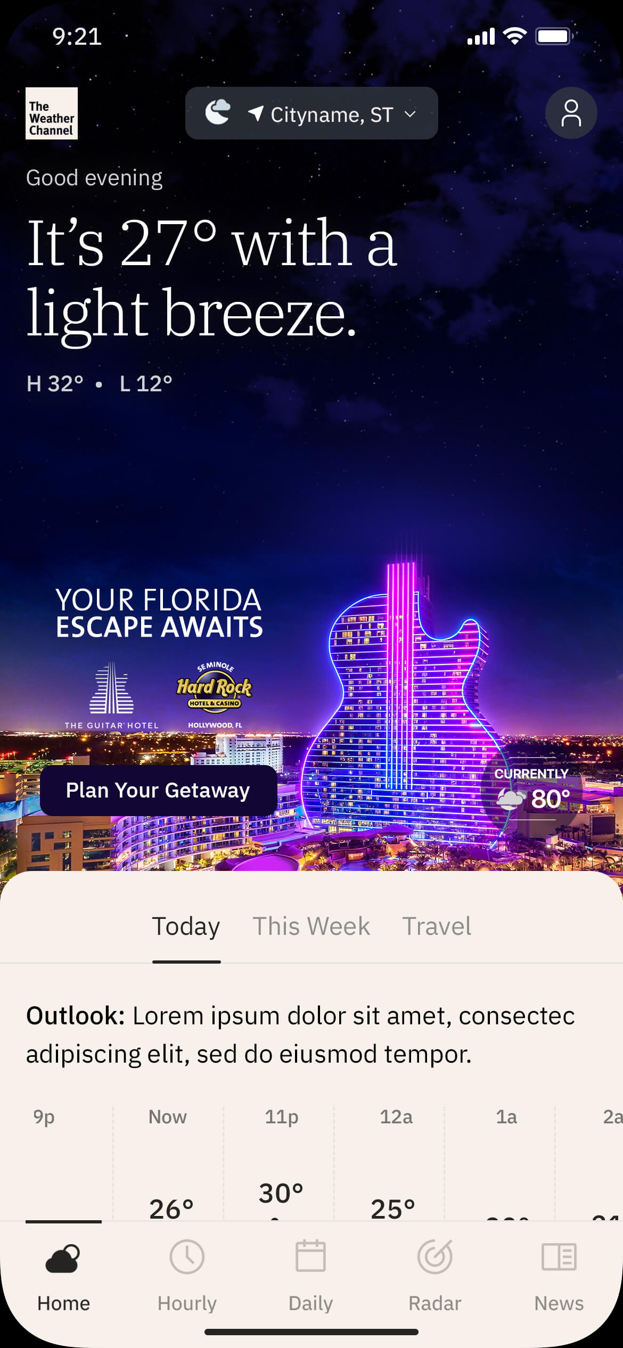
Additional Adaptor Functionalities
Temperature Comparison
With temperature comparison logic, the temperature for our users’ location is compared to that of a separate location. Using this information, the visuals and messaging of the ad unit can compare or contrast the two.
For example, a warm-weather destination such as a resort can use the temperature comparison feature to show users experiencing cold weather how much warmer it is at the resort, driving consideration of a getaway.
The Weather Company Weather Targeting ensures that the relationship between a user’s current temperature and that of the destination being advertised aligns with the campaign’s intent.

Slide 11
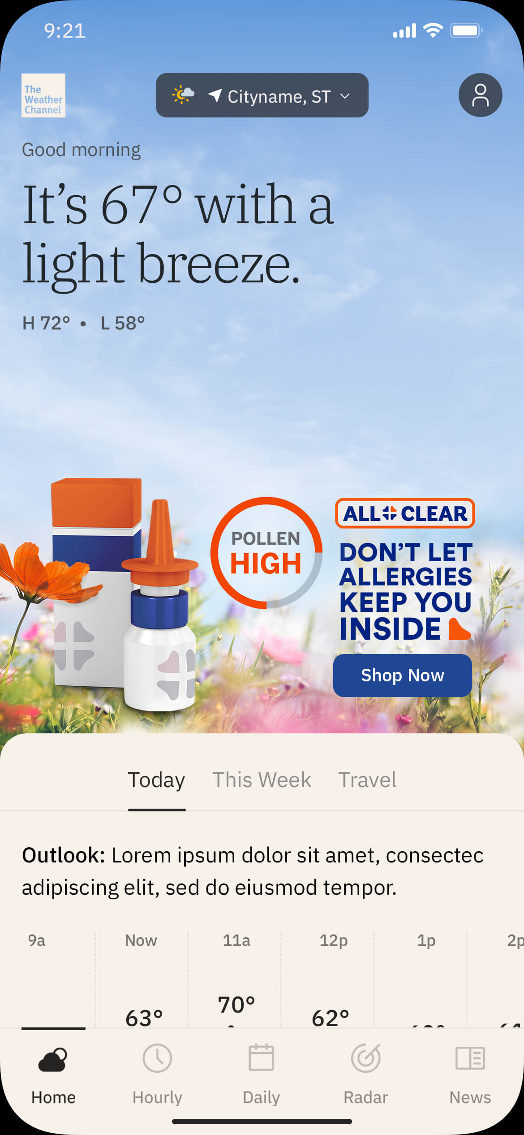
Additional Adaptor Functionalities
Indices
Indices assign values to a wide range of weather-related conditions that are highly influential to consumer behavior. Advertisers can customize their creative imagery and/or messaging based on these values.
The Weather Company can assist in customizing indices to meet specific advertiser goals.
Some examples of adaptable indices include:
Aches and Pains Index: indicates the weather’s influence on an individual's potential to feel aches and pains.
Dry Skin Index: indicates the likelihood that a person will experience dry skin based on weather conditions.
Breathing Index: indicates weather’s influence on the ability to breath for respiratory-sensitive individuals including those who suffer from asthma.
Leisure Travel Index: provides indices of outdoor travel / sightseeing conditions.
Ski Index: provides an index for favorable skiing weather conditions.
Pollen Index: forecasts levels of Grass, Ragweed, and Tree pollen.
Frizz Index: scores the likelihood of experiencing frizzy hair.

Slide 12
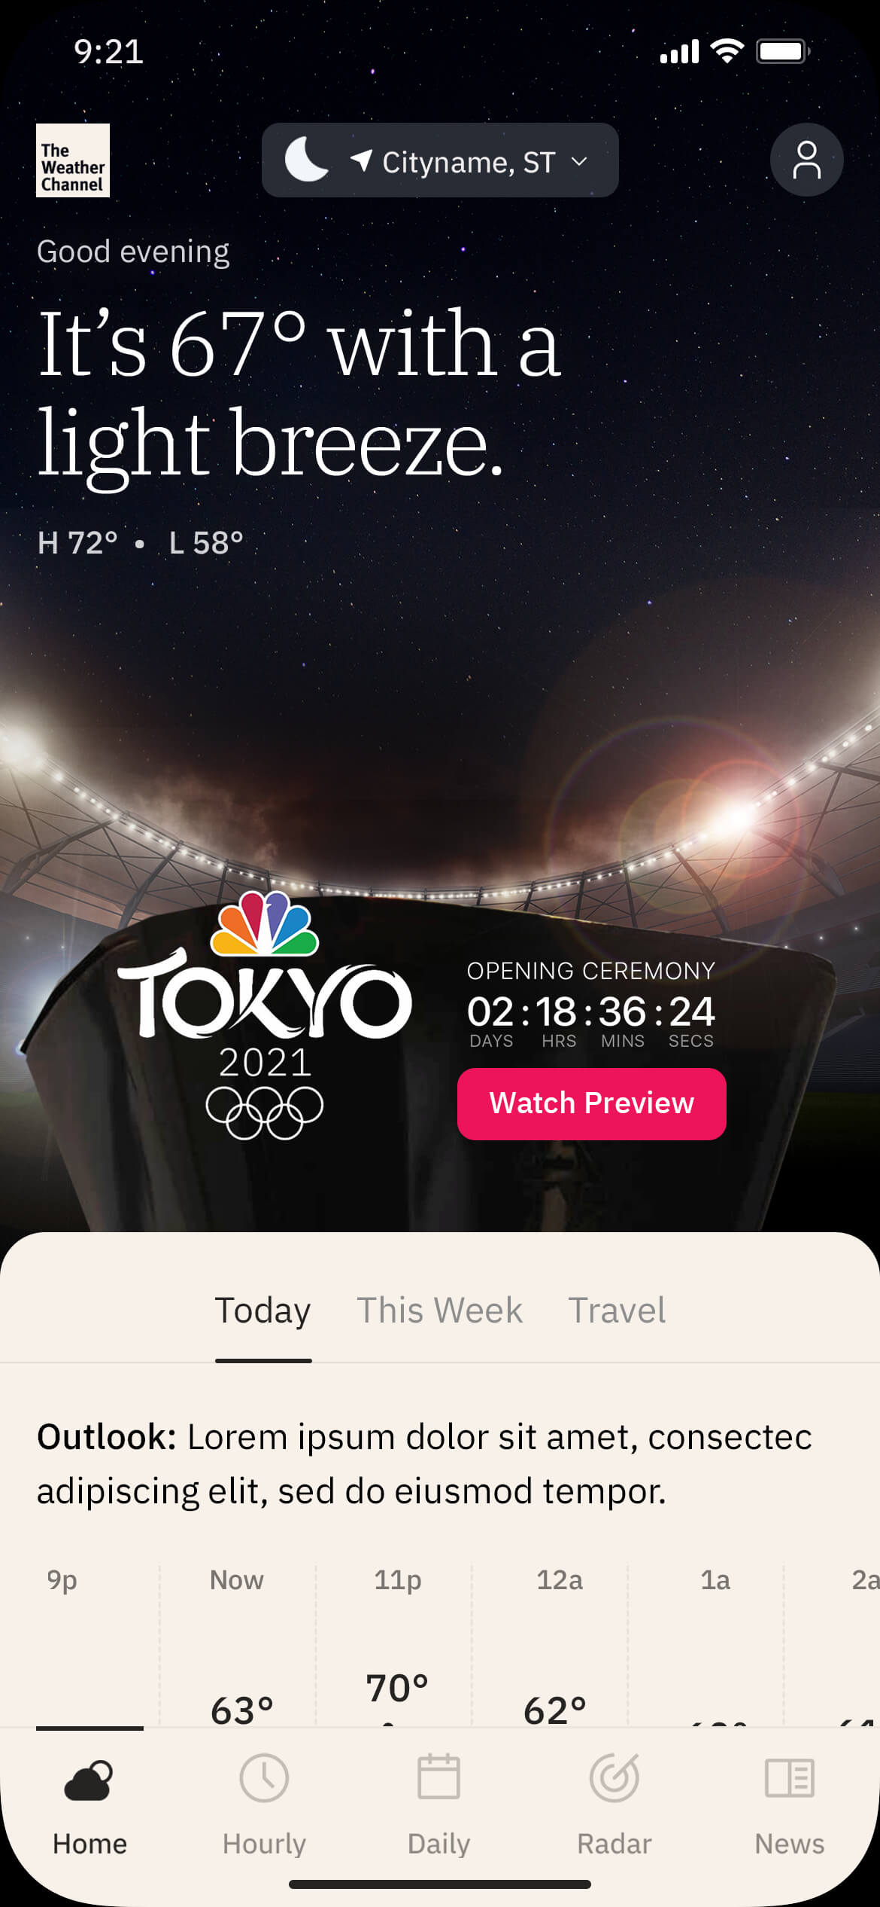
Additional Adaptor Functionalities
Countdown
Countdowns allow advertisers to build anticipation ahead of any type of event. The countdown can display days, hours, minutes, and seconds — this format drives awareness and offers users greater incentive to click on the creative.
Some common use cases for the countdown include series or movie premieres, special events, holidays, the weekend, limited time offers, etc.

Slide 13
Additional Features
Mobile App Integrated Marquees are built using HTML5, which gives brands the ability to incorporate rich media features into the ad space.
This can help draw users’ attention, encourage them to interact with brand content within the unit, and assist in meeting specific KPIs.
Spend Level: Tier 2

Slide 14
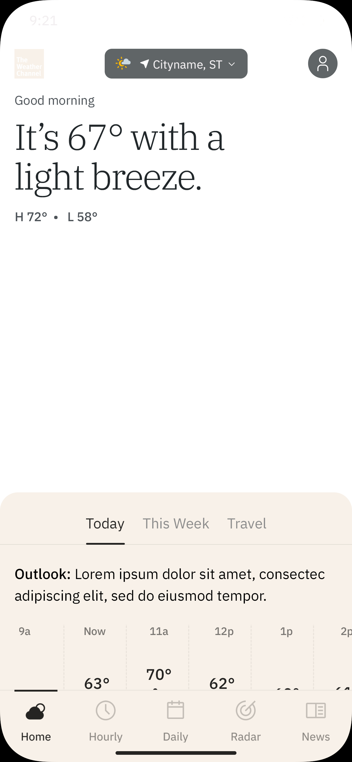
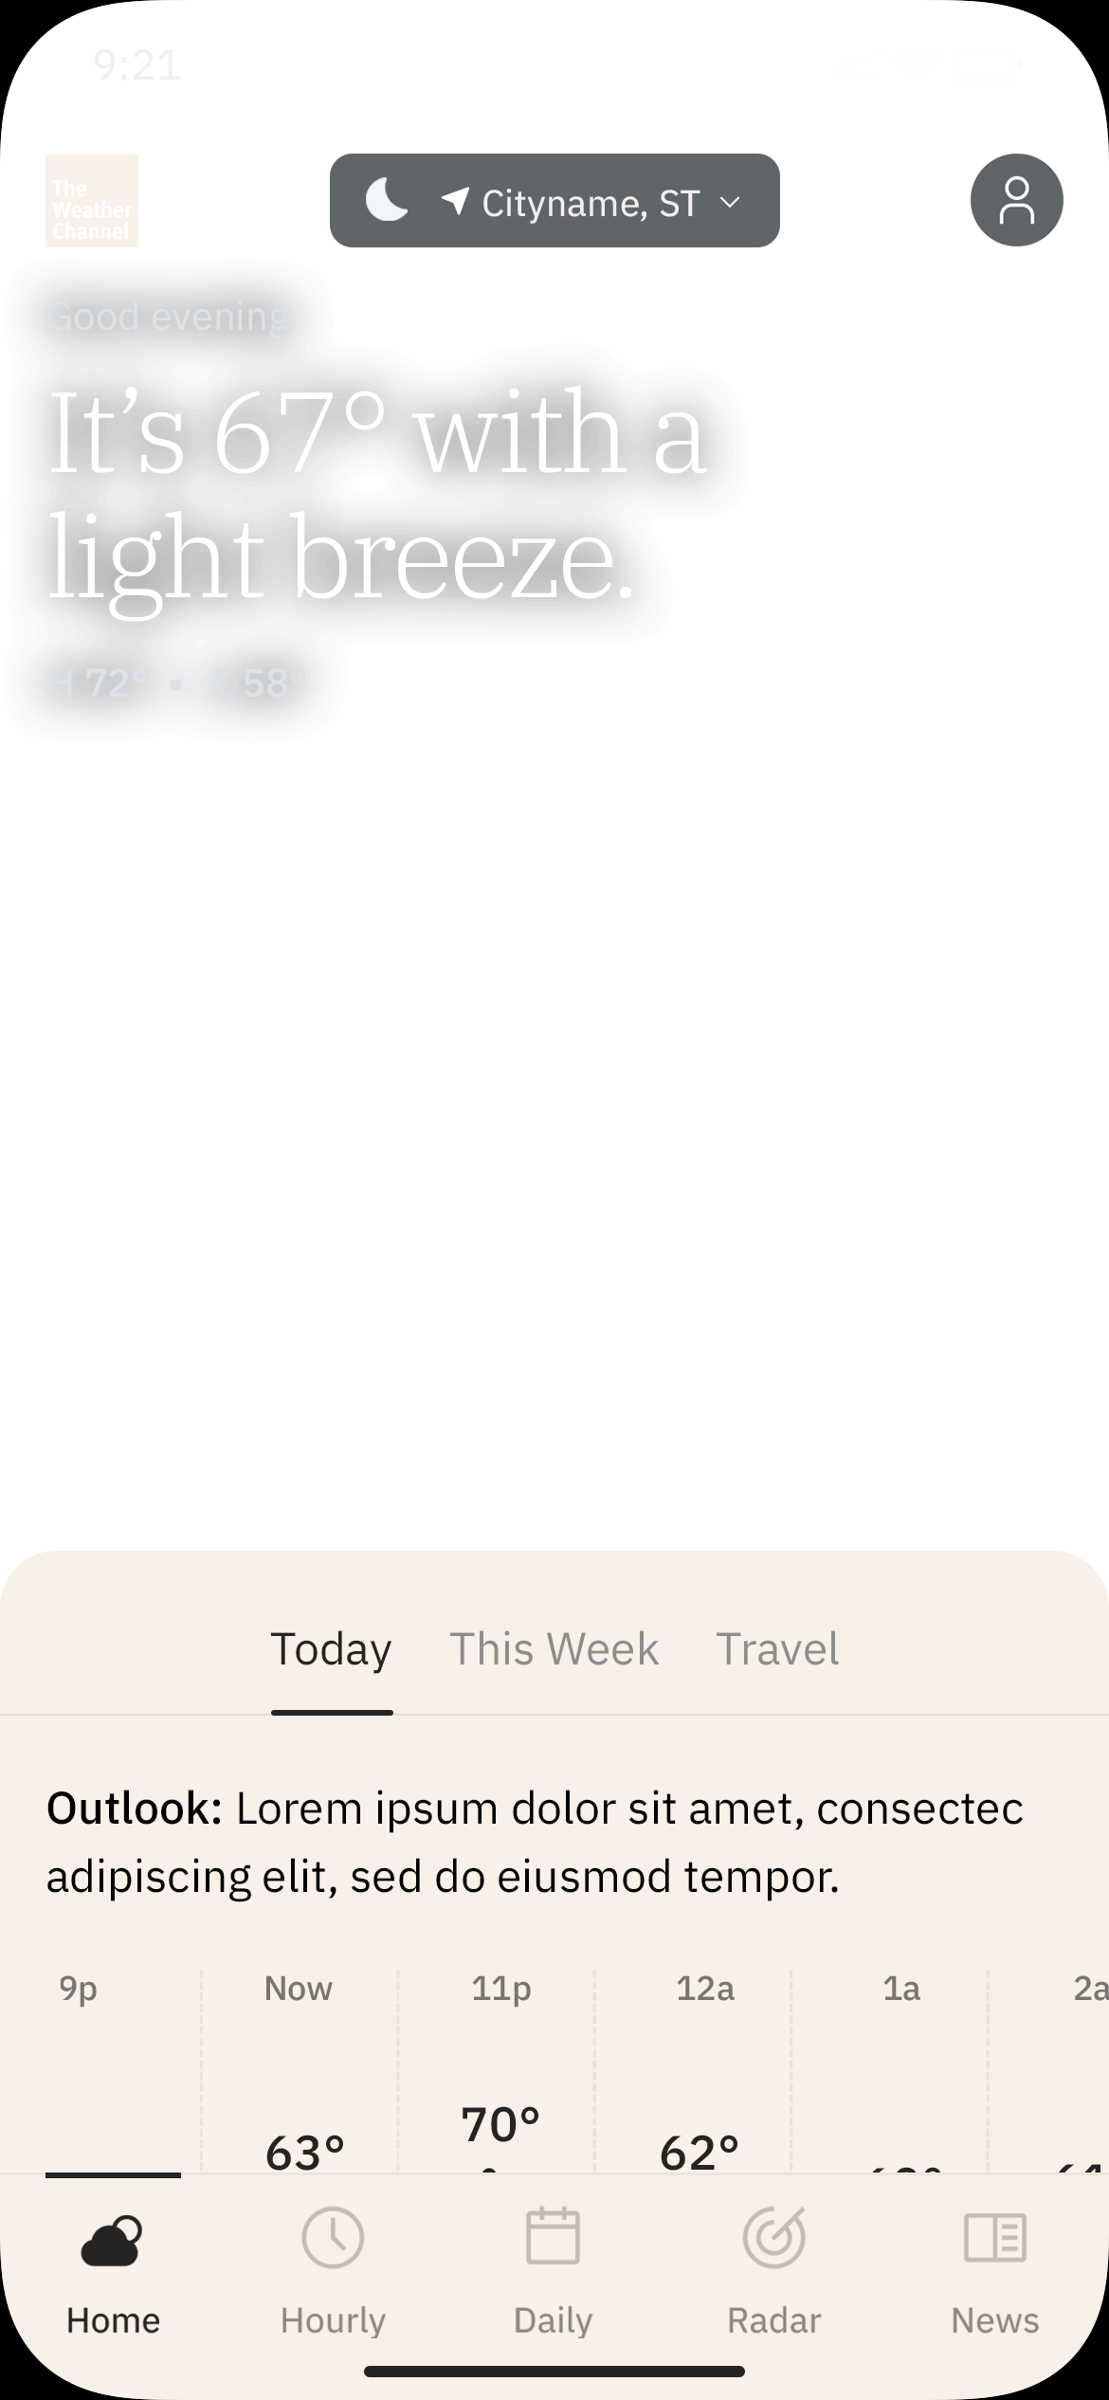
Animation
Additional Features
By default, Mobile App Integrated Marquees use static imagery. Adding animation can help capture users' attention and increase brand awareness. Animations are timed so that they complete a set of loops within the unit’s 24-second runtime: a 6-second clip will loop four times, a 4-second clip six times, and so on. After 24 seconds, the animation will stop on the last frame. Animation Types Cinemagraph: looping animations integrated with static visuals that bring background elements to life (video-based). Video Clip: live action or CGI footage with a stable POV, no text overlays, and no jump cuts. Subject to The Weather Company approval. Custom: complex animation builds, such as moving characters constructed from 2D assets.
Animations are sourced or created by The Weather Company in partnership with the Advertiser and/or Creative Agency.
Cinemagraph
Video Clip
> Presentation Mode

Slide 15
Additional Features
Swipe / Carousel
Swipe interfaces encourage casual user interaction by offering a way to explore additional content inside the ad unit without leaving the screen they are currently on.
Minimum 2, maximum 11 frames/items.
Individual frames can contain unique click-throughs, or the entire unit can click to a single landing page.
Deep-linking is permitted if the functionality exists within the destination app and URI information is provided.
> Presentation Mode

Slide 16
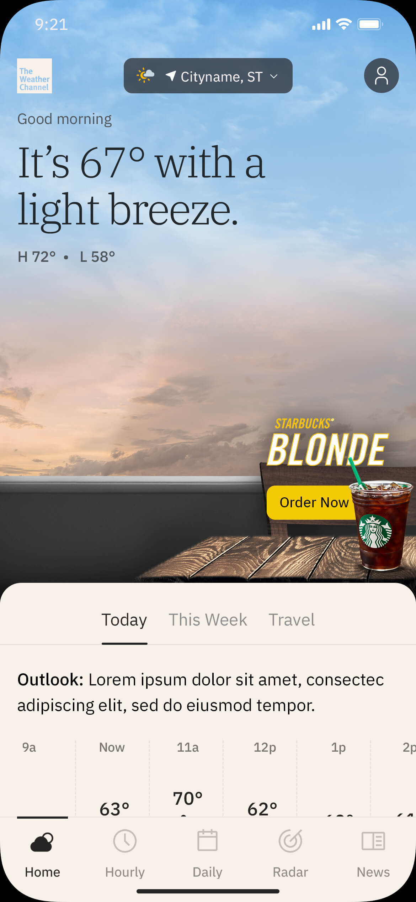
Additional Features
Video Player
Featuring an embedded video player in the Integrated Marquee space is an excellent way to get video content in front of a massive audience.
Videos will auto-play on page load, with the sound disabled: user interaction unmutes the video. When the video ends, a poster image will be displayed along with the option to replay the video.
Video content must be approved and rights-owned, as needed, and must be hosted by The Weather Company.
> Presentation Mode

Slide 17
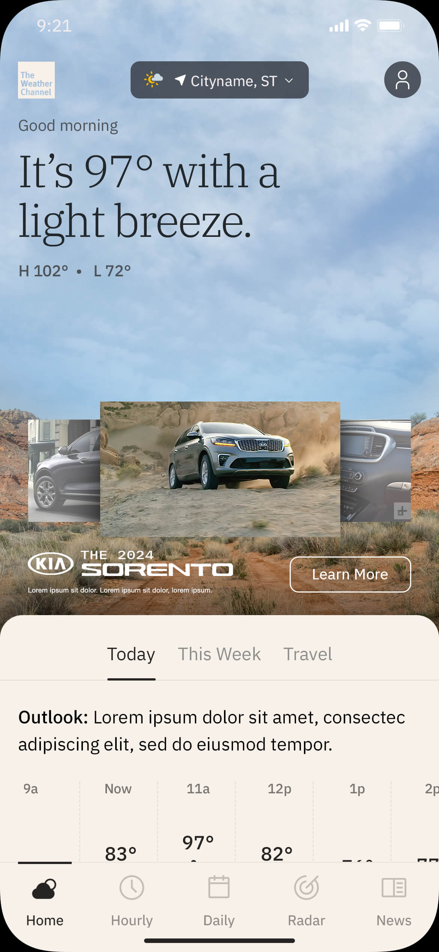
Additional Features
Video Gallery
Video galleries are ideal for advertisers with abundant video content and video interaction KPIs. Multiple videos are presented together, usually in a carousel format.
On load, the first video will start playing immediately with sound disabled. Users can toggle the sound and tap or swipe the carousel controls to access additional video content.
Each video can click through to a unique URL, or the entire unit can click to a single landing page.
Video content must be approved and rights-owned, as needed, and must be hosted by The Weather Company.
> Presentation Mode

Slide 18
Additional Features
Expandable Rich Media
When a user taps on an ad with expandable rich media functionality, the creative expands out of the initial Integrated Marquee space into a full screen experience. This gives the advertiser the opportunity to tell a larger story with more content.
The expanded state can contain, but is not limited to, the following elements:
Additional brands or products with unique CTAs
Image carousels
Video content
Animation and interactivity
> Presentation Mode

Slide 19
Additional Features
Vertical Video
The Integrated Marquee supports a tap-to-launch overlay containing vertical video, which plays in a portrait orientation rather than the typical landscape orientation. Recommended aspect ratio is 9:16.
Benefits of vertical video ads include:
Vertical video leverages up to 100% of the phone’s real estate in portrait orientation versus 25% with horizontal video.
The format integrates well with The Weather Channel App, where consumers are used to viewing content in portrait orientation.
Users aren’t likely to rotate their phones to landscape mode to view ad content. Vertical video optimizes content to our users’ natural (vertical) hand position.
> Presentation Mode

Slide 20
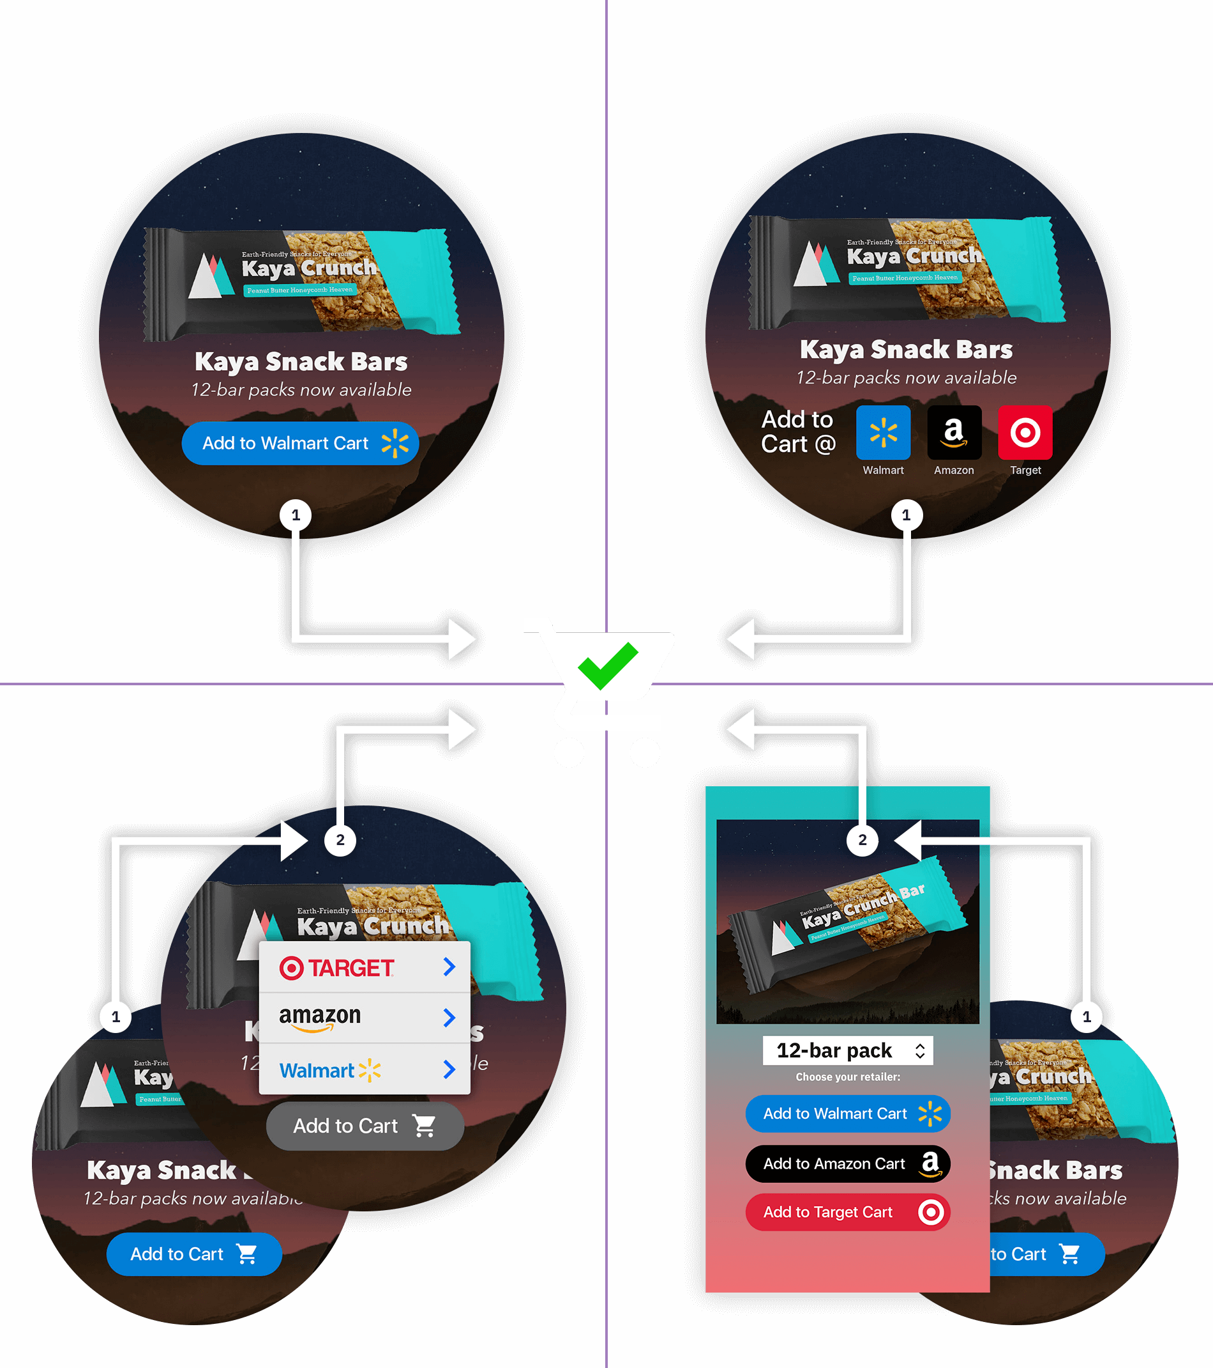
Click2Cart®
Additional Features
A) Single-Retailer Direct
1-click, ~90% CSR
B) Multi-Retailer Direct
1-click, ~90% CSR
Click2Cart is an e-commerce add-on for our premium ad product offerings that places products directly into retailer shopping carts.
There are several Click2Cart options, each with their own use-case:
A) Single-Retailer Direct 1-click, ~90% carting success rate One CTA drives directly to a retailer cart. The simplicity of this option tends to yield the highest overall performance.
B) Multi-Retailer Direct 1-click, ~90% carting success rate Multiple CTAs (3–5) are presented, each driving directly to a retailer cart. Requires dedicating a significant portion of the ad composition to the Click2Cart user interface.
C) Multi-Retailer Menu 2-click, 2–20% carting success rate Multiple retailer options (3–5) are revealed via a menu CTA. This interaction model requires less space in the initial ad composition but typically results in a lower carting rate than a 1-click direct model.
D) Multi-Retailer Window 2-click, 2–20% carting success rate Upon user interaction, multiple retailer and/or product options are presented in an overlay screen (app) or new browser tab (web). This interaction model requires less space in the initial ad composition but typically results in a lower carting rate than a 1-click direct model.
Retailer and product information will be required prior to the production phase of the unit.
C) Multi-Retailer Menu
2-click, 2–20% CSR
D) Multi-Retailer Window
2-click, 2–20% CSR

Slide 21
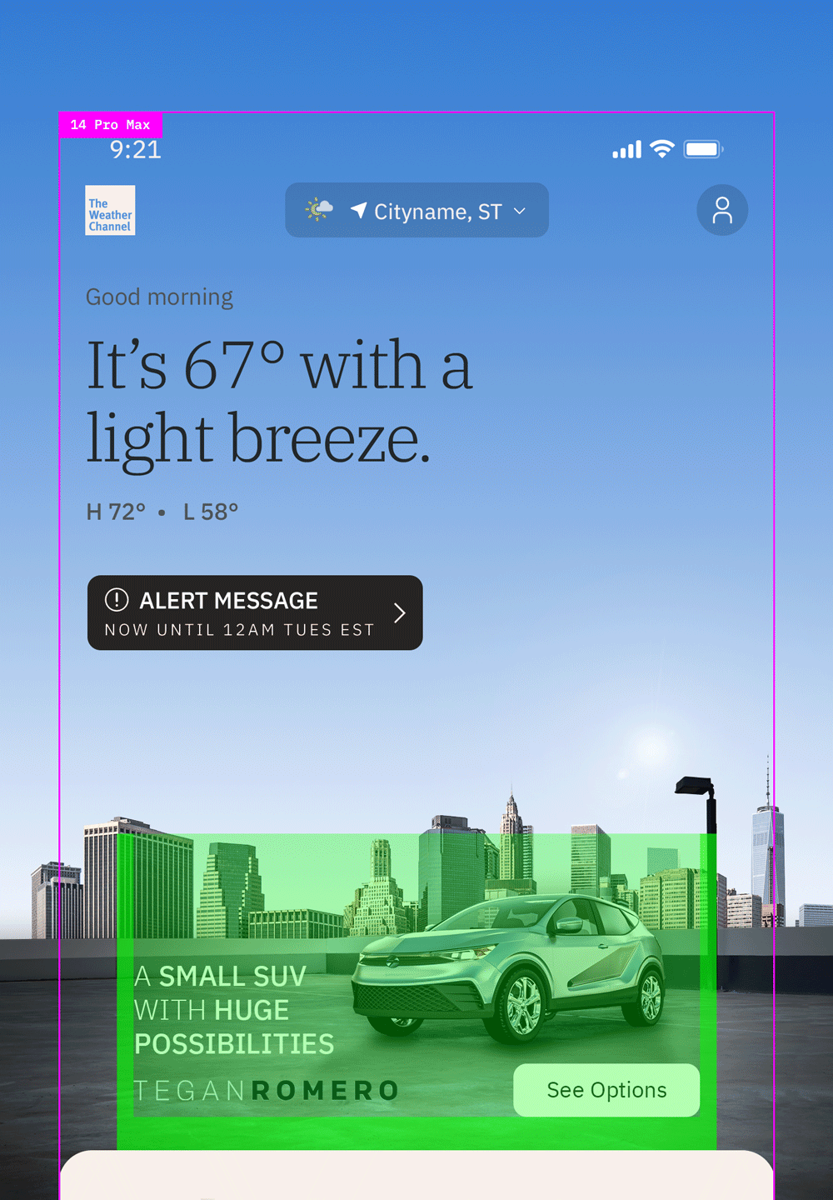
Specifications
The Integrated Marquee ad unit consists of two parts:
An HTML5 layer that houses all brand elements and interactive features. This is the brand area.
A full-bleed background visual that extends behind the app’s user interface.
Each build includes one layout optimized for smaller devices and one layout optimized for regular-to-large devices.
Small Device
–320x190–
Large Device
–360x190–

Slide 22
Production Assets
Clients or agencies can simply provide their key campaign art and messaging — The Weather Company’s Creative Lab will then build out the full range of weather-based creatives per our product specifications. The weather imagery itself is sourced or created by The Weather Company.
The overall creative vision for how a brand or product is presented in this space is the most critical piece of information for our team to understand. We will make sure these goals are being met while also aligning with the requirements of the ad unit.
Mock templates are available to partners’ creative teams for use in comping up layouts. Final designs are handled by the Creative Lab.
Standard Assets
Hi-resolution brand imagery: flat files or PSD(s)
Brand messaging (20–24 characters reco for headlines, 12–16 for CTAs)
Any required copy such as legal disclaimers, trademarks, or copyrights
Fonts (zip file / licensing info)
Logos (PNG, EPS, SVG)
In-Unit Video Player
Initial File Load: 200kb
User-Initiated File Load: 2.2mb
Max Duration: 15 secs
Video Codec: h264
Vertical Video / Full-Screen
Orientation: Portrait (vertical)
Max File Size: 4MB
Max Duration: 30 secs
Video Codec: h264
Please ensure that all assets provided by Advertiser or Agency to Media Company are legally owned and/or legally licensed for digital usage in the U.S.
Upon completion of a campaign, The Weather Company does not share the final creative design or final coded source files to be used for any other advertising purposes beyond our platform.

Slide 23
Timeline: Static Imagery / Video-Based Animation
Timeline begins after receipt of approved assets & creative direction.
3
1
3
3
TO 5
DAYS
OR MORE
DAYS
TO 5
DAYS
DAYS
STEP 1
Design
The Weather Company’s Creative Lab builds out all condition-based creative. Details >
STEP 2
Client Review & Approval
Timeline will be adjusted based on estimated days for client approval and/or feedback.
The Weather Company’s Creative Lab will provide a maximum of three (3) client reviews and design revisions and one (1) redesign per Creative Build prior to launch. Full policy >
STEP 3
Development & QA
Creative and tracking is handed off to dev team for coded build. Details >
Please note tracking is required for development to begin.
STEP 4
Launch
CID prep, final QA, trafficking, and launch.
Once an approved creative build has been trafficked, further edits and changes are no longer available.
Additional tracking preparation time is required for: Campaign Intelligence (+3 days), Click2Cart (+5 days). This work must be complete prior to development (Step 3).
Project timelines may be extended due to multiple products/builds, complex custom animations or interactivity, client feedback/approval times, multiple/complex trafficking placements.

Slide 24
Timeline: Interactive Features / CSS-Based Animation
Timeline begins after receipt of approved assets & creative direction.
3
1
5
1
3
TO 5
DAYS
OR MORE
DAYS
DAYS
OR MORE
DAYS
DAYS
STEP 1
Design
The Weather Company’s Creative Lab builds out all condition-based creative. Details >
STEP 2
Client Review & Approval
Timeline will be adjusted based on estimated days for client approval and/or feedback.
The Weather Company’s Creative Lab will provide a maximum of three (3) client reviews and design revisions and one (1) redesign per Creative Build prior to launch. Full policy >
STEP 3
Development & QA
Creative and tracking is handed off to dev team for coded build. Details >
Please note tracking is required for development to begin.
STEP 4
Client Review & Approval
A live test link will be provided to ensure coded functionality and/or animation is as expected.
Please note designs have been approved at this stage — feedback should be limited to interactivity and/or animation.
STEP 5
Launch
CID prep, final QA, trafficking and launch.
Once an approved creative build has been trafficked, further edits and changes are no longer available.
Additional tracking preparation time is required for: Campaign Intelligence (+3 days), Click2Cart (+5 days). This work must be complete prior to development (Step 3).
Project timelines may be extended due to multiple products/builds, complex custom animations or interactivity, client feedback/approval times, multiple/complex trafficking placements.

Slide 25
