Slide 1
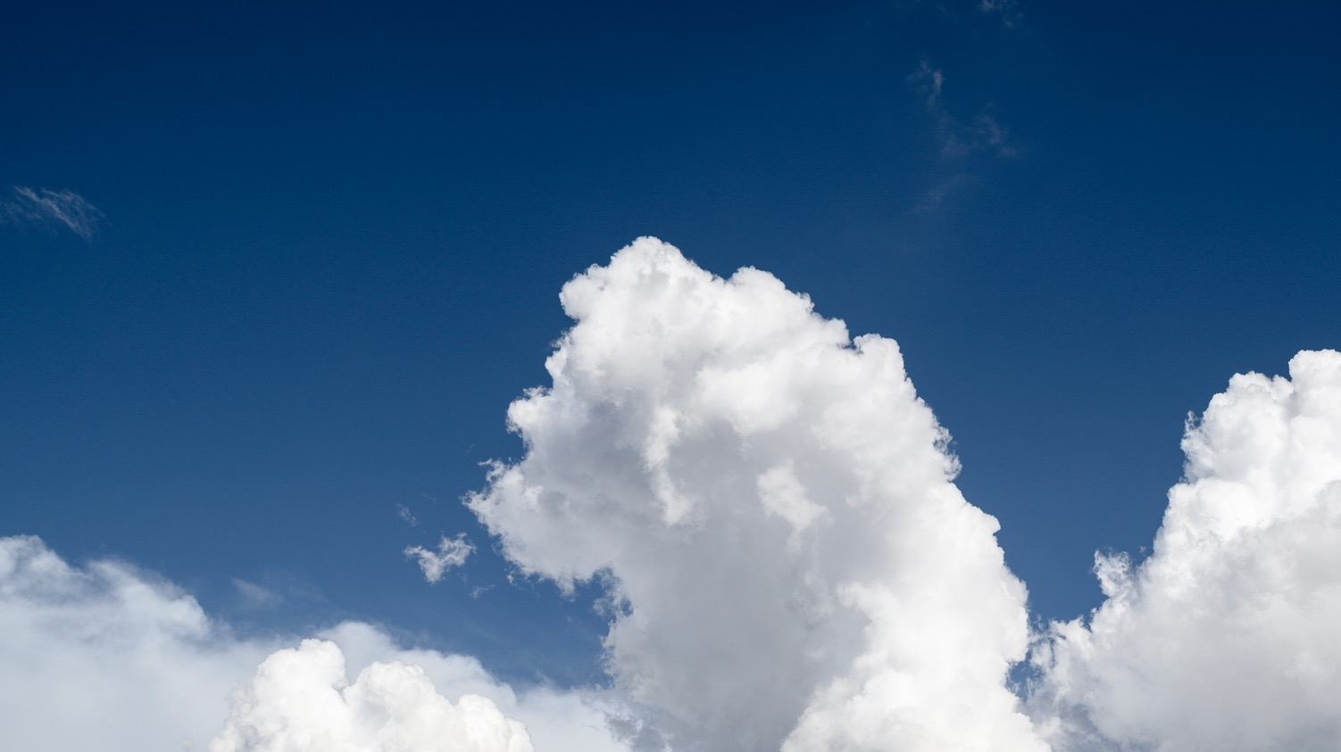
The Weather Company Dynamic Creative Adaptors
—
Specifications and Style Guide 2024.Q1.V1
Please use Presentation Mode to view animated examples.

Slide 2
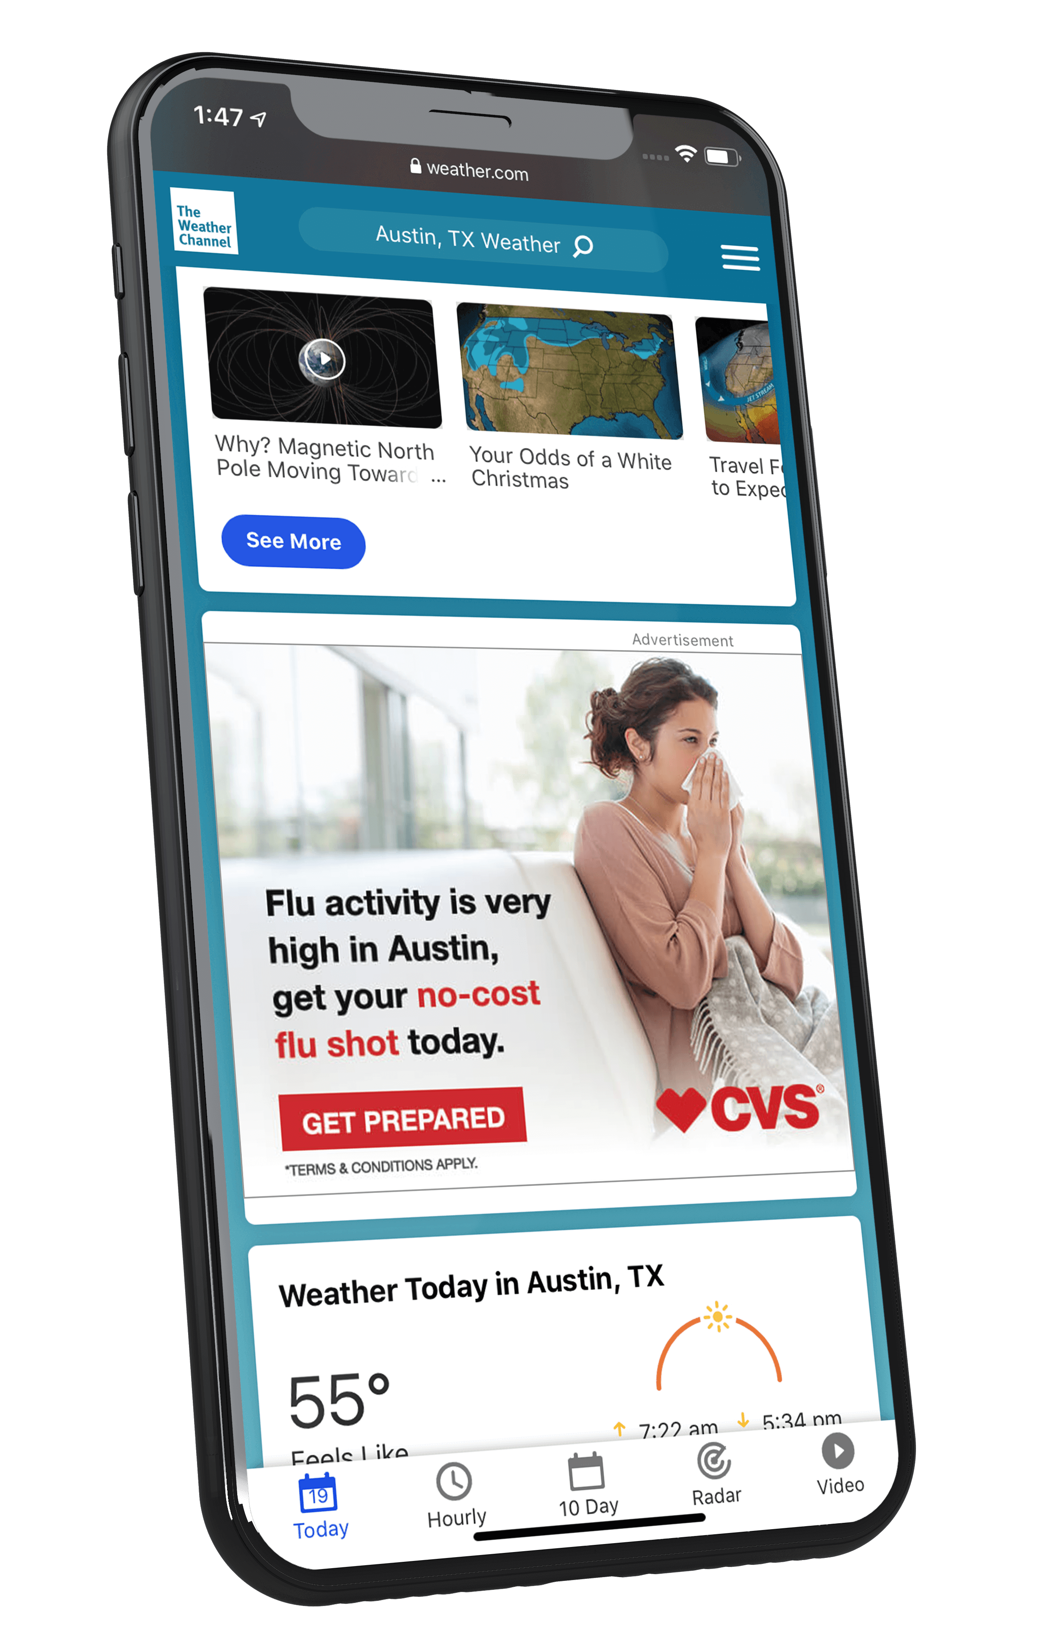
Overview
Adaptors are premium, banner-based ad products that integrate brand imagery and messaging with weather, location, and time to create contextually-relevant advertising experiences.
These units can incorporate a range of data-based feature sets that include user location, weather conditions, and time of day — the units can be further customized using our proprietary Weather Targeting platform.
HTML5-based features such as video playback, animation, and product carousels are available.

Slide 3
Adaptor Functionalities
Adaptors can incorporate a variety of weather-data-driven functionalities that create unique, contextually-relevant brand experiences for users.
Spend Level: Tier 1
3

Slide 4
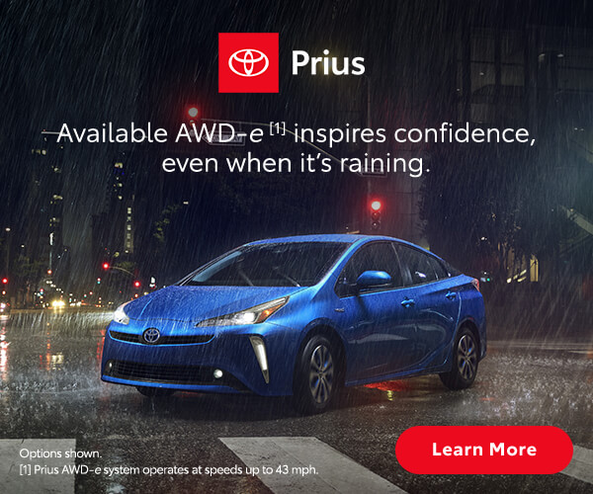
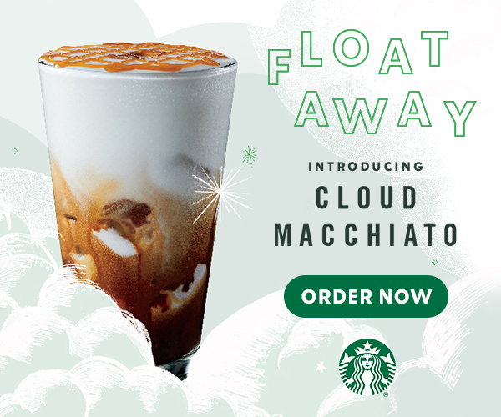
Weather Conditions
Adaptor Functionalities
Using a matrix of four general weather conditions and two dayparts (daytime and night), we build up to eight variations of a given creative.
Each time the unit loads, the version that matches the time of day and current weather conditions for our user’s location or the location they are viewing will serve.
Available Placements
Mobile App
300x250
320x50
320x480 (Interstitial)
Mobile Web
300x250
320x50
Large Web
300x250
300x600
728x90
970x250

Slide 5
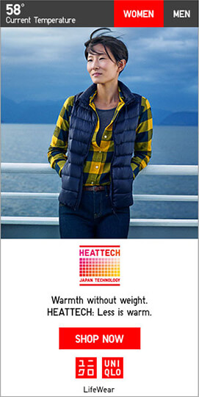
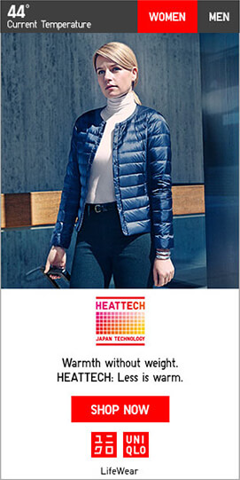
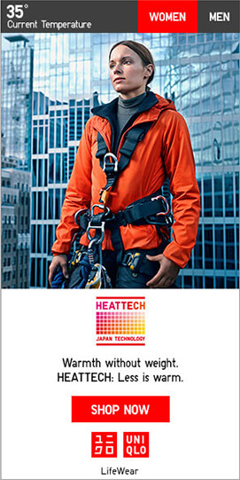
Adaptor Functionalities
Temperature Range
This logic allows advertisers to assign different visuals and messaging to different temperature ranges.
For example, an outdoor retailer could choose to market lightweight gear and accessories on a hot day and cold weather gear on a cold day. Similarly, a QSR advertiser could feature hot beverages on a cold day and cold beverages on a hot day.
Example Temperature Range Matrix:
91° or higher
Featured product and messaging address extremely hot temperatures.
51°– 90°
General message for moderate temperatures.
31°– 50°
Featured product and messaging address cool temperatures.
30° or lower
Featured product and messaging address extremely cold temperatures.
Default Displays if targeted conditions are unavailable
Available Placements
Mobile App
300x250
320x50
320x480 (Interstitial)
Mobile Web
300x250
320x50
Large Web
300x250
300x600
728x90
970x250

Slide 6
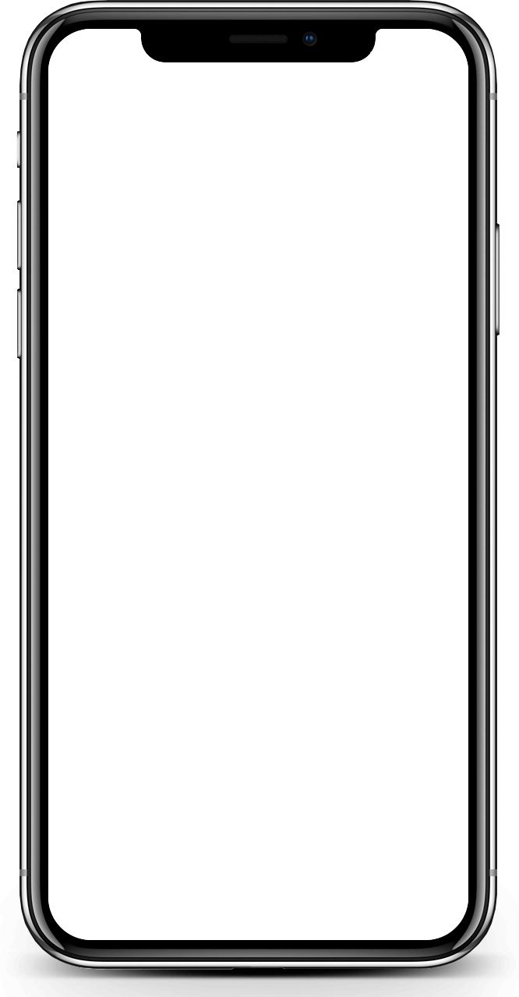
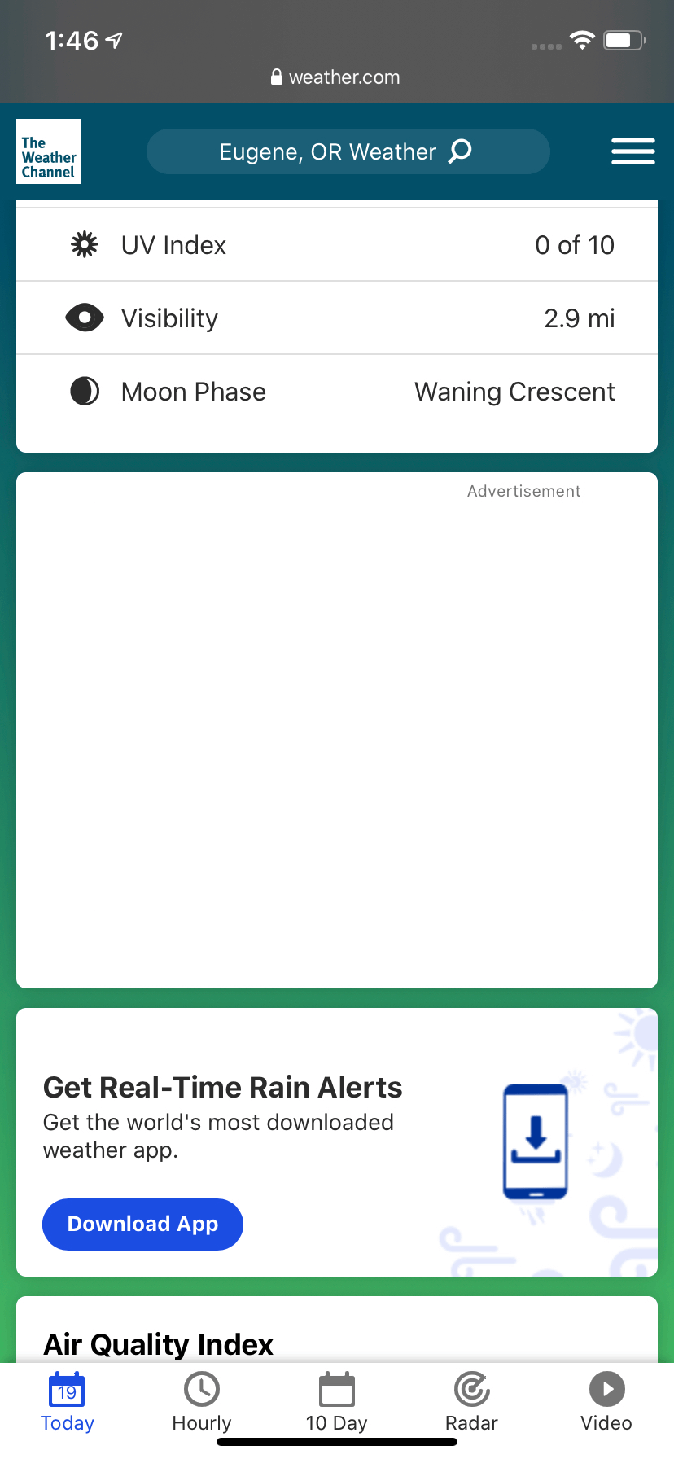
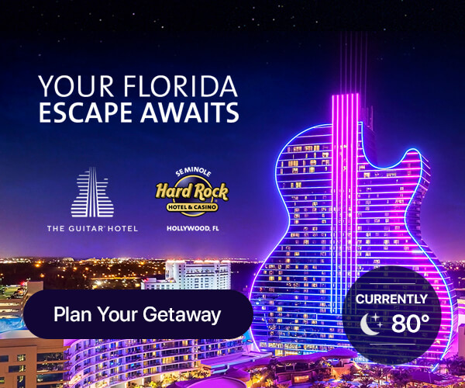
Adaptor Functionalities
Temperature Comparison
With temperature comparison logic, the temperature for our users’ location is compared to that of a separate location. Using this information, the visuals and messaging of the ad unit can compare or contrast the two.
For example, a warm-weather destination such as a resort can use the temperature comparison feature to find users experiencing cold weather and show them how much nicer the weather is at the resort, driving consideration of a getaway.
The Weather Company Weather Targeting ensures that the relationship between our user’s current temperature and that of the destination being advertised aligns with the campaign’s intent.
Available Placements
Mobile App
300x250
320x50
320x480 (Interstitial)
Mobile Web
300x250
320x50
Large Web
300x250
300x600
728x90
970x250

Slide 7
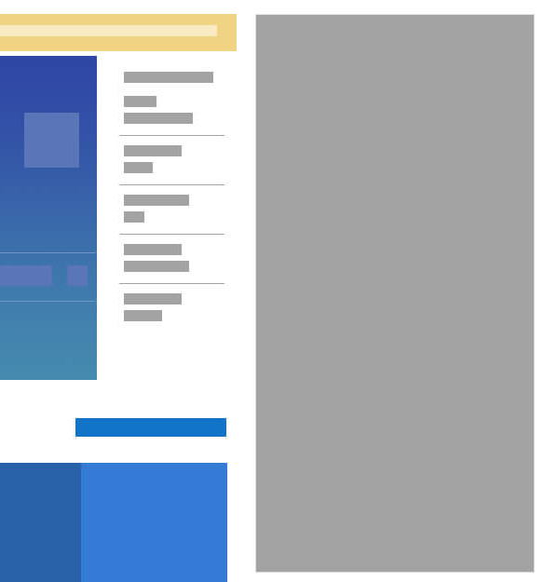
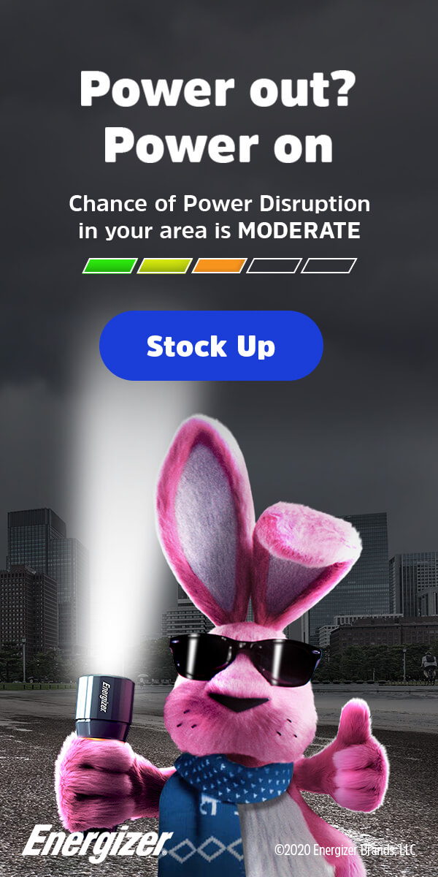
Adaptor Functionalities
Indices
Indices assign values to a wide range of weather-related conditions that are highly influential to consumer behavior. Advertisers can customize their creative imagery and/or messaging based on these values.
The Weather Company can assist in customizing indices to meet specific advertiser goals.
Some examples of adaptable indices include:
Aches and Pains Index: indicates the weather’s influence on an individual's potential to feel aches and pains.
Dry Skin Index: indicates the likelihood that a person will experience dry skin based on weather conditions.
Breathing Index: indicates weather’s influence on the ability to breath for respiratory-sensitive individuals including those who suffer from asthma.
Leisure Travel Index: provides indices of outdoor travel / sightseeing conditions.
Ski Index: provides an index for favorable skiing weather conditions.
Pollen Index: forecasts levels of Grass, Ragweed, and Tree pollen.
Frizz Index: scores the likelihood of experiencing frizzy hair.
Available Placements
Mobile App
300x250
320x50
320x480 (Interstitial)
Mobile Web
300x250
320x50
Large Web
300x250
300x600
728x90
970x250

Slide 8
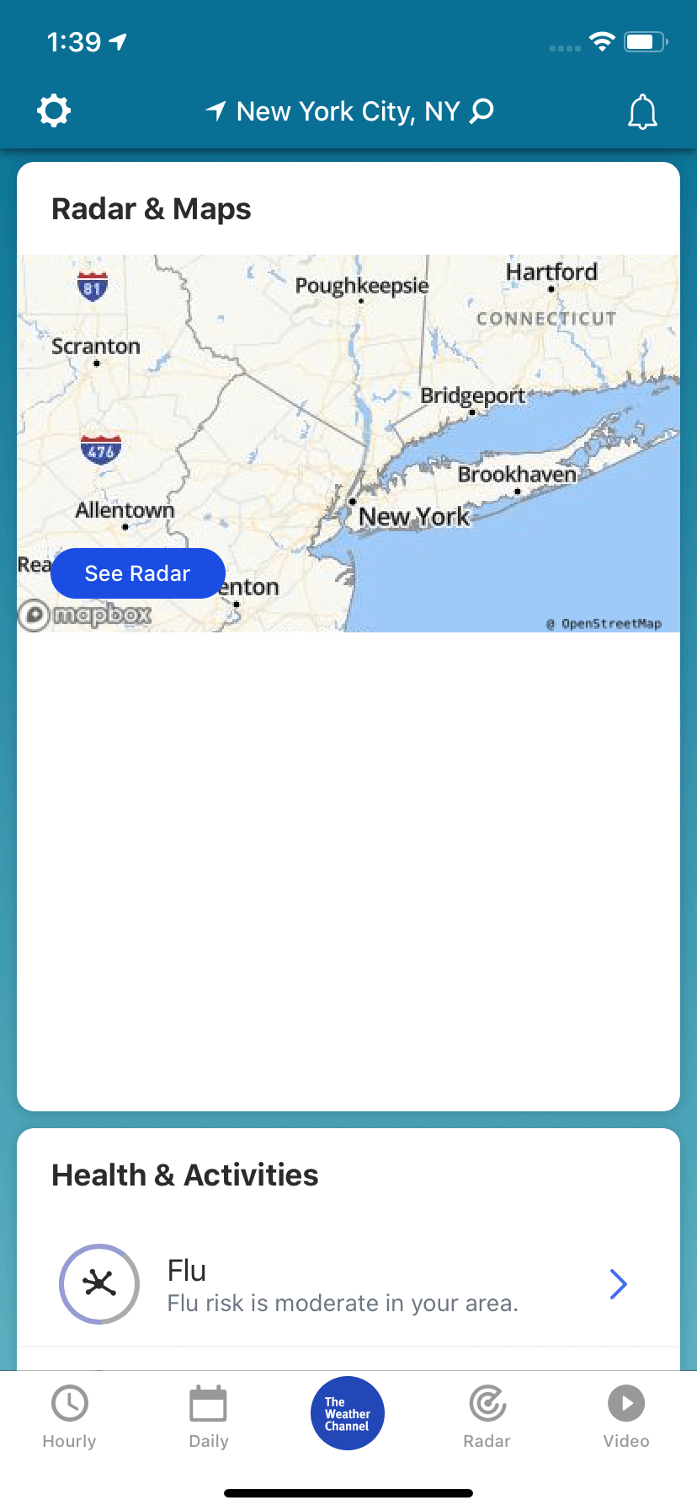
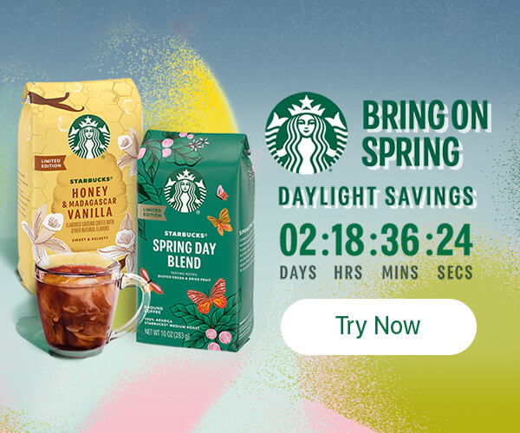
Adaptor Functionalities
Countdown
Countdowns allow advertisers to build anticipation ahead of any type of event. The countdown can display days, hours, minutes, and seconds — this format drives awareness and offers users greater incentive to click on the creative.
Some common use-cases for the Countdown include series or movie premieres, special events, holidays, the weekend, limited time offers, etc.
Available Placements
Mobile App
300x250
320x50
320x480 (Interstitial)
Mobile Web
300x250
320x50
Large Web
300x250
300x600
728x90
970x250

Slide 9
Additional Features
Adaptors are built using HTML5, which gives brands the ability to incorporate rich media features and functionalities into the ad space.
This can help draw users’ attention, encourage them to interact with brand content within the ad unit, and assist in meeting specific KPIs.
Spend Level: Tier 2

Slide 10
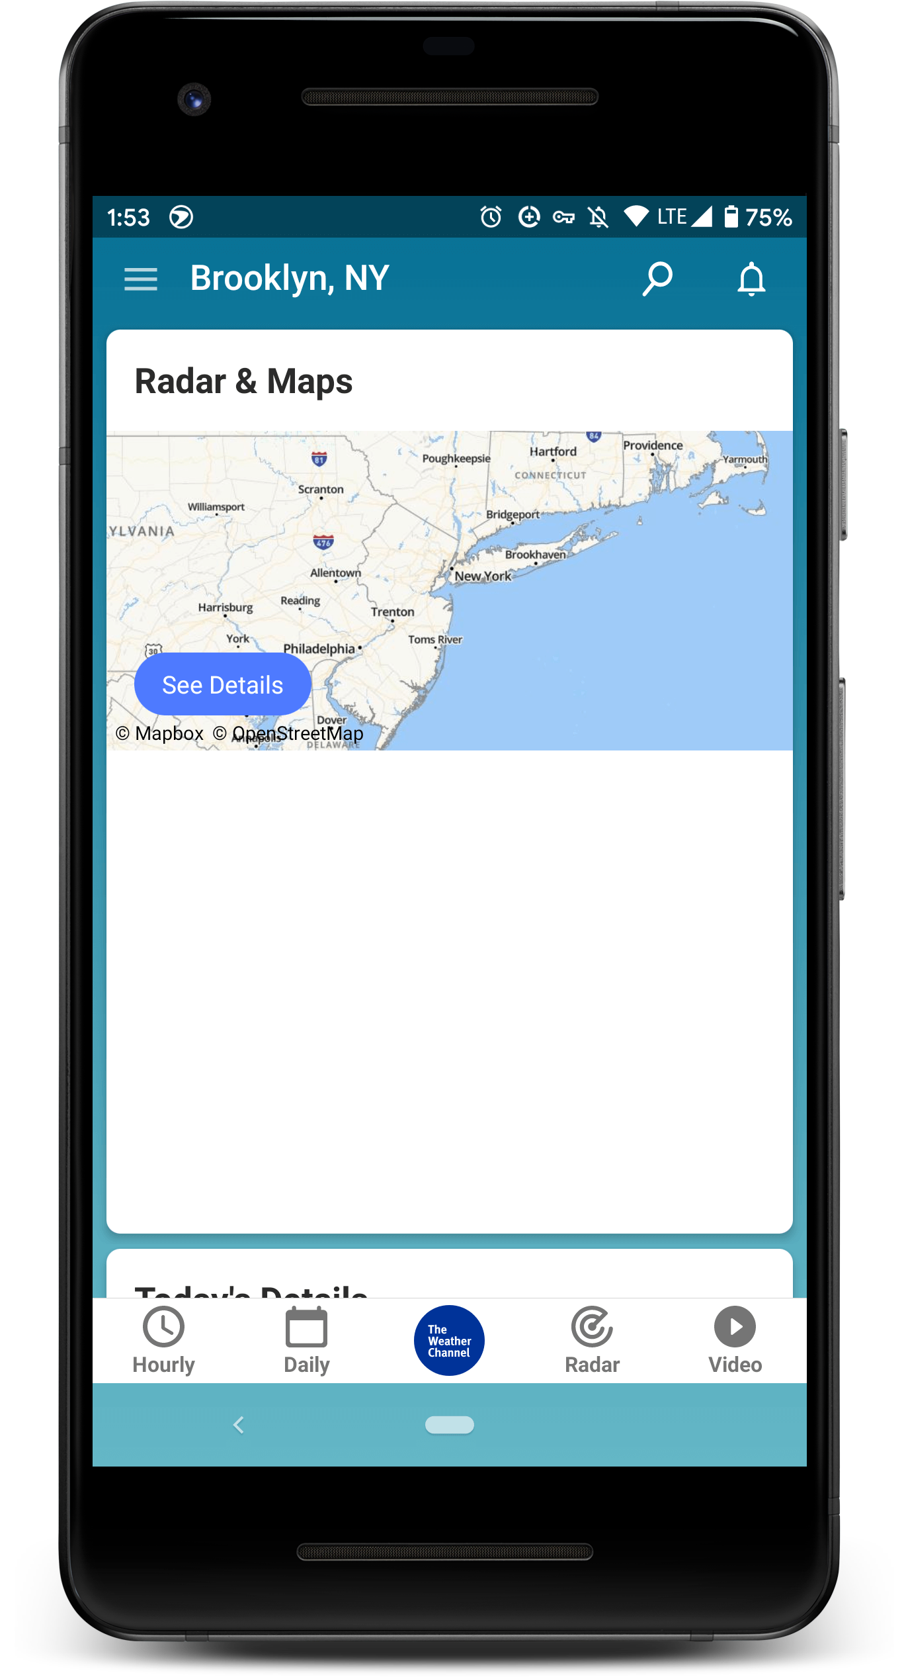
Additional Features
Swipe / Carousel
Swipe interfaces encourage casual user interaction by offering a way to explore additional content inside the ad unit without leaving the screen they are currently on.
Minimum 2, maximum 11 frames/items.
Individual frames can contain unique click-throughs, or the entire unit can click to a single consistent landing page.
Deep-linking is permitted if functionality exists within the brand's app and URI information is provided.
Available Placements
Mobile App
300x250
320x480 (Interstitial)
Mobile Web
300x250
Large Web
300x250
300x600
970x250
> Presentation Mode

Slide 11
Additional Features
Video Player
Featuring an embedded video player in the Integrated Marquee space is an excellent way to get video content in front of a massive audience.
Videos will auto-play on page load, with the sound disabled: user interaction unmutes the video. When the video ends, a poster image will be displayed along with the option to replay the video.
Video content must be approved and rights-owned, as needed, and must be hosted by The Weather Company.
Available Placements
Mobile App
300x250
320x480 (Interstitial)
Mobile Web
300x250
Large Web
300x250
300x600
970x250
> Presentation Mode

Slide 12
Additional Features
Video Gallery
Video galleries are ideal for advertisers with abundant video content and video interaction KPIs. Multiple videos are presented together, usually in a carousel format.
On load, the first video will start playing immediately with sound disabled. Users can toggle the sound and tap or swipe the carousel controls to access additional video content.
Each video can click through to a unique URL, or the entire unit can click to a single landing page.
Video content must be approved and rights-owned, as needed, and must be hosted by The Weather Company.
Available Placements
Mobile Web
300x250
Large Web
300x250
300x600
970x250
> Presentation Mode

Slide 13
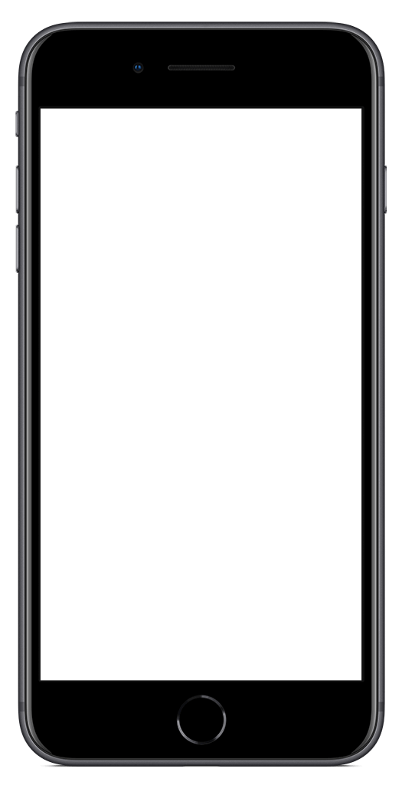
Additional Features
Expandable Rich Media
When a user taps on an ad with expandable rich media functionality, the creative expands out of the initial Integrated Marquee space into a full screen experience. This gives the advertiser the opportunity to tell a larger story with more content.
The expanded state can contain, but is not limited to, the following elements:
Additional brands or products with unique CTAs
Image carousels
Video content
Animation and interactivity
Available Placements
Mobile App
300x250
320x50
> Presentation Mode
> Presentation Mode

Slide 14
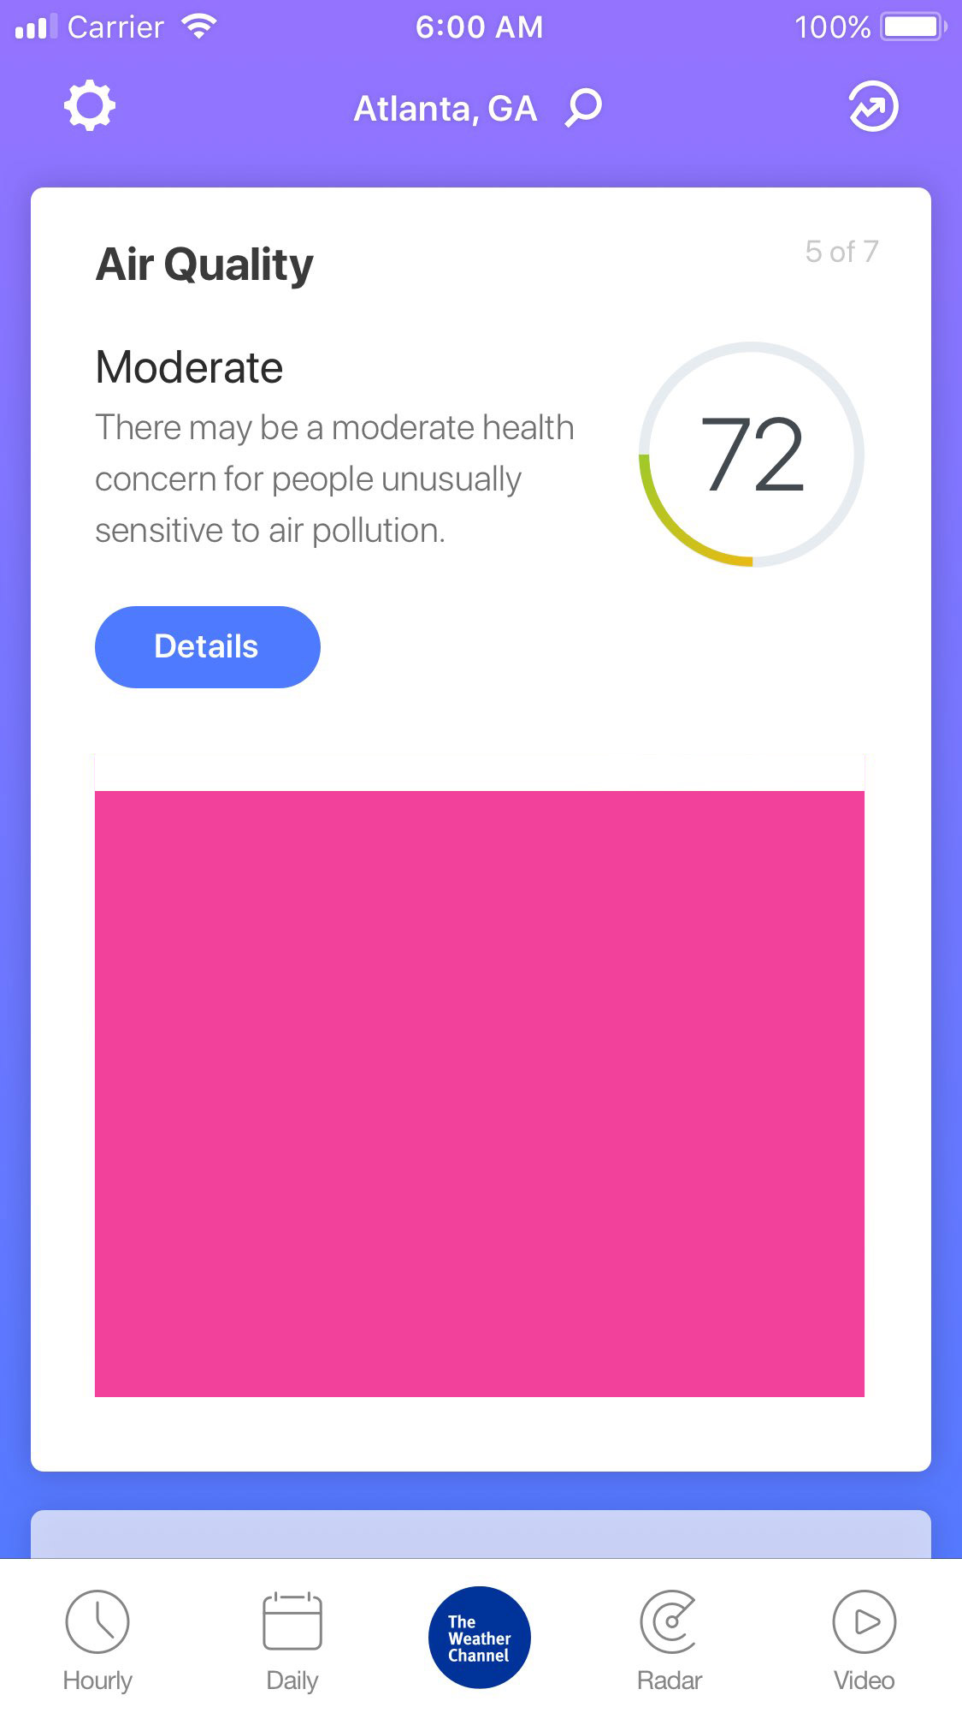
Additional Features
Vertical Video
The Integrated Marquee supports a tap-to-launch overlay containing vertical video, which plays in a portrait orientation rather than the typical landscape orientation. Recommended aspect ratio is 9:16.
Benefits of vertical video ads include:
Vertical video leverages up to 100% of the phone’s real estate in portrait orientation versus 25% with horizontal video.
The format integrates well with The Weather Channel App, where consumers are used to viewing content in portrait orientation.
Users aren’t likely to rotate their phones to landscape mode to view ad content. Vertical video optimizes content to our users’ natural (vertical) hand position.
Available Placements
Mobile App
300x250
320x50
> Presentation Mode

Slide 15
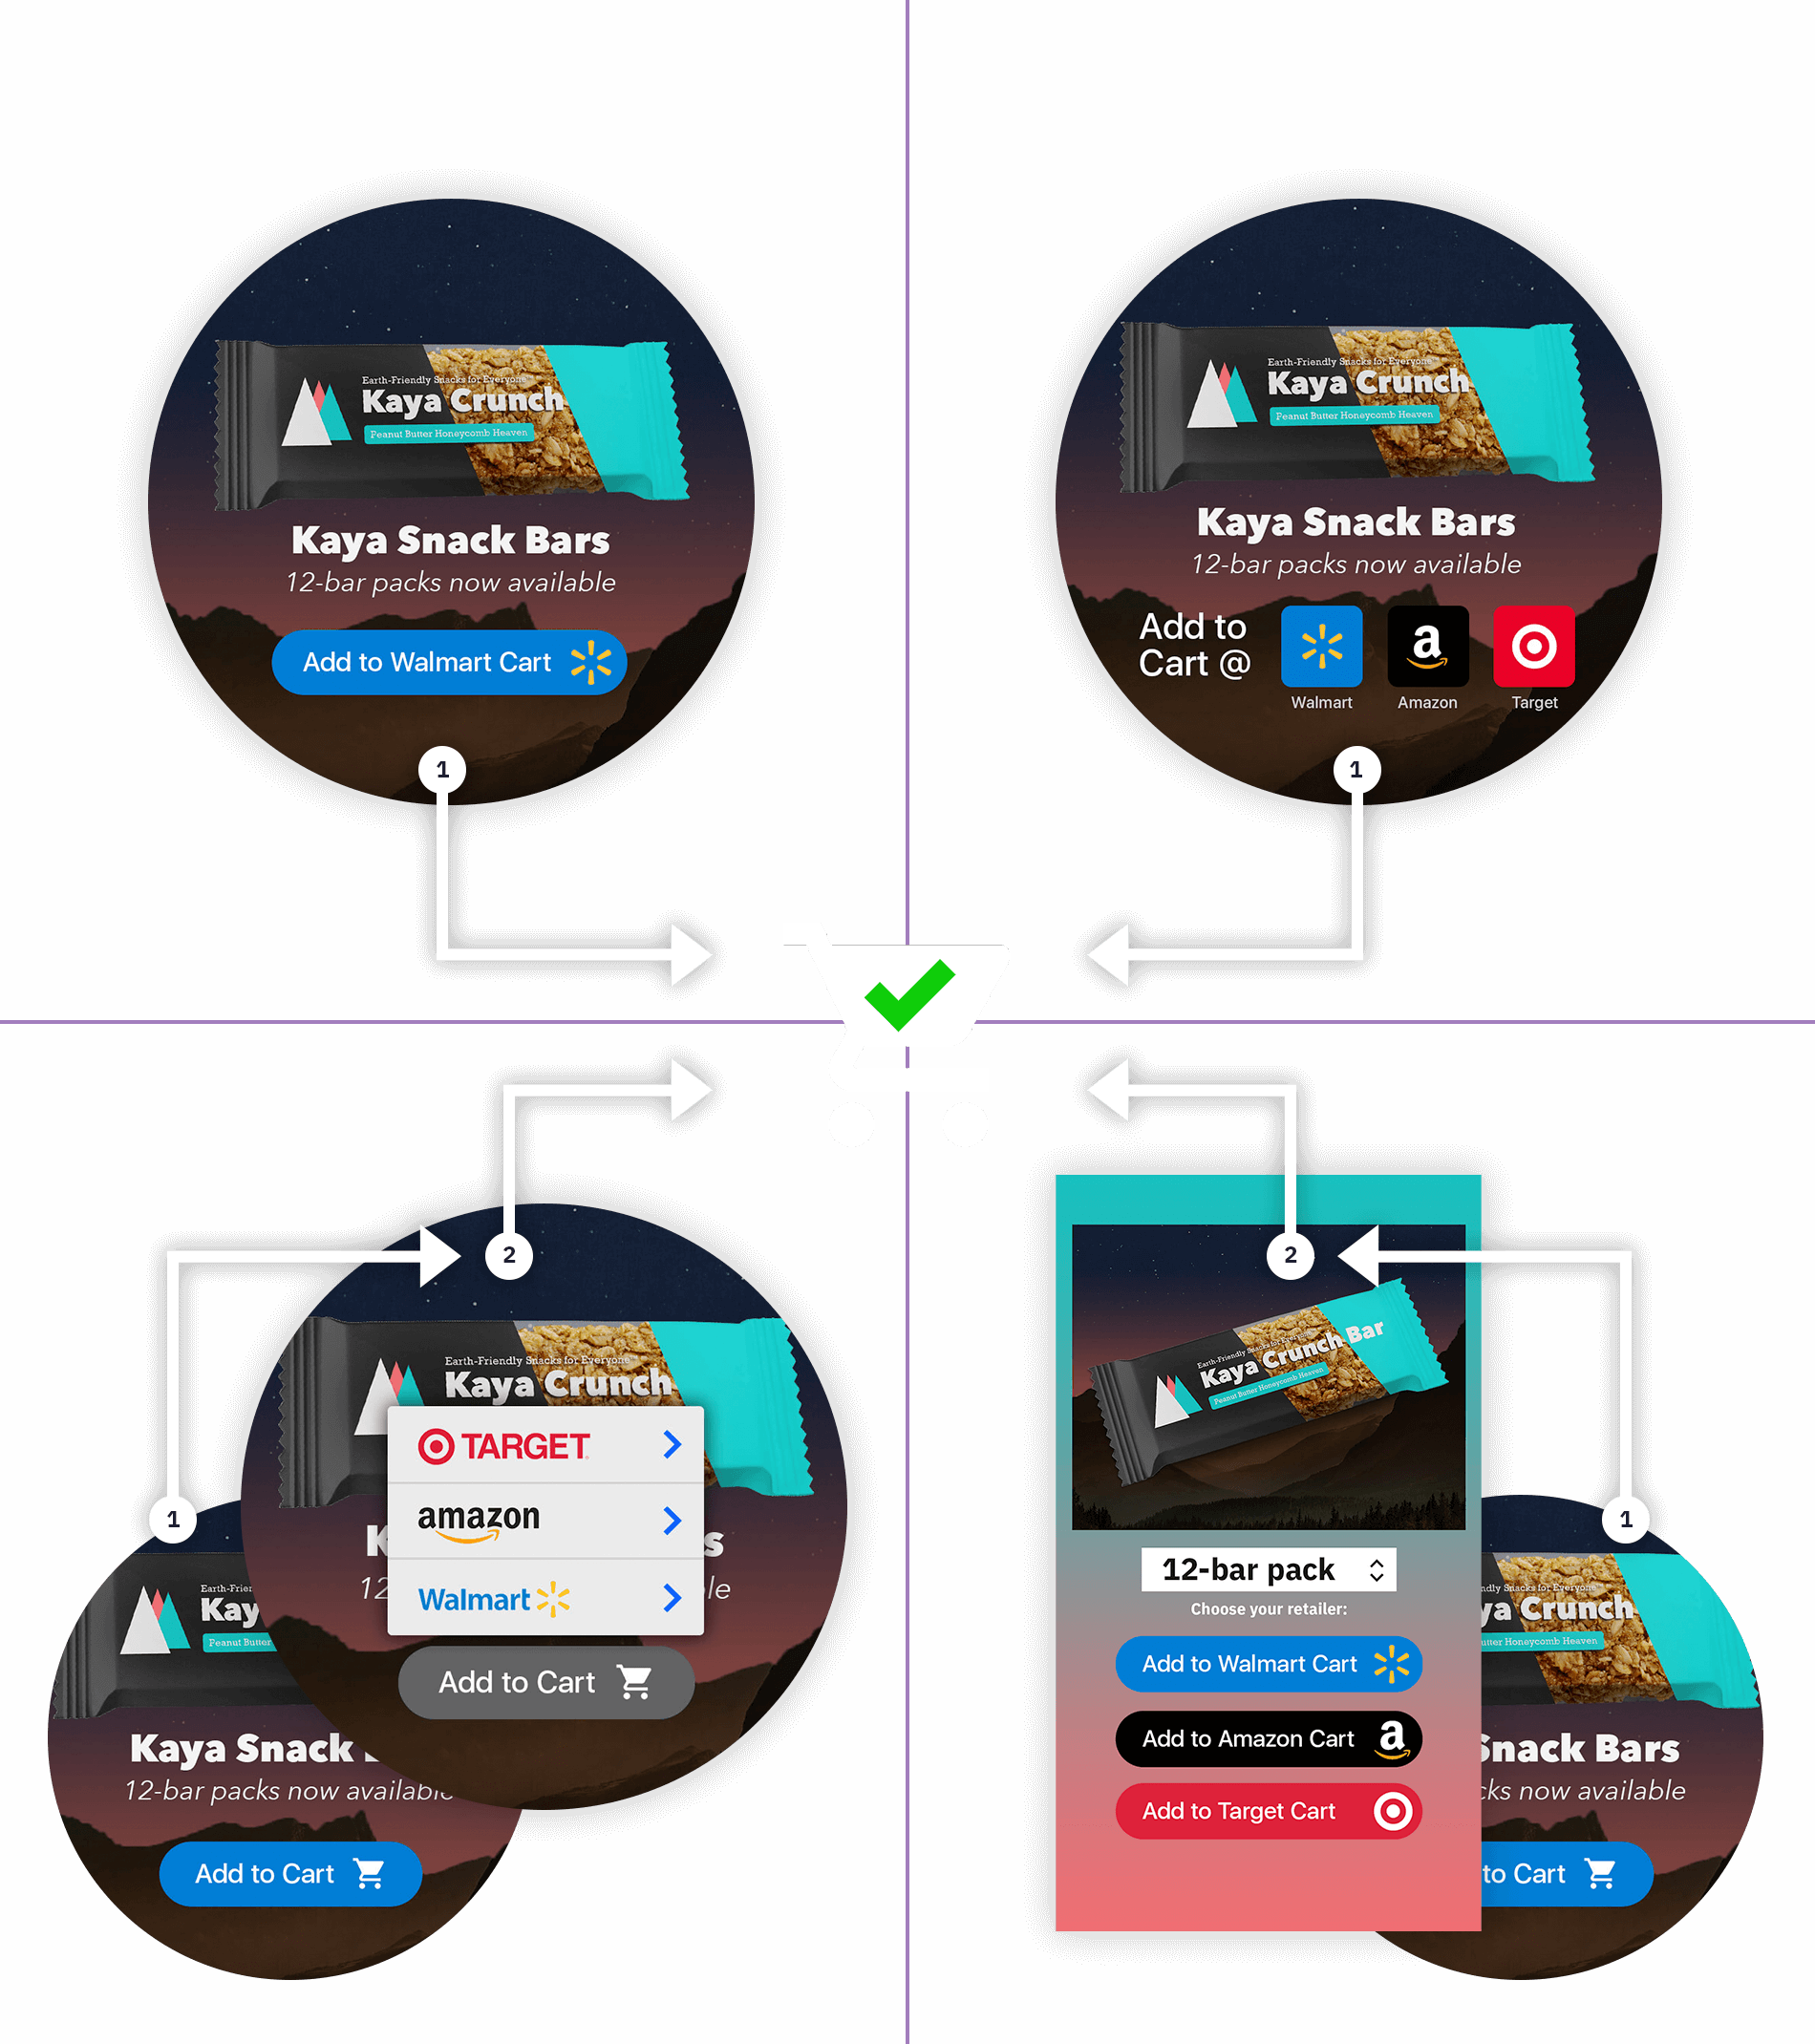
Click2Cart®
Additional Features
A) Single-Retailer Direct
1-click, ~90% CSR
B) Multi-Retailer Direct
1-click, ~90% CSR
Click2Cart is an e-commerce add-on for our premium ad product offerings that places products directly into retailer shopping carts.
There are several Click2Cart options, each with their own use-case:
A) Single-Retailer Direct 1-click, ~90% carting success rate One CTA drives directly to a retailer cart. The simplicity of this option tends to yield the highest overall performance.
B) Multi-Retailer Direct 1-click, ~90% carting success rate Multiple CTAs (3–5) are presented, each driving directly to a retailer cart. Requires dedicating a significant portion of the ad composition to the Click2Cart user interface.
C) Multi-Retailer Menu 2-click, 2–20% carting success rate Multiple retailer options (3–5) are revealed via a menu CTA. This interaction model requires less space in the initial ad composition but typically results in a lower carting rate than a 1-click direct model.
D) Multi-Retailer Window 2-click, 2–20% carting success rate Multiple retailer and/or product options are presented in an overlay screen (app) or new browser tab (web). This interaction model requires less space in the initial ad composition but typically results in a lower carting rate than a 1-click direct model.
Retailer and product information will be required prior to the production phase of the unit.
C) Multi-Retailer Menu
2-click, 2–20% CSR
D) Multi-Retailer Window
2-click, 2–20% CSR
Available Placements
Mobile App
300x250
320x50
320x480 (Interstitial)
Mobile Web
300x250
320x50
Large Web
300x250
300x600
728x90
970x250

Slide 16
Production Assets
Clients or agencies can simply provide their key campaign art and messaging — The Weather Company’s Creative Lab will then build out the creatives per our product specifications.
The overall creative vision for how the brand or product is presented in this space is the most critical thing for our team to understand before we get started on designs — we will do our best to make sure these goals are met while aligning to the requirements of the ad unit.
These units may also be designed the advertiser.* Development is handled by Creative Lab. Serving is executed by The Weather Company via direct or managed service with AppNexus.
* Interactive functionalities require Creative Lab support. Designs subject to The Weather Company approval. App and web design subject to change.
Creative must follow IAB guidelines and MRAID 2.0 specs.
Upon completion of a campaign, The Weather Company does not share the final creative design or final coded source files to be used for any other advertising purposes beyond our platform.
Standard Assets
Hi-resolution brand imagery: flat files or PSD(s)
Brand messaging
Any required copy such as legal disclaimers, trademarks, or copyrights
Fonts (zip file / licensing info)
Logos (PNG, EPS, SVG)
In-Unit Video Player
Initial File Load: 200kb
User-Initiated File Load: 2.2mb
Max Duration: 15 secs
Video Codec: h264
Vertical Video / Full-Screen
Orientation: Portrait (vertical)
Max File Size: 4MB
Max Duration: 30 secs
Video Codec: h264
Please ensure that all assets provided by Advertiser or Agency to Media Company are legally owned and/or legally licensed for digital usage in the U.S.

Slide 17
Timeline: Static Imagery / Video-Based Animation
Timeline begins after receipt of approved assets & creative direction.
3
1
3
3
TO 5
DAYS
OR MORE
DAYS
TO 5
DAYS
DAYS
STEP 1
Design
The Weather Company’s Creative Lab builds out all condition-based creative. Details >
STEP 2
Client Review & Approval
Timeline will be adjusted based on estimated days for client approval and/or feedback.
The Weather Company’s Creative Lab will provide a maximum of three (3) client reviews and design revisions and one (1) redesign per Creative Build prior to launch. Full policy >
STEP 3
Development & QA
Creative and tracking is handed off to dev team for coded build. Details >
Please note tracking is required for development to begin.
STEP 4
Launch
CID prep, final QA, trafficking, and launch.
Once an approved creative build has been trafficked, further edits and changes are no longer available.
Additional tracking preparation time is required for: Campaign Intelligence (+3 days), Click2Cart (+5 days). This work must be complete prior to development (Step 3).
Project timelines may be extended due to multiple products/builds, complex custom animations or interactivity, client feedback/approval times, multiple/complex trafficking placements.

Slide 18
Timeline: Interactive Features / CSS-Based Animation
Timeline begins after receipt of approved assets & creative direction.
3
1
5
1
3
TO 5
DAYS
OR MORE
DAYS
DAYS
OR MORE
DAYS
DAYS
STEP 1
Design
The Weather Company’s Creative Lab builds out all condition-based creative. Details >
STEP 2
Client Review & Approval
Timeline will be adjusted based on estimated days for client approval and/or feedback.
The Weather Company’s Creative Lab will provide a maximum of three (3) client reviews and design revisions and one (1) redesign per Creative Build prior to launch. Full policy >
STEP 3
Development & QA
Creative and tracking is handed off to dev team for coded build. Details >
Please note tracking is required for development to begin.
STEP 4
Client Review & Approval
A live test link will be provided to ensure coded functionality and/or animation is as expected.
Please note designs have been approved at this stage — feedback should be limited to interactivity and/or animation.
STEP 5
Launch
CID prep, final QA, trafficking and launch.
Once an approved creative build has been trafficked, further edits and changes are no longer available.
Additional tracking preparation time is required for: Campaign Intelligence (+3 days), Click2Cart (+5 days). This work must be complete prior to development (Step 3).
Project timelines may be extended due to multiple products/builds, complex custom animations or interactivity, client feedback/approval times, multiple/complex trafficking placements.

