Slide 1
The Weather Company Weather Targeting for DOOH
—
Specifications and Style Guide 2024.Q1.V1
Please use Presentation Mode to view animated examples.

Slide 2
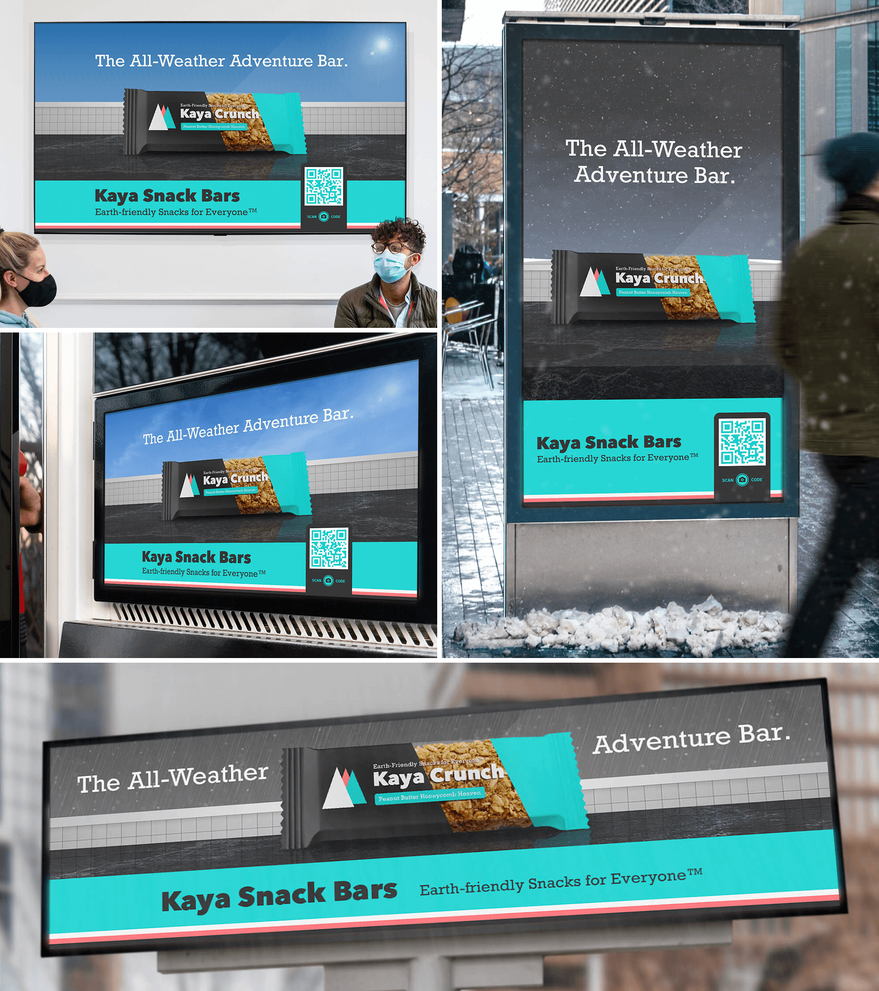
Overview
Digital Out-of-Home is any screen-based advertising that is found outside the home in a public environment.
Digital OOH has strengthened its presence in recent years to become one of the fastest growing channels in advertising.
Outdoor advertising has existed for centuries, and its key benefit remains the same: it’s a one-to-many medium that can reach a broad audience at once with impactful messaging.
Dynamic Creative for Digital OOH enables The Weather Company’s Creative Lab and Weather Targeting platform to bring data-driven, contextually-relevant creative to this space.

Slide 3
Digital Out-of-Home Functionalities
Digital OOH can incorporate a variety of weather-data-driven functionalities that create unique, contextually-relevant brand experiences for users via TWC Weather Targeting.
Spend Level: Tier 1
3

Slide 4
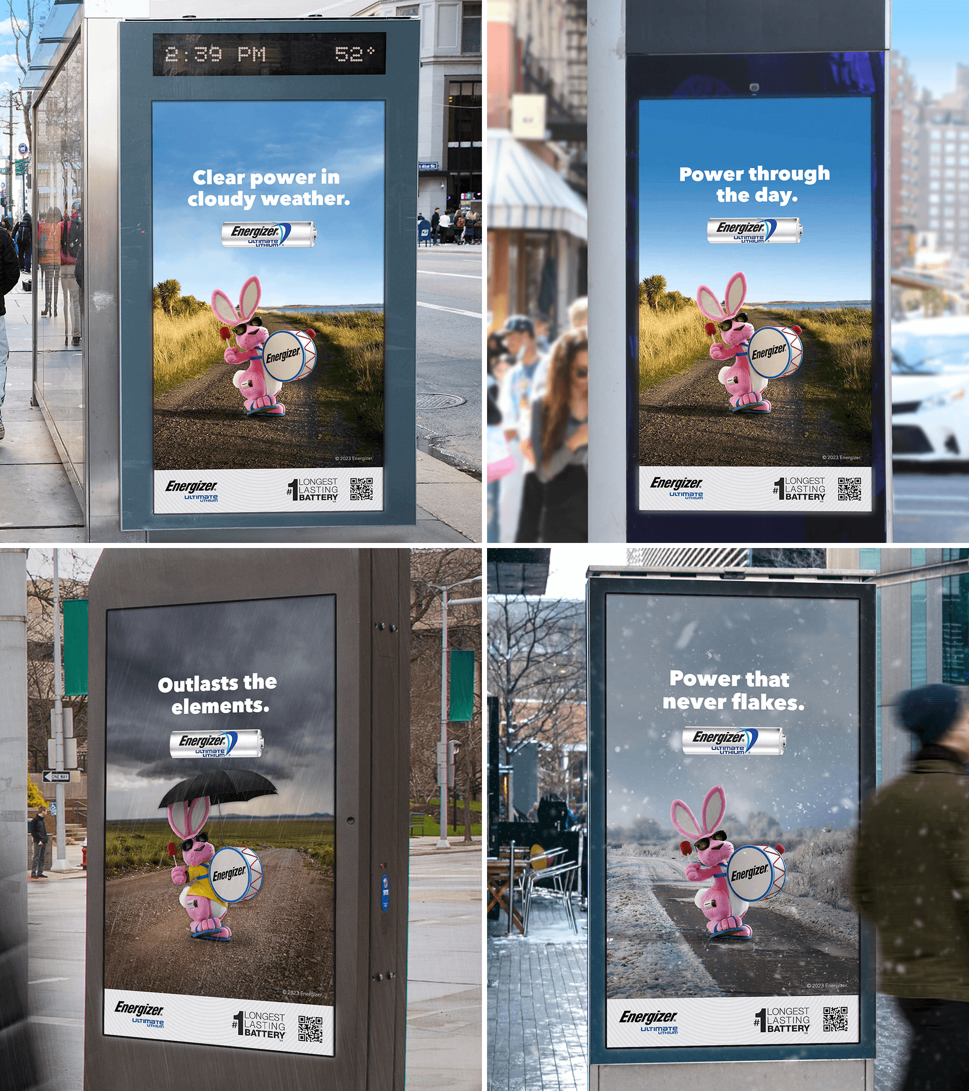
Weather Conditions
DOOH Functionalities
Custom ad creative is served to areas experiencing select current or forecast weather conditions via IWA Weather Targeting.
The ad creative can align to current or forecast clear, cloudy, rainy, and wintry weather, creating a strong contextual relevance for its audience.
Each time the unit loads, the version that matches the user’s current or forecast weather conditions will display.

Slide 5
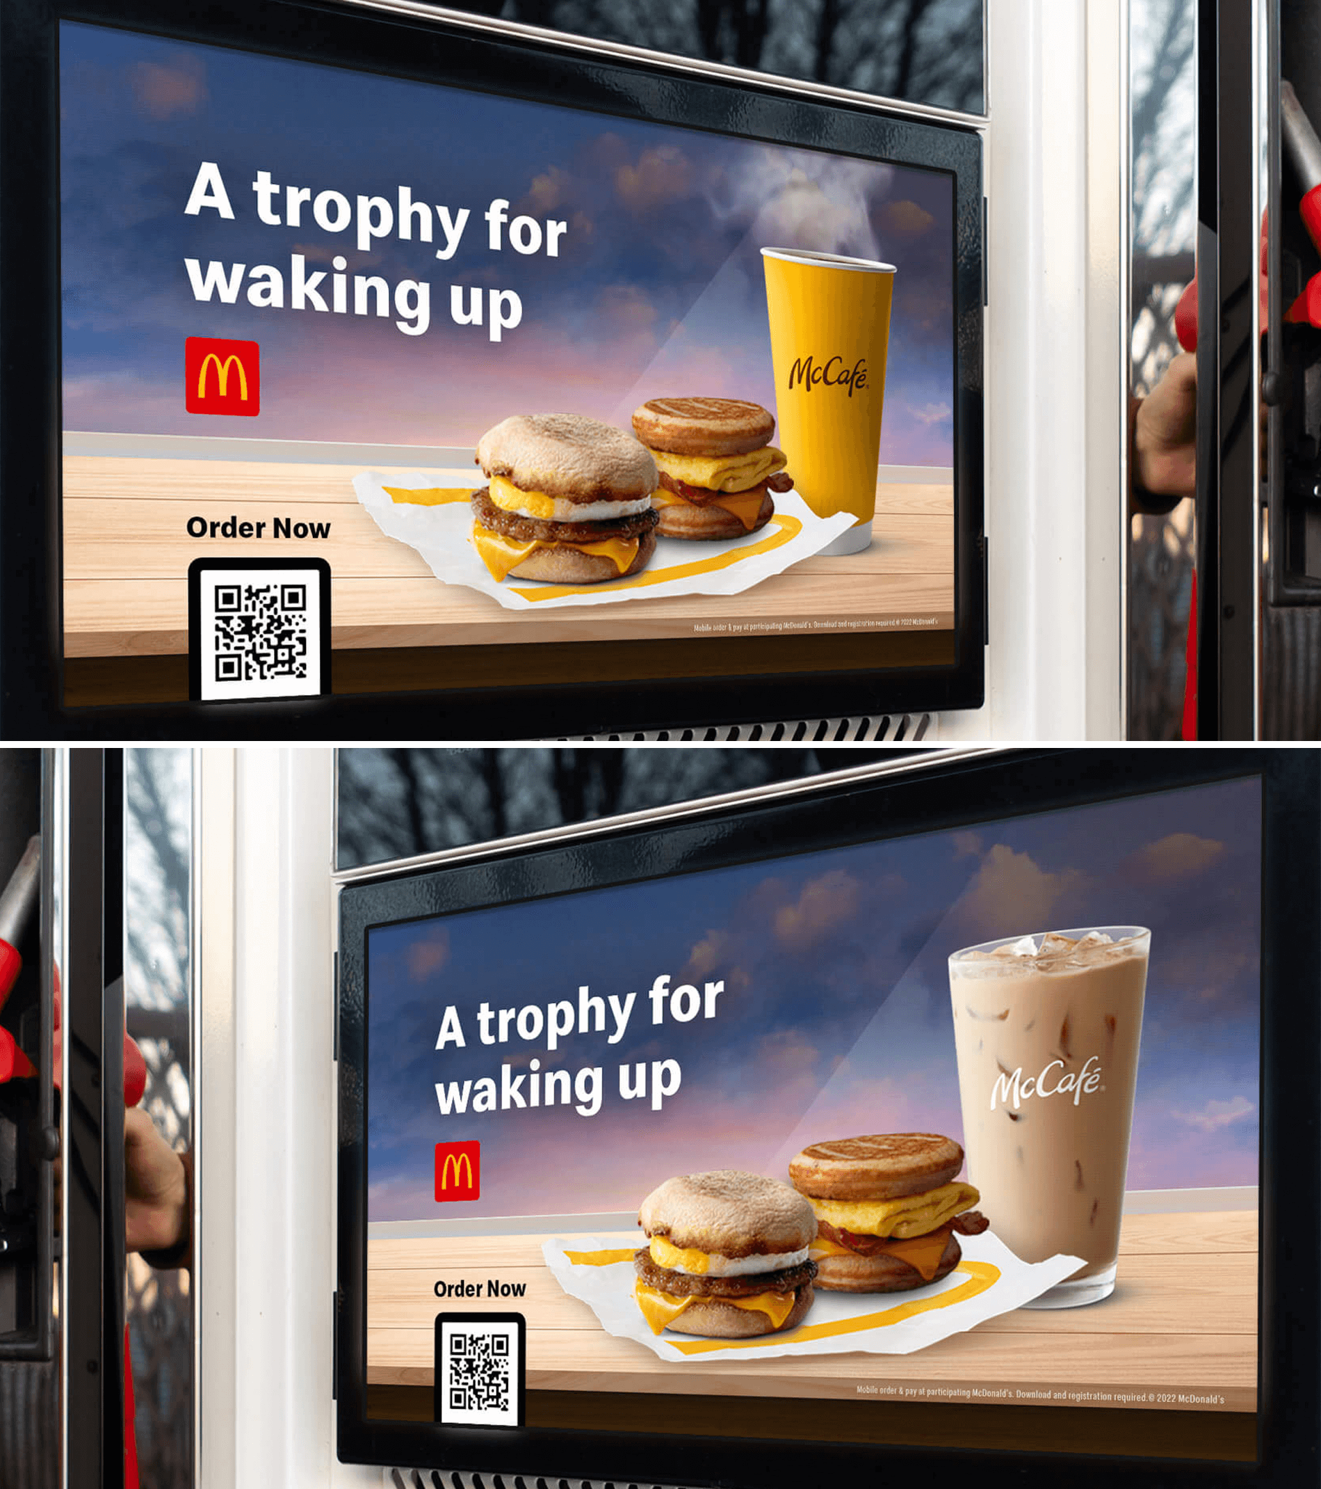
DOOH Functionalities
Relative Temperature
Relative Temperature allows advertisers to display different visuals and/or messaging in different relative temperatures.
For example, a QSR advertiser could feature a cold beverage on a hot day and a hot beverage on a cold day.
Temperatures that feel hot or cold to someone living in Miami are not the same as temperatures that feel hot or cold to someone living in Minneapolis. The Relative Temperature functionality ensures the appropriate version of the creative is served based on regional perceptions of hot or cold conditions.

Slide 6
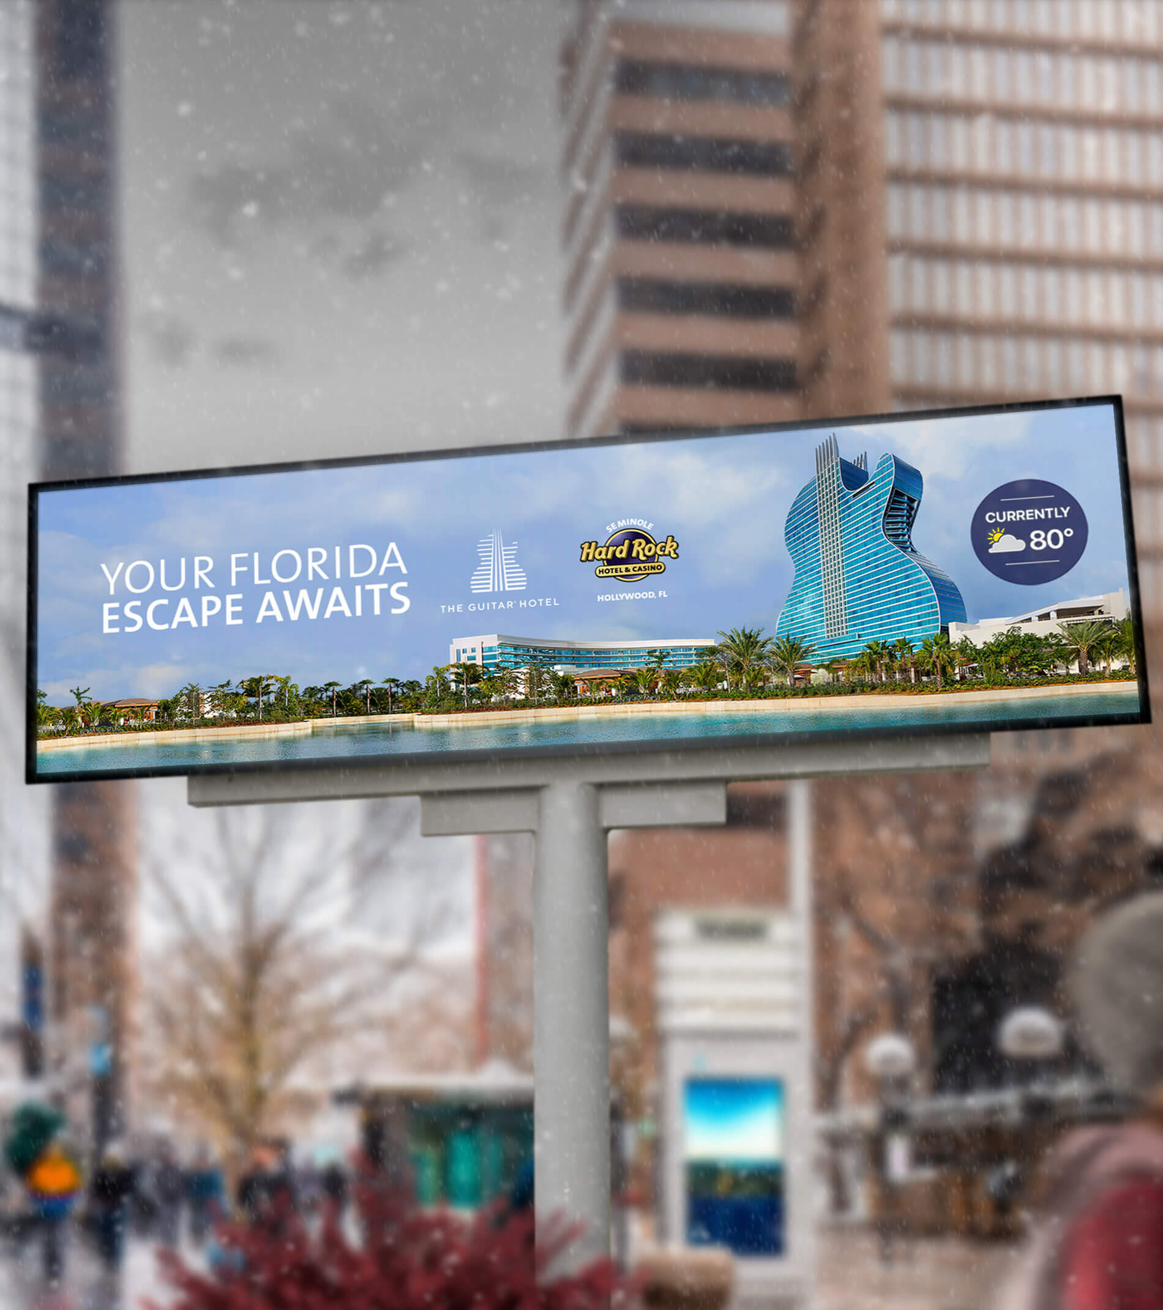
DOOH Functionalities
Temperature Comparison
With Temperature Comparison logic, the temperature for our users’ location is compared to that of a separate location. Using this information, the visuals and messaging of the ad unit can compare or contrast the two.
For example, a warm-weather destination such as a resort can use the temperature comparison feature to find users experiencing cold weather and show them how much nicer the weather is at the resort, driving consideration of a getaway.

Slide 7
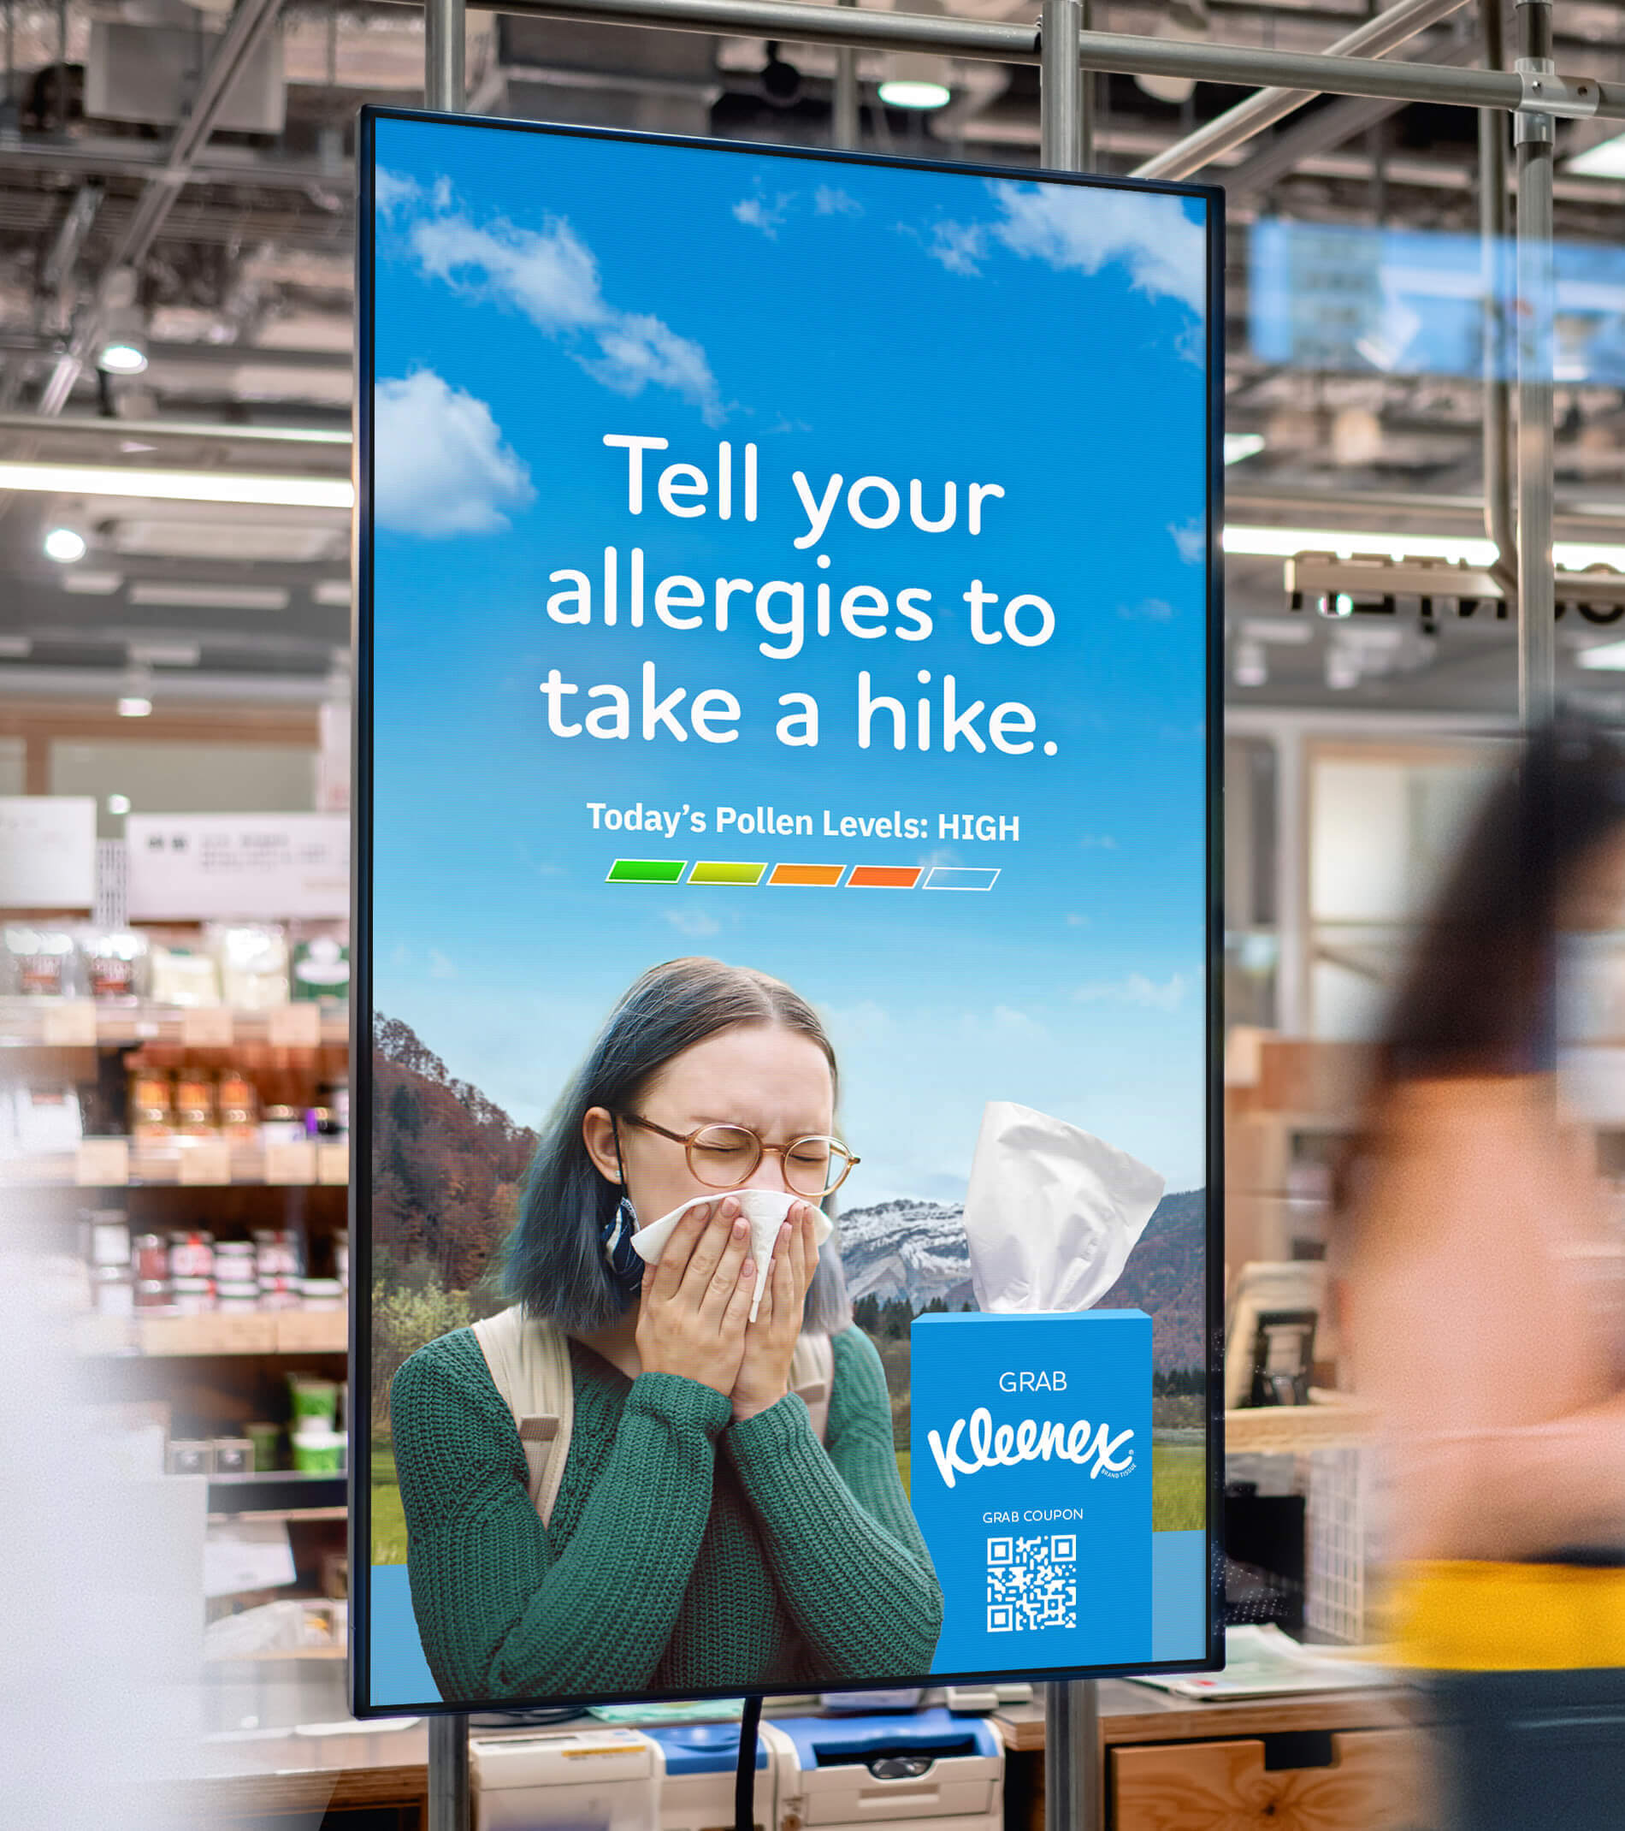
DOOH Functionalities
Indices
Indices assign values to a wide range of weather-related conditions that are highly influential to consumer behavior. Advertisers can customize their DOOH imagery and/or messaging based on these values.
Some examples of indices include:
Aches and Pains Index: indicates the weather’s influence on an individual's potential to feel aches and pains.
Breathing Index: indicates weather’s influence on the ability to breath for respiratory-sensitive individuals including those who suffer from asthma.
Leisure Travel Index: provides indices of outdoor travel / sightseeing conditions.
Static Electricity Index: indicates the potential for static electricity based on weather conditions.
Ski Index: provides an index for favorable skiing weather conditions.
Frost Potential Index: indicates the likelihood of Frost being present.
Dry Skin Index: indicates the likelihood that a person will experience dry skin based on weather conditions.
Pollen Index: forecasts levels of Grass, Ragweed, and Tree pollen.
Frizz Index: scores the likelihood of experiencing frizzy hair.

Slide 8
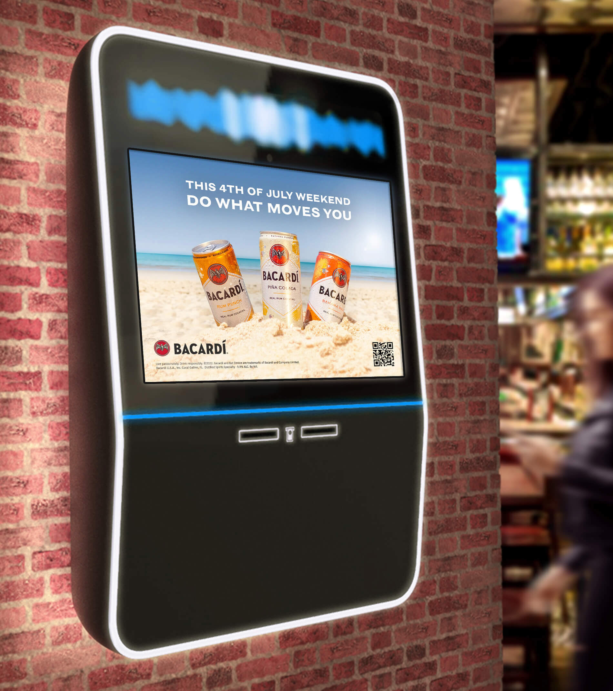
DOOH Functionalities
Timed Messaging
Advertisers can used Timed Messaging to build anticipation ahead of any type of event. Visuals and/or messaging can be adjusted as the event date draws nearer, keeping the brand top of mind for consumers.
Some common use-cases include series or movie premieres, special events, holidays, the weekend, limited time offers, etc.

Slide 9
Additional Features
By default, Digital OOH creative uses static imagery. Adding animation brings the creative to life, helping capture users' attention and increase brand awareness.
Spend Level: Tier 2

Slide 10
Animation
Additional Features
DOOH animations are video-based and run for 15 seconds. Products, scenery, and brand elements such as logos and headlines can all be brought to life with animation.
Generally, cinemagraph-style animations are used to create effects such as falling rain, drifting clouds, etc. Additional animated elements depend on available assets and will be defined in partnership with brands and/or agencies.
> Presentation Mode

Slide 11
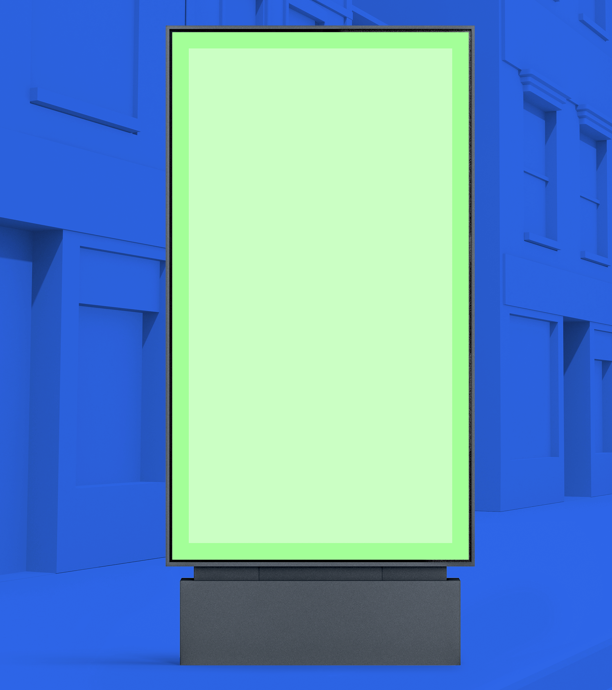
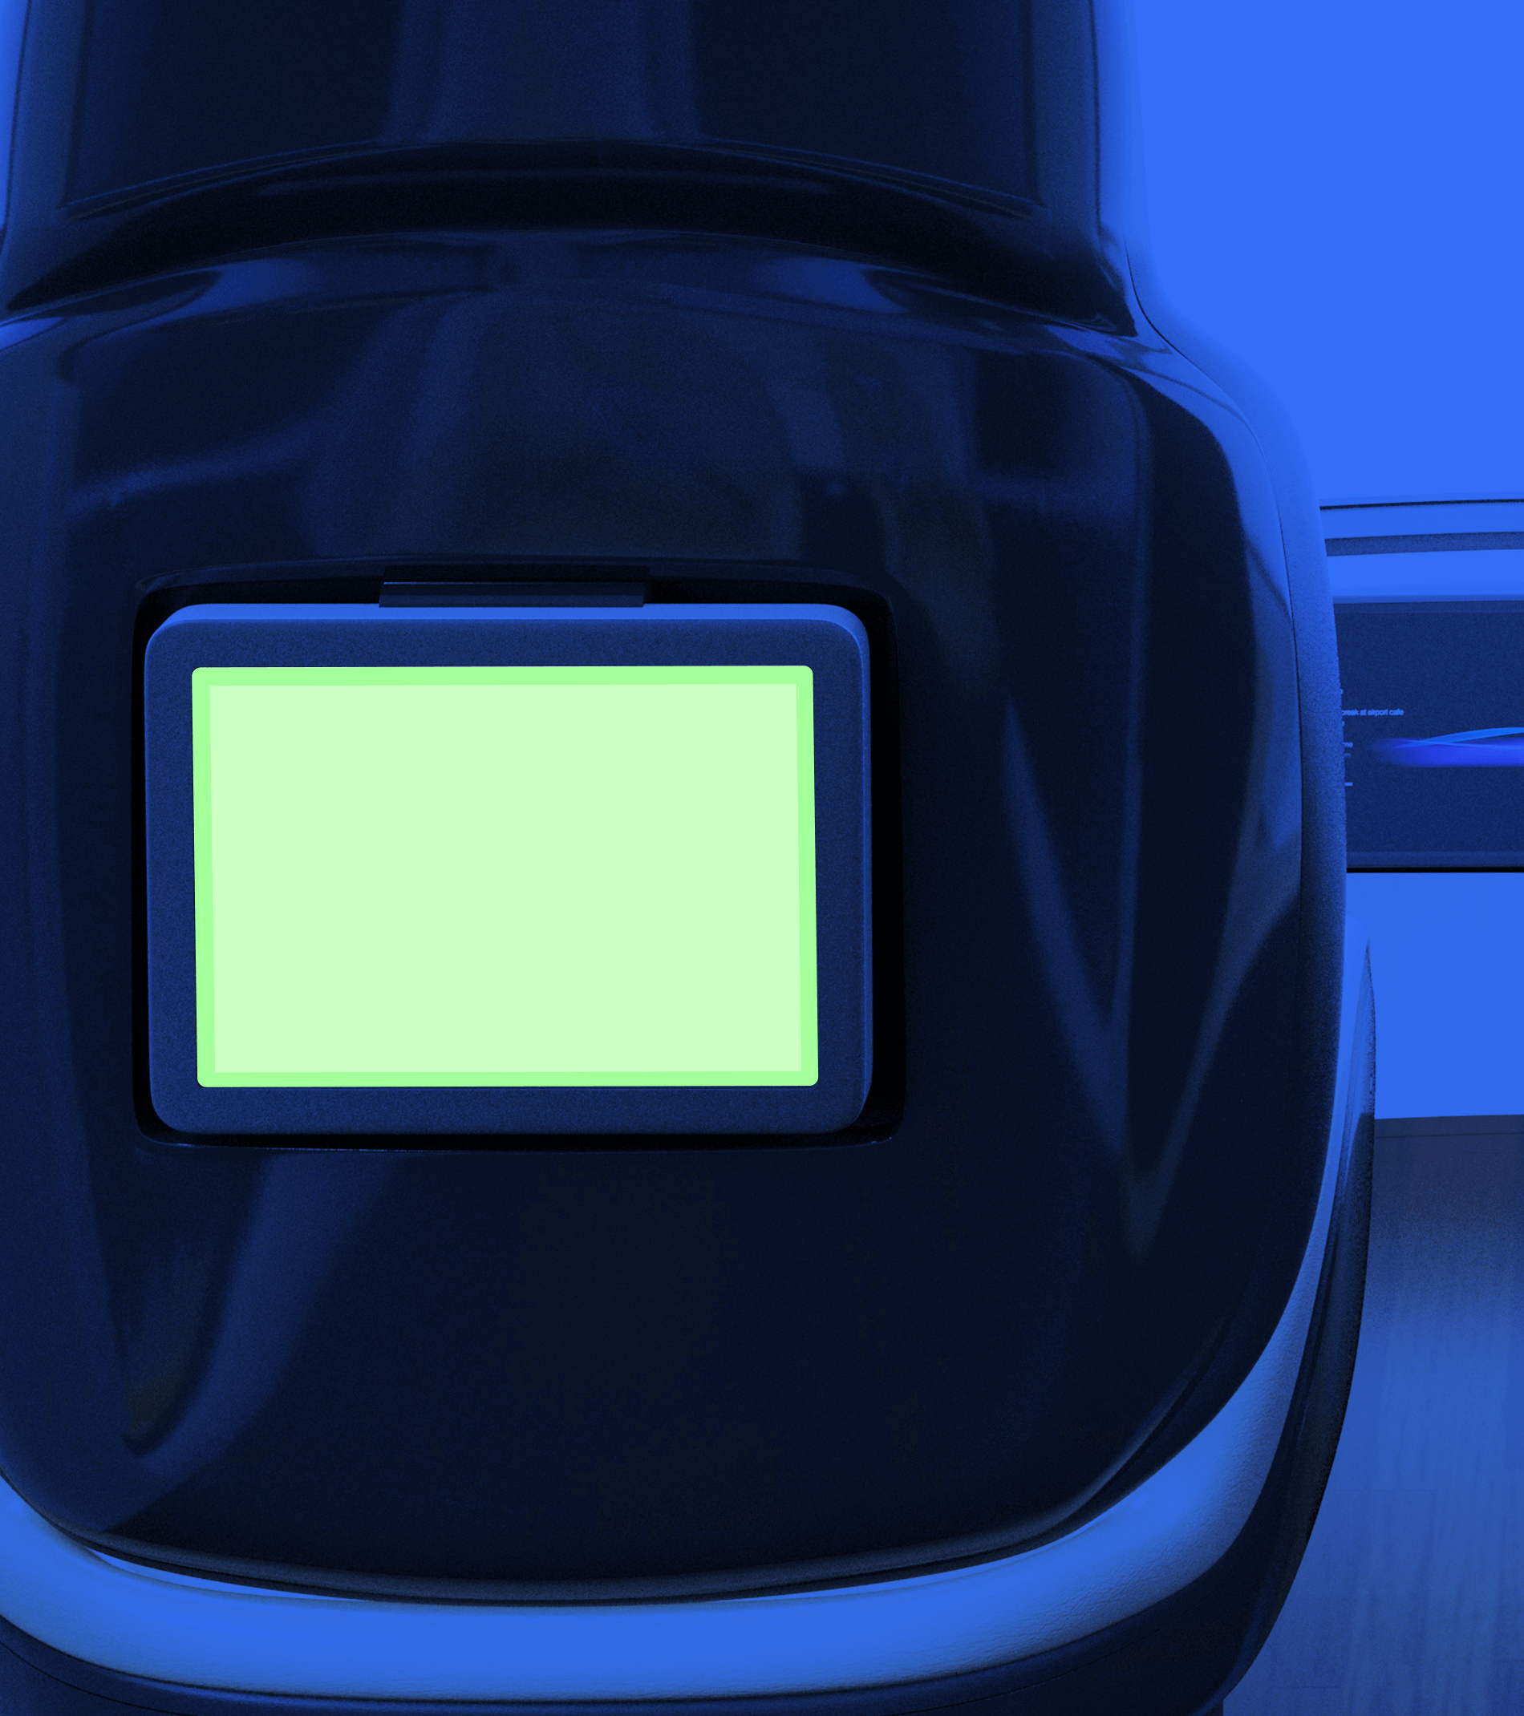
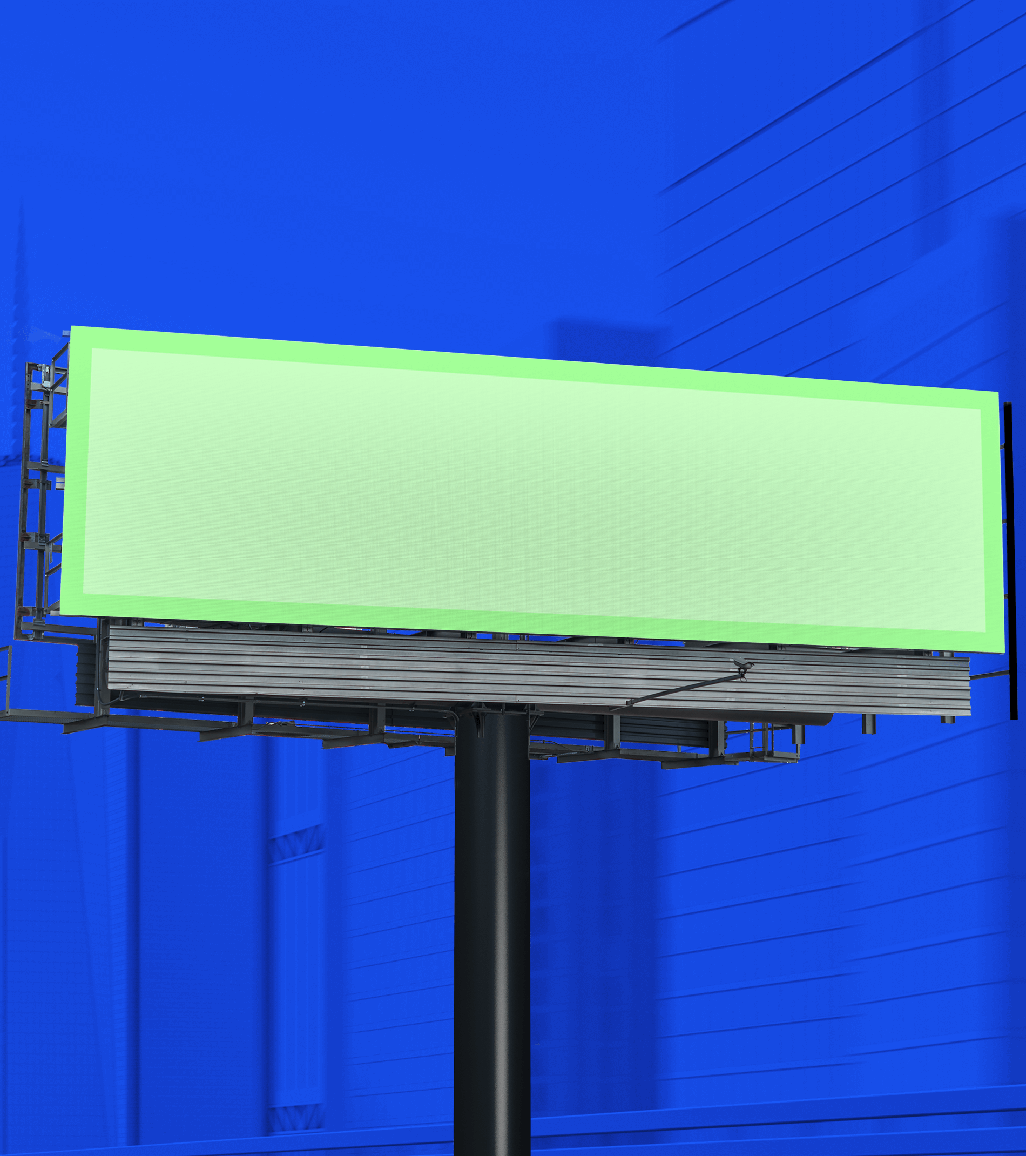
Specifications
Digital Out-of-Home screens come in many shapes and sizes.
To ensure ad creative displays across an optimal range of screen types, Vistar provides automated creative transcoding based on 4 key sizes:
16:9 (1920x1080)
9:16 (1080x1920)
4:3 (1280x960)
7:2 (1400x400) note: this size does not support animation or QR codes.

Slide 12
Production Assets
Clients or agencies can simply provide their key campaign art and messaging — The Weather Company’s Creative Lab will then build out the creatives per our product specifications.
The overall creative vision for how the brand or product is presented in this space is the most critical thing for our team to understand before we get started on designs — we will do our best to make sure these goals are met while aligning to the requirements of the ad unit.
Standard Assets
Hi-resolution brand imagery: flat files or PSD(s)
Brand messaging
Any required copy such as legal disclaimers, trademarks, or copyrights
Fonts (zip file / licensing info)
Logos (PNG, EPS, SVG)
Landing page URL / QR code (optional)
Please ensure that all assets provided by Advertiser or Agency to Media Company are legally owned and/or legally licensed for digital usage in the U.S.

Slide 13
Timeline: DOOH
Timeline begins after receipt of approved assets & creative direction.
2
1
3
TO 6
DAYS
OR MORE
DAYS
DAYS
STEP 1
Design
The Weather Company’s Creative Lab builds out all creative variations, inclusive of weather-based functionality.
STEP 2
Client Review & Approval
Timeline will be adjusted based on estimated days for client approval and/or feedback.
The Weather Company’s Creative Lab will provide a maximum of three (3) client reviews and design revisions and one (1) redesign per Creative Build prior to launch. Full policy >
STEP 3
Launch
Final QA, trafficking and launch.
Once an approved creative build has been trafficked, further edits and changes are no longer available.
Additional tracking preparation time is required for Click2Cart (+5 days).
Project timelines may be extended due to multiple products/builds, complex custom animations, client feedback/approval times, multiple/complex trafficking placements.

